Slide 1
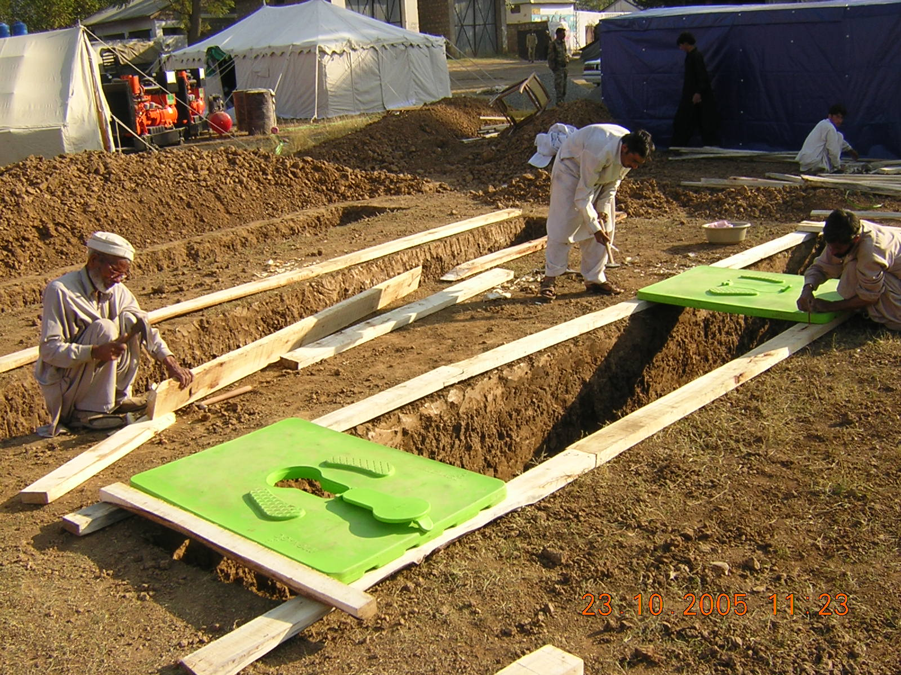
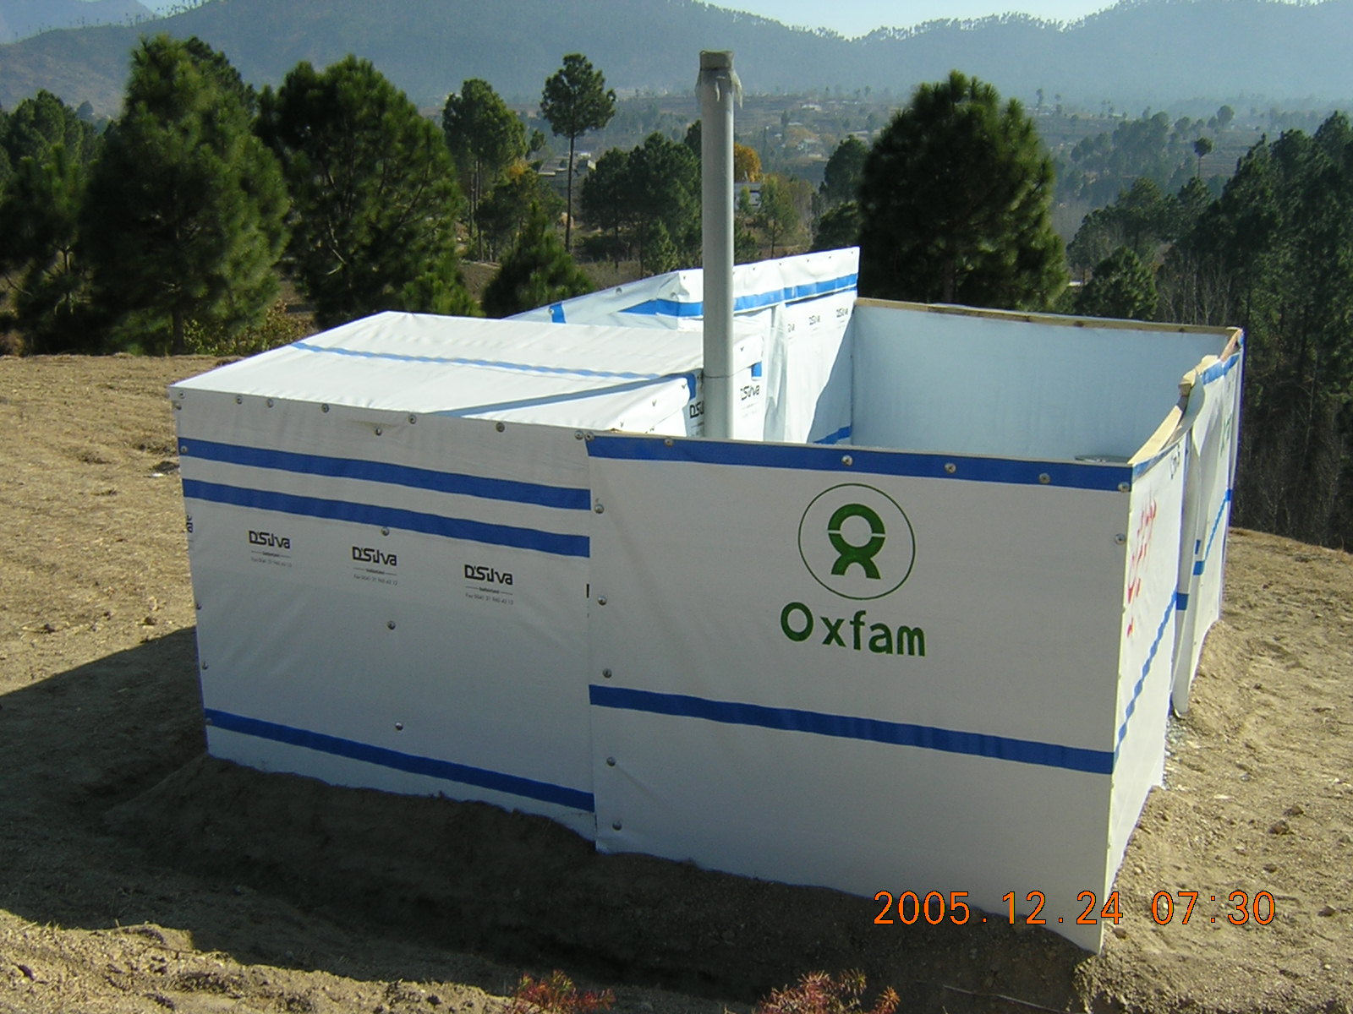
EXCRETA DISPOSAL in EMERGENCIES
A service, not just an infrastructure

Slide 2

Foreword
This manual aims to help you find your way around excreta disposal systems wherever your curiosity leads you. Next you will find the main page where you can click on any topic to go directly to the sections and sub-sections that interest you. In each section a menu on the left side lists links to the manual’s chapters. For any subchapter that contains more than one page you will find navigation arrows on the top right side of the page.
At the bottom of each page, you will find the references used and if it is available on the web a hyperlink has been added for you to reach and consult the original document. You are encouraged to click on the reference titles to open the hyperlinks and look at the documents to find further information.
Enjoy your reading
Authors: Andy Bastable & Laurence Hamai
with inputs from Raissa Azzalini, Zulfiquar Ali Haider, Frederick Komakech and other Oxfam colleagues’ resources whose products can be found in https://www.oxfamwash.org/en

Slide 3
Main page
Annexes
Adaptation for easier access
Operation & maintenance
Consultation
Latrine superstructure
Continuity of service
Excreta disposal system
Monitoring
Assessment
Slab
Final disposal
Modalities of implementation
Storage / pre-treatment pit
Treatment
Desludging

Slide 4
Main page
Excreta disposal system
Process to select the most appropriate technologies
Technology choices
Step 1
Conduct rapid needs assessment (including users’ consultation) and mapping of the settlement area. 7 key important social and physical factors in deciding which technology /design to use
Decision tree
Design spec
Latrine choices
Transport choices
Step 2
Apply decision tree for sanitation design including materials available and how the latrine will be desludged to identify the most appropriate sustainable design latrine
Treatment choices
Assessment
Consultation
Step 3
Rapidly construct latrines then get feedback on their use and modify accordingly (Sani Tweaks approach)
Monitoring
Modalities of implementation
Step 4
Design and implement a system for keeping the latrines clean and in good repair
Adaptation for easier access
Step 5
Design the desludging modality and whether a centralized or decentralized faecal sludge treatment plant is necessary
Latrine superstructure
Slab
Step 6
Consult with local authorities and utilities to determine the most appropriate treatment options and end-product market, design parameters (e.g., site location, skillset, operation and maintenance requirement)
Storage / pre-treatment pit
Desludging
Step 7
Determine implementation modalities for the treatment facility (by contractor or not; with or without local authorities /utility) and implement the agreed treatment design
Treatment
Final disposal
Continuity of service
Step 8
Implement a monitoring and tracking feedback from the users – Continue consultation. Improve the quality based on the feedbacks and meet users’ expectations
Operation & maintenance
Annexes

Slide 5

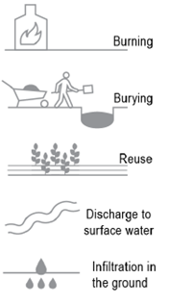


Main page
Technology choices
Page 1/2
Excreta disposal system
A complete excreta disposal system doesn’t stop at the latrine, whether communal in a camp or familial in household compound. It also includes a desludging / transportation service and an off-site treatment and final disposal site. Various technical options are available for each component of the sanitation service chain. The next page shows a table of suitable options according to the emergency phase.
Technology choices
Decision tree
Design spec
Latrine choices
If you don’t consider the other components of the excreta disposal system when you design your latrine then your sanitation service stops once the latrine pit is full.
Household
Transport
Transport choices
Treatment choices
Manual / mechanical desludging & transport or sewers
If you don’t consult users and service’s stakeholders, you compromise the long-term sustainability of the system.
Assessment
User interface
Collection / Storage
Consultation
Monitoring
Modalities of implementation
Adaptation for easier access
Latrine superstructure
Slab
Treatment
Storage / pre-treatment pit
Desludging
Treatment
Use / Disposal
Final disposal
Continuity of service
Operation & maintenance
Annexes
Reference: Compendium of Sanitation Technologies in Emergencies and GWC – FSM TWIG – Terminology Factsheet

Slide 6
Main page
Page 2/2
Excreta disposal system
Technology choices
Decision tree
Design spec
Latrine choices
Transport choices
Treatment choices
Assessment
Consultation
Monitoring
Modalities of implementation
Adaptation for easier access
Latrine superstructure
Slab
Storage / pre-treatment pit
Desludging
Treatment
Final disposal
Continuity of service
Operation & maintenance
Annexes
Reference “Compendium of sanitation technologies in Emergencies”

Slide 7
Main page
Decision tree for latrine
Page 1/2
Excreta disposal system
Technology choices
On-site toilet choice will depend on excavation, water table level and the space available
Decision tree
Design spec
Excavate?
Latrine choices
Transport choices
Treatment choices
Yes
Assessment
No
Consultation
Flood prone / water table < 1.5 m
Monitoring
Yes
Modalities of implementation
No
Adaptation for easier access
Pits / subsurface structures to be built
Raised above ground structures to be built
Latrine superstructure
Slab
Is there water or not? This will determine if the toilet is direct drop (no water) or offset (with water)
Storage / pre-treatment pit
Desludging
Subsurface Direct Drop Toilet
Subsurface Offset Toilet
Raised Direct Drop Toilet
Raised Offset Toilet
Treatment
Final disposal
Continuity of service
Is the soil stable or unstable? Is there enough space to build new pit to replace full latrine or will the pit need to be desludged? This will determine is the pit is lined (unstable soil and /or desludging operation) or unlined (stable soil and no desludging)
Operation & maintenance
Annexes

Slide 8
Main page
Decision tree for treatment and desludging service
Page 2/2
Excreta disposal system
There isn’t a simple decision tree to select technology options for desludging and treatment . For similar settings, it’s possible to make different selections based on what services are already available and what has been pre-positioned in contingency stock. However, there are some questions that will help you decide:
Technology choices
Decision tree
Design spec
Desludging service
Treatment service
Latrine choices
Transport choices
Treatment choices
What daily volume of faecal sludge is collected and needs treatment?
Assessment
Is there desludging services available, mechanical or manual?
Consultation
What is the level of technical expertise available?
Monitoring
How accessible are latrines in the target area for trucks, for smaller mechanical system?
Is there an existing treatment facility and how far from the area of intervention?
Modalities of implementation
Adaptation for easier access
What are the local hydrogeological conditions and contamination risks? Are there local standards that need to be adhered to? Which treatment parameters (BOD, COD, E-Coli, N, P, pH, need to be monitored and treatment standard met?
Latrine superstructure
What is the viscosity of the sludge and what is the farthest distance and height for pumping out?
Will construction licence and environmental survey be required?
Slab
Storage / pre-treatment pit
Is there land available for building a centralised / semi-centralised treatment plant onsite or offsite and with which surface?
How scattered are the target latrines and what is the average distance for transport?
Desludging
Treatment
What is the topography like and where can effluent be discharged? Does this location impose additional treatment requirement for the effluent?
Final disposal
Does the desludging system available required transport capacity and / or transfer stations?
Continuity of service
Is several decentralised treatment stations more efficient than one centralised / semi-centralised treatment plant (in term of CAPEX / OPEX, speed of construction, long term sustainability or integration with local sanitation plan)?
Operation & maintenance
Annexes
Is there a market for faecal sludge treatment output, i.e fuel briquette, gas, dry sludge, compost, slurry from biodigestor, biomass?

Slide 9
Main page
Design parameters and specifications
Excreta disposal system
Technology choices
COVERAGE:
Sphere Standard: Maximum of 20 people per latrine. (In initial phase aim for 50 p/p/latrine) Trench latrines: maximum of 100 people per 3.5m length of trench at 1m deep and 300mm wide. Separate toilets may need to be provided for men and women – distance to be determined following consultation with women. Ensure disabled toilets and facilities for children
POSITION:
Toilets should be no more than 50m from dwellings. Pit latrines should be a minimum of 6m from dwellings. Latrines should be at least 30m from any ground water sources. Latrines should be available in public places such as markets, health centres & food/non-food distribution points.
PIT DEPTH
The bottom of the latrine should be at least 1.5m above the water table. In fine unsaturated soils and unconsolidated strata within 1.5m virtually all bacteria, viruses and other faecal organisms are removed. This distance will increase in large grained soils, gravels or fissured rock.
ACCUMULATION RATES (approx.)
Solids: 0.5 Litres/person/day in emergencies (0.04 - 0.15m³/person/year in stable situations) Liquid: 0.8 Litres/person/day where water is not used for anal cleansing (approx.) If water is used for anal cleansing the design figure is 1.3 l/p/d. In the initial phase, before wash areas are constructed, people may wash in latrines in which case the figure could be 8 – 10 l/p/d
OTHER:
Ensure locks for doors. All doors should have a functioning locking mechanism. Security lighting may also be necessary. Provide handwashing facilities and if necessary, water or other materials for anal cleansing. Special rails may also be needed to assist the disabled and elderly.
Decision tree
Design spec
Latrine choices
Transport choices
Treatment choices
Assessment
Consultation
Monitoring
Modalities of implementation
Adaptation for easier access
Latrine superstructure
Slab
Storage / pre-treatment pit
Desludging
Treatment
Final disposal
Children’s And Infant’s Excreta
Children under five often make up a significant proportion of the population in many poorer countries – up to 20% in some instances. It is therefore important that ways are also found to dispose of their excreta safely. This issue must be discussed with mothers, especially to identify whether nappies, potties or specially designed latrines will be necessary
Continuity of service
Operation & maintenance
Annexes

Slide 10
Main page
Latrine choices
Page 1/7
Excreta disposal system
Sub Surface Direct drop toilet (Excavate)
Technology choices
Shallow trench latrine
Decision tree
Deep trench latrine
Design spec
Latrine choices
Transport choices
Treatment choices
Assessment
Consultation
Monitoring
Modalities of implementation
Adaptation for easier access
Latrine superstructure
Slab
Storage / pre-treatment pit
Desludging
Treatment
Final disposal
Continuity of service
Will users feel safe to use these structures? Ensure your consultation process include feedback from women and girls, children and people with mobility issues.
Operation & maintenance
Annexes
Reference: Compendium of Sanitation Technologies in Emergencies

Slide 11
Main page
Sub Surface Direct drop toilet (Excavate)
Page 2/7
Single pit latrine
Twin Pits Dry System
Excreta disposal system
Technology choices
Decision tree
Design spec
Latrine choices
Transport choices
Treatment choices
Assessment
Consultation
Fossa alterna
Monitoring
Modalities of implementation
Adaptation for easier access
Latrine superstructure
Slab
Storage / pre-treatment pit
Double VIP
Desludging
Treatment
Single ventilated improved pit (VIP)
Final disposal
Continuity of service
Operation & maintenance
Annexes
Reference: Compendium of Sanitation Technologies in Emergencies

Slide 12
Main page
Sub Surface offset toilet (Excavate + Water)
Page 3/7
Excreta disposal system
Technology choices
Decision tree
Twin Pits for Pour Flush
Worm-Based Toilet (Emerging Technology)
Design spec
Latrine choices
Transport choices
Treatment choices
Assessment
Consultation
Monitoring
Modalities of implementation
Adaptation for easier access
Will you find appropriate worm locally and will users accept handling wermicompost?
Latrine superstructure
Slab
Storage / pre-treatment pit
Desludging
Treatment
Final disposal
Continuity of service
Operation & maintenance
Annexes
Reference: Compendium of Sanitation Technologies in Emergencies

Slide 13
Main page
Sub Surface offset toilet (Excavate + Water)
Page 4/7
Excreta disposal system
Septic Tank
Technology choices
Decision tree
Design spec
Latrine choices
Transport choices
Treatment choices
Assessment
Consultation
Monitoring
Modalities of implementation
Adaptation for easier access
Latrine superstructure
Effluent still contain contaminants and needs to be discharged either through a sewer or through a percolation field. How much space is available, and would user want to reuse effluent for irrigation? (meaning an additional step for effluent treatment will be required to reduce contamination risks or discouraging the idea)?
Slab
Storage / pre-treatment pit
Desludging
Treatment
Final disposal
Continuity of service
Operation & maintenance
Reference: Compendium of Sanitation Technologies in Emergencies
Annexes

Slide 14
Main page
Page 5/7
Raised direct drop toilet
Excreta disposal system
Technology choices
Decision tree
Raised Latrine
Double Vault UDDT
(Urine Diversion Dehydration Toilet)
Design spec
Latrine choices
Transport choices
Treatment choices
Assessment
Consultation
Monitoring
Modalities of implementation
Adaptation for easier access
Latrine superstructure
Slab
Storage / pre-treatment pit
Desludging
Treatment
Final disposal
Continuity of service
Operation & maintenance
Annexes
Consult with users to ensure they will feel comfortable emptying the stabilised dry sludge
Reference: Compendium of Sanitation Technologies in Emergencies

Slide 15
Main page
Page 6/7
Raised direct drop toilet
Excreta disposal system
Appropriate in places where there is little space, or where people are mostly renting their accommodation
Technology choices
Chemical Toilet
Container-Based Toilet
Decision tree
Design spec
Latrine choices
Transport choices
Treatment choices
Assessment
Consultation
Monitoring
Modalities of implementation
Adaptation for easier access
Latrine superstructure
Slab
Storage / pre-treatment pit
Desludging
Treatment
Final disposal
Continuity of service
Operation & maintenance
Annexes
Consult with users to ensure there is an appropriate system to collect, transport and safely disposed of bag (or clean containers)
Reference: Compendium of Sanitation Technologies in Emergencies

Slide 16
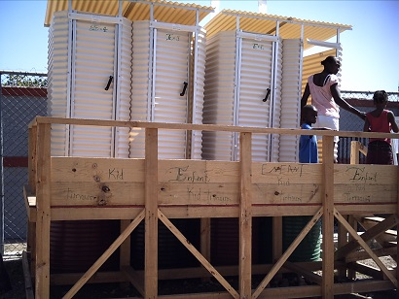
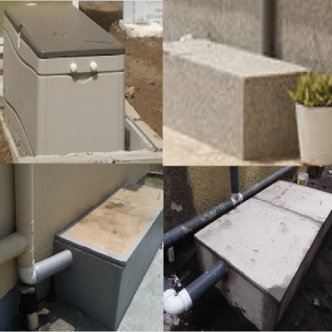

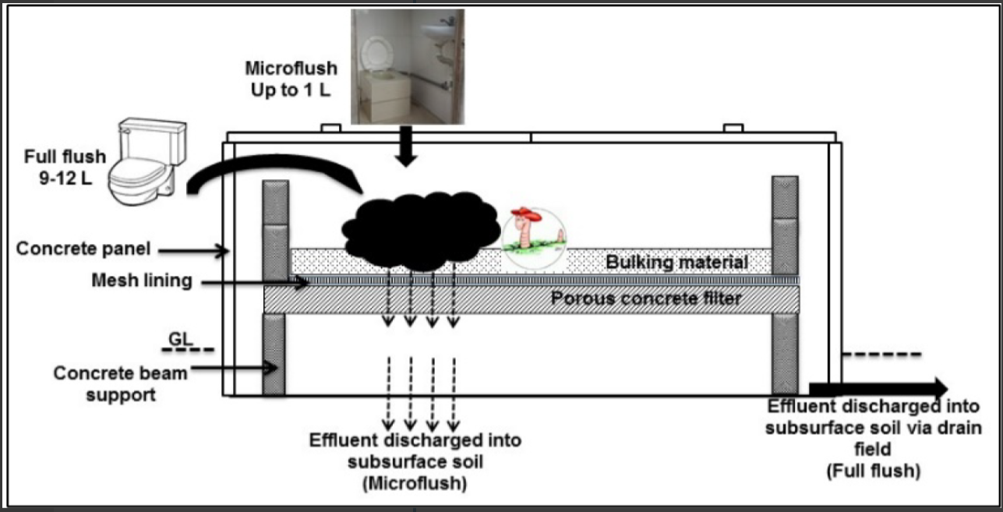
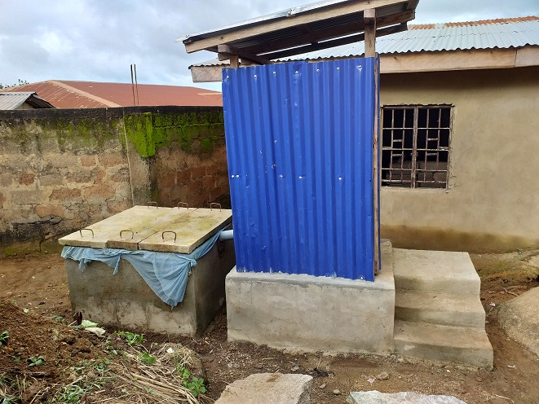
Main page
Page 7/7
Raised offset toilet (Water)
Biofil Toilet
Excreta disposal system
Technology choices
It is both a containment and a treatment technology. The system is composed of a pour flush interface, followed by a composting part were solids and liquid are separated. Microorganisms degrade matter through aerobic decomposition in enclosed container (Biofilcom, 2017)
Decision tree
Raised Pour Flush
Design spec
Latrine choices
Transport choices
Treatment choices
Assessment
Consultation
Monitoring
Modalities of implementation
Adaptation for easier access
Latrine superstructure
Slab
Worm-Based Toilet
Storage / pre-treatment pit
Desludging
Treatment
Final disposal
Continuity of service
Operation & maintenance
Annexes

Slide 17
Main page
Transport choices
Page 1/2
Excreta disposal system
Manual emptying and transport
Motorised emptying and transport
Technology choices
Decision tree
Design spec
Latrine choices
Transport choices
Treatment choices
Assessment
Consultation
Monitoring
Modalities of implementation
Adaptation for easier access
Latrine superstructure
Slab
Storage / pre-treatment pit
Desludging
Treatment
Final disposal
Continuity of service
Operation & maintenance
Annexes
Reference: Compendium of Sanitation Technologies in Emergencies

Slide 18
Main page
Page 2/2
Excreta disposal system
Simplified sewer
Conventional gravity sewer
Technology choices
Decision tree
Design spec
Latrine choices
Transport choices
Treatment choices
Assessment
Consultation
Monitoring
Modalities of implementation
Adaptation for easier access
Latrine superstructure
Slab
Storage / pre-treatment pit
Desludging
Treatment
Final disposal
Continuity of service
Operation & maintenance
Mobilisation and promotion is required to minimise pipe blockage and facilitate proper maintenance. Prior consultation will be used to determine an appropriate O&M mechanism
Annexes
Reference: Compendium of Sanitation Technologies in Emergencies

Slide 19
Main page
Treatment choices
Page 1/9
Excreta disposal system
A treatment plant is constituted of different treatment steps, each with various choices.
Technology choices
Decision tree
Design spec
Latrine choices
Pre-treatment
Primary treatment
Secondary treatment
Tertiary treatment
Transport choices
Treatment choices
Assessment
Sludge
Consultation
Dry sludge
Biomass
Biogas
Compost
Blackwater Greywater Faecal sludge
Fuel briquette manufacturing
Co-composting
Monitoring
Modalities of implementation
Anaerobic Treatment
Physical Treatment
Initial consultation with users is required to ensure the quality and reuse of treatment outputs fit into the local circular economy and match population needs.
Adaptation for easier access
Physical Treatment
Aerobic treatment (may require compressor to inject air / oxygen)
Latrine superstructure
Chemical or physical Treatment
Slab
Wastewater and faecal sludge generated by medical centres and factories may contain metallic and other pollutant requiring specific treatment whose end products may not be eligible for reuse.
Mixed aerobic and anaerobic treatment
Storage / pre-treatment pit
Post treatment
Desludging
Effluent
Effluent
Producing swimming water quality effluent
Treatment
Final disposal
Eliminate grit and solid waste to protect equipment (pump, pipe) and ensure the quality of end product
Dewatering and concentration of sludge to reduce the size of the secondary treatment infrastructure
Organic matter (BOD, TDS, TSS) and nutrient reduction and / or transformation, pathogen removal are various objectives achieved by the different treatment structures
This stage depend on environment sensitivity, local regulations and standards, for reuse and / or disposal compared to the quality of output from the secondary treatment
Continuity of service
Operation & maintenance
Annexes

Slide 20
Main page
Pre- and Post treatment
Page 2/9
Pre-Treatment
Post-Treatment
Excreta disposal system
Technology choices
Decision tree
Design spec
Latrine choices
Transport choices
Treatment choices
Assessment
Consultation
Monitoring
Modalities of implementation
Adaptation for easier access
Latrine superstructure
Slab
Storage / pre-treatment pit
Desludging
Treatment
Final disposal
Continuity of service
Operation & maintenance
Reference: Compendium of Sanitation Technologies in Emergencies
Annexes

Slide 21
Main page
Primary treatment
Page 3/9
Excreta disposal system
Technology choices
Settler
Sedimentation and thickening ponds
Decision tree
Design spec
Latrine choices
Transport choices
Treatment choices
Assessment
Consultation
Monitoring
Modalities of implementation
Adaptation for easier access
Latrine superstructure
Slab
Storage / pre-treatment pit
Desludging
Treatment
Final disposal
Continuity of service
Operation & maintenance
Annexes
Reference: Compendium of Sanitation Technologies in Emergencies

Slide 22
Main page
Secondary treatment
Page 4/9
Excreta disposal system
Aerobic treatment process
Need pre- and primary treatment to operate correctly
Mostly aerobic reactions with pockets of anaerobic conditions
Technology choices
Decision tree
Activated Sludge
Design spec
Trickling Filter
Latrine choices
Transport choices
Treatment choices
Assessment
Consultation
Monitoring
Modalities of implementation
Adaptation for easier access
Latrine superstructure
Slab
Storage / pre-treatment pit
Desludging
Treatment
Final disposal
Continuity of service
Operation & maintenance
Annexes
Reference: Compendium of Sanitation Technologies in Emergencies

Slide 23
Main page
Page 5/9
Excreta disposal system
Need pre-treatment to operate correctly
Technology choices
Anaerobic Filter
Anaerobic Baffled Reactor (ABR)
Decision tree
Design spec
Latrine choices
Transport choices
Treatment choices
Assessment
Consultation
Monitoring
Modalities of implementation
First chamber acts as primary treatment
Adaptation for easier access
Latrine superstructure
Slab
Storage / pre-treatment pit
Desludging
Treatment
Final disposal
Continuity of service
Operation & maintenance
Annexes
Reference: Compendium of Sanitation Technologies in Emergencies

Slide 24
Main page
Page 6/9
Excreta disposal system
Need pre-treatment to eliminate plastic and other non-organic solids
Aerobic treatment processes
Technology choices
Decision tree
Co-composting
Vermicomposting and vermifiltration
Design spec
Latrine choices
Transport choices
Treatment choices
Assessment
Consultation
Monitoring
Modalities of implementation
Adaptation for easier access
Local taboo in handling sanitation by-product from faecal sludge may apply to the resulting compost. Consult with users to identify such issues
Latrine superstructure
Slab
Storage / pre-treatment pit
Desludging
Treatment
Final disposal
Continuity of service
Operation & maintenance
Annexes
Reference: Compendium of Sanitation Technologies in Emergencies

Slide 25
Main page
Page 7/9
Excreta disposal system
Unplanted Drying Beds
Planted Drying Beds
Technology choices
Dry sludge and leachate need further treatment (e.g. respectively co-composting and waste stabilisation pond)
Plan several beds to alternate and maintain operation
Leachate needs further treatment (e.g. horizontal flow constructed wetland).
Sludge may require pre-treatment
Aerobic treatment process
Decision tree
Design spec
Latrine choices
Transport choices
Treatment choices
Assessment
Consultation
Monitoring
Modalities of implementation
Dry sludge need removal every 3-5 years
Adaptation for easier access
Dry sludge needs removal every 10-15 days
Sludge applied every 3-7 days
Latrine superstructure
Slab
Storage / pre-treatment pit
Desludging
Treatment
Final disposal
Continuity of service
Operation & maintenance
Annexes
Reference: Compendium of Sanitation Technologies in Emergencies

Slide 26
Main page
Page 8/9
Biogas Reactor
Excreta disposal system
Effluent and digestate (produced daily) may require further treatment if reuse in agriculture or if aquifer contamination risks are high
Hydrated Lime Treatment
Technology choices
Decision tree
Design spec
Latrine choices
Transport choices
Treatment choices
Assessment
Consultation
Monitoring
Modalities of implementation
Hydraulic retention time will depend on temperature and pathogenic risk of sludge and varies from 15 to 60 days
Adaptation for easier access
Latrine superstructure
Slab
Storage / pre-treatment pit
Desludging
Treatment
Final disposal
Continuity of service
Operation & maintenance
Annexes
Reference: Compendium of Sanitation Technologies in Emergencies

Slide 27
Main page
Treatment of effluent and wastewater
Page 9/9
Excreta disposal system
Waste Stabilisation Ponds
Mixed Aerobic and anaerobic treatment process
Constructed Wetland
Technology choices
Decision tree
Design spec
Latrine choices
Transport choices
Treatment choices
Assessment
Consultation
Monitoring
Modalities of implementation
Adaptation for easier access
Latrine superstructure
Slab
Storage / pre-treatment pit
Desludging
Treatment
Final disposal
Continuity of service
Operation & maintenance
Annexes
Reference: Compendium of Sanitation Technologies in Emergencies

Slide 28
Main page
7 rapid questions before starting latrine building
Excreta disposal system
These questions need answers even in a rapid onset emergency
Assessment
What are local practices?
  How did people dispose of excreta before the crisis,
  What are they doing now & what would they find acceptable now,
  Is water available e.g pour flush versus direct drop,
  Religious/cultural habits,
  Sharing preferences,
  And anal cleansing practice?
Location; which locations are possible given soil and topography and what is socially acceptable?
Can you excavate? The importance of soil type – rocky, very hard, very soft sand to be determine.
What is the space available? Are the affected population densely packed or spread out? E.g., design for desludging or re-digging pits. Where would desludged material go?
What is the ground permeability? Infiltration capacity of the soil to determine ground conditions.
Where is the water table level? i.e., groundwater considerations regarding contamination and whether underground structures might flood during seasonal fluctuations.
What is present capacity? Are there current facilities, sewage system that can be repaired or connected too?
Consultation
Monitoring
Modalities of implementation
Adaptation for easier access
Latrine superstructure
Slab
Storage / pre-treatment pit
Desludging
Treatment
Final disposal
Continuity of service
Mapping of the settlement area for latrine construction
Mapping of the nature of the settlement area in view of the suitability for construction of specific type of latrine is an important step towards making the right decision for latrine design options.
In formal settlements such as refugee camps, with designated locations for latrines, mapping should focus on flooding during the rainy season, the groundwater level in dry and rainy seasons, whether the soil can be excavated (e.g. whether subsurface conditions are rocky) and whether the subsoil is collapsible when wet.
The findings of the mapping will inform which kinds of latrine technology will be appropriate in the settlement (or in parts of the settlement). This will provide important information in planning and the O&M aspects of the sanitation program.
Operation & maintenance
Annexes

Slide 29
Main page
Excreta disposal system
Assessment
Consultation
Access Issues
Community engagement
SaniTweak
CPT
Monitoring
Modalities of implementation
Adaptation for easier access
Latrine superstructure
Slab
Storage / pre-treatment pit
Desludging
Treatment
Final disposal
If latrines aren’t used, money, time and resources are wasted and we are failing in our responsibility to the communities we work with.
Continuity of service
Operation & maintenance
Annexes

Slide 30
Main page
Access Issues
Recent research from humanitarian responses shows that on average 40% of women are not using the latrines provided.
Excreta disposal system
Assessment
Consultation
The main reasons stated are:
Access Issues
Community engagement
SaniTweak
Not wanting to be seen going to the toilet
CPT
Monitoring
Modalities of implementation
Adaptation for easier access
Latrine superstructure
Ensure you listen to all users to understand barriers and adapt your design
Slab
Storage / pre-treatment pit
Desludging
Treatment
Lack of cleanliness
Final disposal
Continuity of service
Not only young children can be afraid to use a toilet. Even a 6-year old child can fall through a 25cm diameter latrine hole
Operation & maintenance
People with mobility issues may face difficulty using a toilet
Annexes

Slide 31

Main page
Community Engagement
Page 1/4
Excreta disposal system
Assessment
Community engagement in WASH is a planned and dynamic process to connect communities and other emergency response stakeholders to increase community’s control over the impact of the response. It brings together the capacities and perspectives of communities and responders.
Consultation
Access Issues
Community engagement
SaniTweak
Community Engagement in WASH video
CPT
Monitoring
Modalities of implementation
Adaptation for easier access
Latrine superstructure
Slab
Storage / pre-treatment pit
Desludging
Treatment
Final disposal
Continuity of service
Operation & maintenance
Annexes
Reference: Oxfam – An introduction to Community Engagement in WASH

Slide 32
Main page
Page 2/4
Excreta disposal system
Assessment
Consultation
Tools like Sani Tweak and the Community Perception Tracker (CPT) will help better engage communities in the process of designing, building and maintaining an excreta disposal service
Access Issues
Community engagement
SaniTweak
CPT
Each step in which WASH Engineers participate will facilitate the design, implementation, and operation & maintenance of an appropriate excreta disposal service
Monitoring
Modalities of implementation
Adaptation for easier access
Latrine superstructure
Slab
Storage / pre-treatment pit
WASH Engineers should consider Community Engagement as a high return investment to ensure the success of their project.
Desludging
Treatment
Final disposal
Continuity of service
Operation & maintenance
Annexes
Reference: Oxfam – An introduction to Community Engagement in WASH

Slide 33
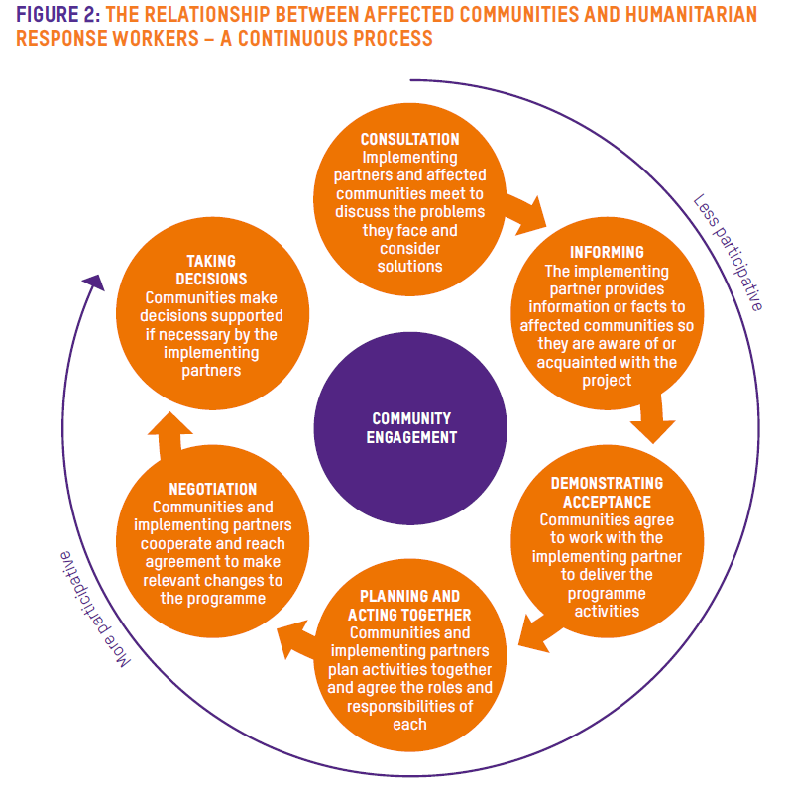
Main page
Page 3/4
Excreta disposal system
Assessment
Community engagement enables people to have a say in decision making wherever possible.
Consultation
The context also play its part: what is possible in a conflict situation may be different from opportunities in a protracted crisis or natural disaster.
Access Issues
Community engagement
SaniTweak
CPT
Monitoring
Modalities of implementation
Adaptation for easier access
Latrine superstructure
Different levels of engagement may be practical or appropriate at different stages in the response – or they may happen simultaneously.
Slab
Storage / pre-treatment pit
Ask yourself: Where is my programme in this continuous process ... and can we hand over more control to communities?
Desludging
Treatment
Final disposal
Continuity of service
Operation & maintenance
Annexes

Slide 34
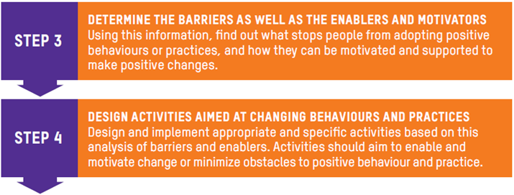
Main page
Page 4/4
As part of the community engagement process, hygiene promoters will go through a 5 step process for designing activities to change behaviour and practices regarding public health risks, including excreta disposal and handwashing with soap.
Excreta disposal system
Assessment
Consultation
Access Issues
WASH engineers need to pay attention to two of these steps as they can influence and improve the design of an excreta disposal system
Community engagement
SaniTweak
CPT
Monitoring
Modalities of implementation
Understanding enablers and motivators can inform latrine design
Adaptation for easier access
Understanding taboo in handling faecal sludge treatment by-products will influence both treatment design and operation and maintenance systems
Latrine superstructure
Slab
Storage / pre-treatment pit
Desludging
Treatment
Final disposal
Improving agriculture or energy production as a by-product of faecal sludge treatment could be a motivator for both latrine uptake and long-term sustainability of the excreta disposal system
Design options for the excreta disposal system will influence any plan and activity to change behaviour and practices
Continuity of service
Operation & maintenance
Annexes

Slide 35

Main page
SaniTweak
Page 1/4
Excreta disposal system
Assessment
The goal
Consultation
Consult
Modify the design
Consult again
Access Issues
Community engagement
SaniTweak
Sani Tweaks’ aim is to ensure
that, before the superstructure
is designed, even in rapid onset emergencies, appropriate consultation with potential
users happens.
CPT
Monitoring
Modalities of implementation
Adaptation for easier access
Latrine superstructure
Slab
Storage / pre-treatment pit
Desludging
Treatment
Final disposal
Continuity of service
Operation & maintenance
Annexes

Slide 36
Main page
Sani Tweaks – What does it means?
Page 2/4
Excreta disposal system
Assessment
Consult
Consult
Modify the design
Consult again
Consultation
Before starting a latrine building programme, consult the users: what are their practices, preferences, minimum distance between men's and women's toilets, vulnerable people's needs, children and babies' needs, menstrual hygiene management needs, siting constraints.
Access Issues
Community engagement
SaniTweak
Modify
CPT
Monitoring
Modalities of implementation
Change both the design of the latrine, and the sanitation programme, and keep changing it as the programme continues. Consider lighting, door locks, accessibility, privacy, wall height, wall material, doors, male/female segregation, screens, adaptations for the disabled and elderly, child-specific latrines, sanitary pad reuse/drying or disposal facilities, handwashing facilities and handwashing motivators.
Adaptation for easier access
Latrine superstructure
Slab
Storage / pre-treatment pit
Desludging
Consult again
Treatment
Final disposal
Have a system in place for gathering feedback whilst the latrine is in use, and for ongoing repairs - particularly if the latrine is made of plastic sheeting. How will the latrines be kept clean, and how will they be desludged or replaced?
Continuity of service
Operation & maintenance
Annexes

Slide 37

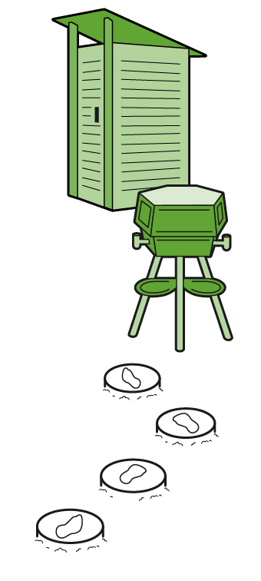
Main page
Sani Tweaks - Best Practices in Sanitation
Page 3/4
Excreta disposal system
Assessment
See Sani Tweak video
Consultation
Access Issues
Community engagement
SaniTweak
CPT
Monitoring
Modalities of implementation
Adaptation for easier access
Latrine superstructure
Slab
Storage / pre-treatment pit
Desludging
Treatment
Final disposal
Continuity of service
Operation & maintenance
Annexes

Slide 38
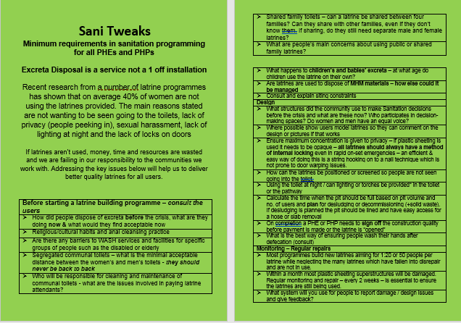

Main page
Page 4/4
Excreta disposal system
Sani Tweaks Resources
Assessment
Consultation
Access Issues
The following resources provide guidance, in a variety of formats to suit different needs, onhow to conduct such continuous consultation with the community:
Community engagement
Checklist
SaniTweak
CPT
Monitoring
Modalities of implementation
Adaptation for easier access
Latrine superstructure
Slab
Storage / pre-treatment pit
Booklet
Desludging
Treatment
Final disposal
Continuity of service
Find out more at
https://www.oxfamwash.org/sanitweaks
Operation & maintenance
Annexes

Slide 39
Main page
Page 1/2
Excreta disposal system
Community Perception Tracker - CPT
Assessment
Consultation
The CPT is an approach that uses a mobile tool to enable staff to capture, analyse and understand the perceptions of communities during disease outbreaks. Correlated with epidemiological data, it is used to inform and adjust programming, and provide an evidence base for advocacy and influencing
Access Issues
Community engagement
SaniTweak
CPT
Monitoring
Modalities of implementation
Adaptation for easier access
Latrine superstructure
Slab
Storage / pre-treatment pit
The CPT is a vital part of Oxfam’s Community Engagement approach.
Desludging
Treatment
Final disposal
Continuity of service
Operation & maintenance
Annexes
Find out more at: https://www.oxfamwash.org/en/communities/community-perception-tracker

Slide 40
Main page
How is the CPT relevant to the work of engineers?
Page 2/2
Excreta disposal system
Assessment
Consultation
When participating in the CPT, you learn to listen completely to community members without the boundary of your program
The CPT can give information on the context, some of which may be useful for adapting design, operation and maintenance approaches
Access Issues
Community engagement
SaniTweak
CPT
Monitoring
The CPT is like a temperature check. It give you a sense of perception trends within the communities.
Modalities of implementation
Adaptation for easier access
If the CPT is in place in your country of operation, contact the team in charge to use it and to get information in order to attune to communities
Latrine superstructure
Slab
Storage / pre-treatment pit
The CPT is real time and documented
Desludging
The CPT provide insight on what is a priority for communities
Treatment
Final disposal
From the trends analysis, you can identify what questions need further in-depth research (through focus group discussion for example)
Continuity of service
Operation & maintenance
The CPT provides only qualitative insight
Annexes

Slide 41










Main page
Excreta disposal system
Monitoring
Assessment
Consultation
Monitoring
Process
Monitoring is the systematic and continuous process of collecting and using information throughout the programme cycle for the purpose of management and decision-making. WASH programmes should include:
Process monitoring that looks at how the project is being developed.
Impact monitoring that looks at whether the project is having the intended impact.
Impact
Indicators
Modalities of implementation
Adaptation for easier access
WASH team responsibility
Latrine superstructure
Slab
Storage / pre-treatment pit
Desludging
Treatment
Final disposal
Continuity of service
MEAL responsibility with WASH team inputs
Operation & maintenance
Annexes

Slide 42
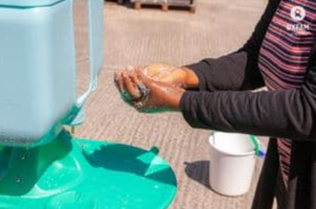
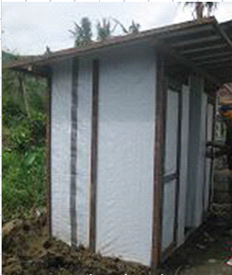
Main page
Page 1/3
Excreta disposal system
Process monitoring (continuous process - checklist)
Assessment
To verify design specifications are respected and are maintained as long as the service is needed
Consultation
Monitoring
Functional latrine
Process
Impact
Check there is a functioning handwashing station
Check the pit is not full
Indicators
Modalities of implementation
Adaptation for easier access
Check water doesn’t stay on the roof
Stick with 50cm and 1m marks, lower to the top of the faeces in the pit
Latrine superstructure
Slab
Check the walls are not see-through
Storage / pre-treatment pit
Desludging
1m mark visible, plan for desludging or digging a new pit as replacement
Treatment
50cm mark visible, the pit is overfilled
Check water falling from the roof is drained out and doesn’t dig under the slab
Check the inside lock always function
Final disposal
Continuity of service
Operation & maintenance
Check inside the slab is clean
Annexes
Check the slab and latrine are not collapsing or at risk to collapse

Slide 43
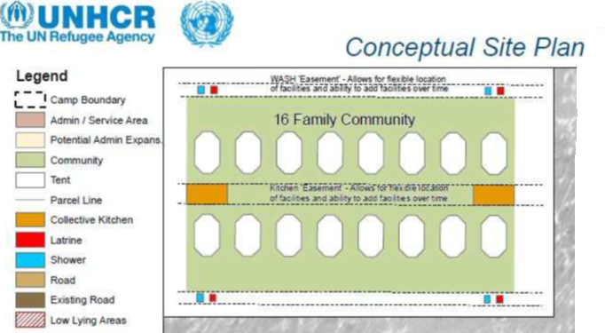
Main page
Page 2/3
Excreta disposal system
16 FAMILY COMMUNITY LAYOUT
Assessment
Consultation
There are two possible camp layouts styles.
Their respective advantage are:
Corridor layout has less scattered facilities
16-family community has shorter distance to sanitation facilities for all users
Monitoring
Process
Impact
Indicators
Modalities of implementation
Adaptation for easier access
Latrine superstructure
Slab
SANITATION CORRIDOR LAYOUT
Storage / pre-treatment pit
Numbering each facility with a post code type for user to report issues help monitoring and service continuity
Maximum 5 dwellings per latrine
Desludging
Sufficient functional facilities for all users
Treatment
Dwellings
Final disposal
Family latrines
Continuity of service
The ratio of people per latrine should only take into account functional latrines
Check adapted latrine availability for people with reduced mobility
Operation & maintenance
Annexes
3 m
Check distance to facilities
minimum between dwellings
12 m minimum corridor width
Sanitation corridor

Slide 44
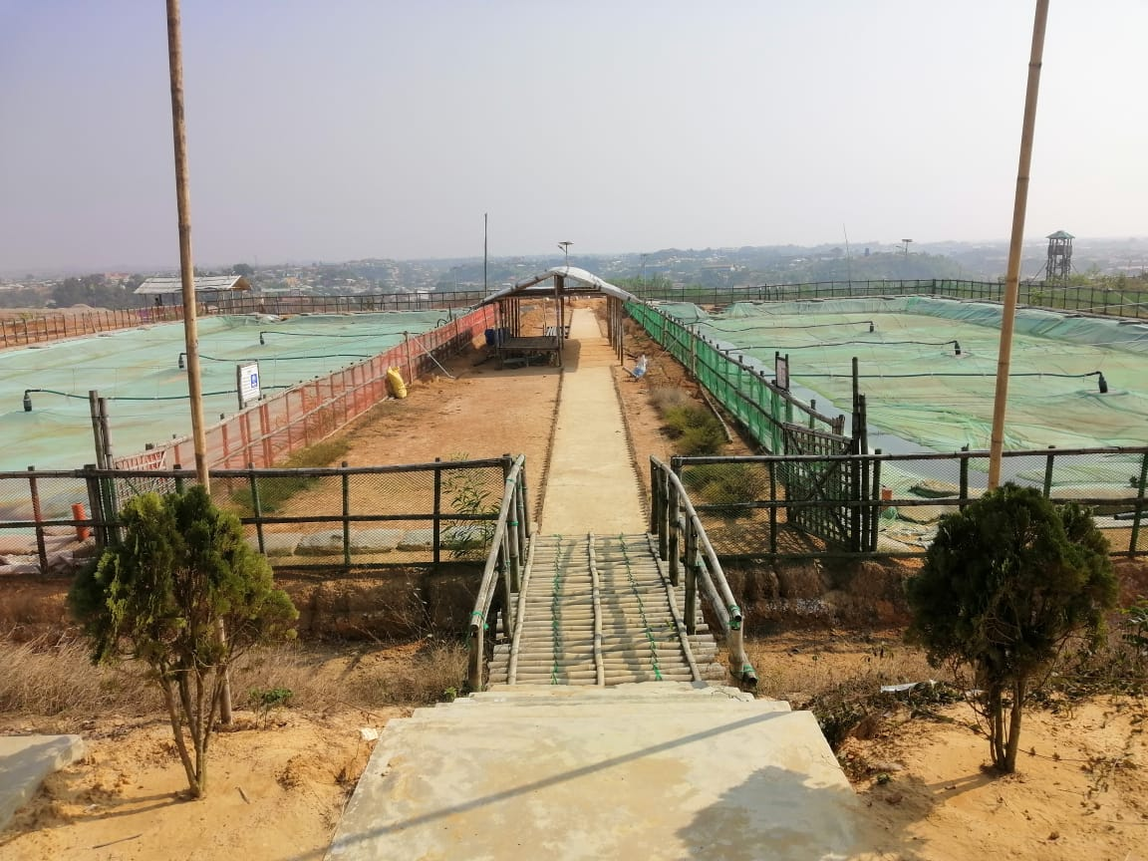
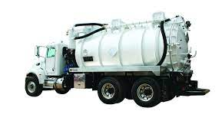
Main page
Page 3/3
Excreta disposal system
Safe evacuation of faecal sludge
Assessment
Consultation
Check road security rules and application
Check the treatment eliminate disease risks (e.g. cholera vibrio, parasites)
Monitoring
Process
Impact
Indicators
Modalities of implementation
Adaptation for easier access
Check surrounding aquifers are not contaminated by treatment and disposal sites (monitor bacteriological, helminths eggs and nitrate concentration)
Latrine superstructure
Slab
Storage / pre-treatment pit
Check there isn’t any spillage
Desludging
Treatment
Check the destination is only an approved site
Final disposal
Check the treatment outputs are used according to National Standards and international recommendations
Continuity of service
Operation & maintenance
Check the faecal sludge doesn’t contain items (e.g. solid waste) that present risk to desludging and to treatment
Check final disposal site are protected against flood and rain runoff
Annexes
Check if operators and stakeholders are satisfied with treatment processes and infrastructures
Reference: Feacal sludge management – Systems approach for Implementation and Operation

Slide 45
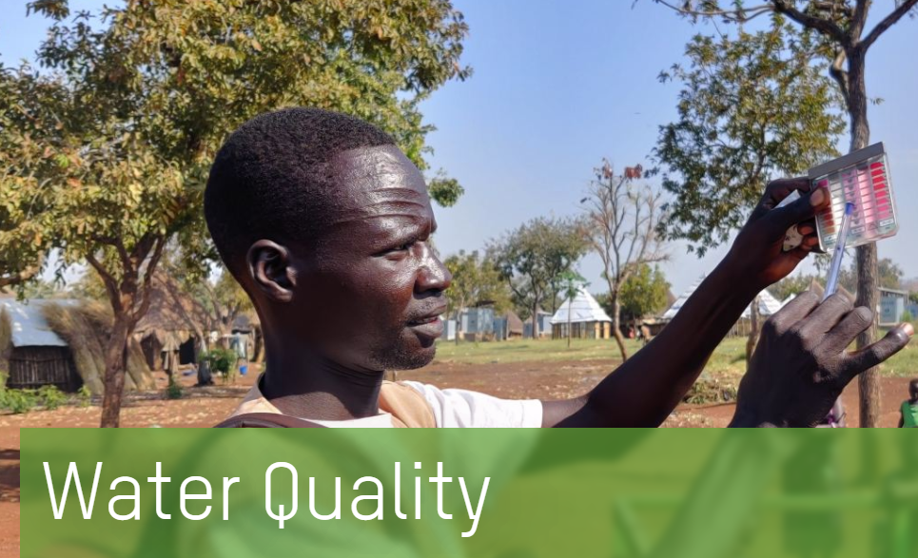


Main page
Impact monitoring (punctual process at key time of the implementation – FGD / survey)
Excreta disposal system
Assessment
Are everyone only using toilet (or commode / potty) to defecate?
Are water sources protected from faeces contamination?
Consultation
Monitoring
Process
Impact
Indicators
Modalities of implementation
Is the level of cost recovery sufficient to sustain the operation and maintenance of the excreta disposal system?
Adaptation for easier access
Latrine superstructure
Slab
Storage / pre-treatment pit
Is everyone washing their hands after defecation?
Are diarrhoeal diseases morbidity reduced?
Desludging
Treatment
Final disposal
Continuity of service
Operation & maintenance
Annexes

Slide 46
Main page
Indicators
MATRIX OF INDICATORS FOR MEASURING COMMUNITY PARTICIPATION AND SATISFACTION IN RELATION TO WASH IN THE INITIAL 4 TO 6 MONTHS OF RESPONSE
Page 1/4
Excreta disposal system
Assessment
WASH outcomes
Community participation
Community satisfaction
Consultation
Monitoring
• There is no evidence of WASH-related disease outbreaks
• Formal and informal community leaders, community organizations and institutions are identified
• Communities report that key information is clearly communicated in appropriate languages and reaches all sections of the community using context-specific channels
Process
• A stakeholder map developed with communities is used to analyse power dynamics and for programme planning
Impact
• Access to appropriate sanitation facilities and resources is available to all, in line with Sphere standards
Indicators
Modalities of implementation
• Communities report that specific gendered needs of women and men, boys and girls are taken in to account in the design and location of the facilities (access, privacy, safety, menstrual hygiene management-friendly)
• A diverse range of people selected by the community is involved in decisions on the planning, design and maintenance of sanitation infrastructure and services
Adaptation for easier access
• Sanitation facilities are consistently used and users are involved in maintaining them
Latrine superstructure
• Communities, including more marginalized groups, influence the design of feedback and complaints mechanisms
Slab
• There is no evidence of open defecation
• Marginalized groups and individuals express satisfaction with consultation and programme adaptations
Storage / pre-treatment pit
• Hand washing is effectively practised
• Diverse community members are included in identifying local priorities, problems and their own solutions
Desludging
• Communities report that they have the skills and support to manage WASH facilities and services
Treatment
• Implementation plan with roles and responsibilities of all actors is agreed and monitored
Final disposal
• Community members are involved in monitoring programme activities and in the feedback loop to their wider community
Continuity of service
Operation & maintenance
• Communities are supported to advocate on their behalf to Oxfam and to other stakeholders
through coordination platforms
Annexes
• Capacity development and a timely exit/ transition plan is agreed by communities and other key stakeholders

Slide 47
Main page
GLOBAL WASH CLUSTER REPOSITORY OF INDICATORS TO MEASURE NEEDS AND RESPONSE
Page 2/4
Excreta disposal system
Code | Sub-domain | Title
AAP-1 | Feedback mechanism | Number of feedback received (including complaints) which have been acted upon
AAP-3 | Participation | Number of persons consulted (disaggregated by sex/age) before designing a program/project [alternatively: while implementing the program/project]
W 7-1 | W7 Aggravating Factors | Presence of faecal-oral diseases
W 7-4 | W7 Aggravating Factors | Density of settlement in m2 of total site area per person
W 7-5 | W7 Aggravating Factors | Nb of people on the site
W1-8 | W1.2 Hygiene Practices | Proportion of men, women, boys and girls who last defecated in a toilet (or whose faeces was last disposed of in a safe manner)
W1-9 | W1.2 Hygiene Practices | Proportion of men, women, boys and girls washing hands with water and soap or substitute after contact with faeces and before contact with food and water
W3-1 | W3.1 Environment | Presence of human faeces on the ground on and around the site
W3-2 | W3.2 Toilet Facilities | Average number of users per functioning toilet
W3-3 | W3.2 Toilet Facilities | Proportion of households with access to a functioning toilet
W3-4 | W3.2 Toilet Facilities | Proportion of toilets with functioning and convenient handwashing facilities
W3-5 | W3.2 Toilet Facilities | Proportion of toilets that are clean
W8-1 | W8 WASH Programme Design and Implementation | All groups within the affected population have equitable access to WASH facilities and services
W8-2 | W8 WASH Programme Design and Implementation | The WASH response includes effective mechanisms for representative and participatory input from all users at all phases
W8-3 | W8 WASH Programme Design and Implementation | The affected population takes responsibility for the management and maintenance of facilities as appropriate, and all groups contribute equitably
Assessment
Consultation
Monitoring
Process
Impact
Indicators
Modalities of implementation
Adaptation for easier access
Latrine superstructure
Slab
Storage / pre-treatment pit
Desludging
Treatment
Final disposal
Continuity of service
Operation & maintenance
Annexes

Slide 48
Main page
THE ACCOUNTABILITY & QUALITY ASSURANCE INITIATIVE
Page 3/4
Excreta disposal system
The AQA approach
VANITY vs ACTIONABLE METRICS
Assessment
Consultation
Monitoring
Process
Impact
Indicators
Modalities of implementation
Adaptation for easier access
Latrine superstructure
Slab
Storage / pre-treatment pit
Desludging
Treatment
Final disposal
Continuity of service
Reference: L. Lacan & J. Brown, The accountability & quality assurance initiative – measuring what matters
Operation & maintenance
Annexes

Slide 49
Main page
Page 4/4
Excreta disposal system
Example of contextualised module
Example of quality snapshot chart
Assessment
Consultation
Monitoring
Process
Impact
Indicators
Modalities of implementation
Adaptation for easier access
Latrine superstructure
Slab
Storage / pre-treatment pit
Desludging
Treatment
Final disposal
Continuity of service
Operation & maintenance
Annexes
Reference: L. Lacan & J. Brown, The accountability & quality assurance initiative – measuring what matters

Slide 50
Main page
Excreta disposal system
Assessment
Excreta disposal service is required from day one of an emergency onset. The modality of implementation needs to be adapted to the targeted population and to the phase of the emergency.
Consultation
Monitoring
Modalities of implementation
Construction mode
Consultation / community engagement
Public toilet
Family shared toilet
Household toilet
Early recovery
Adaptation for easier access
1st phase / onset emergency
2nd phase / stabilisation period
Recovery / exit phase
Latrine superstructure
Slab
Storage / pre-treatment pit
Open defecation management
Trench latrine
Communal latrine
Distribution of commode and potty (children and people with disabilities
Family shared toilet
Household toilet
Inclusion of marginalised population
Sustainable system / waste to value
CLTS
Sanitation marketing
Desludging
Treatment
Final disposal
Continuity of service
Operation & maintenance
Annexes

Slide 51
Main page
Construction modalities
Excreta disposal system
Assessment
There are a number of ways of constructing sanitation facilities:
The entire latrine can be constructed by the agency
The beneficiaries can dig their own pit & the agency provides the slabs, superstructure and technical assistance.
The beneficiaries are mobilised to construct their own latrines using locally available materials. The agency may need to provide tools and technical assistance or vouchers (conditional cash)
Using contractors & ensuring good monitoring and sign off by the agency
Consultation
Monitoring
Modalities of implementation
Construction mode
While contracting works has its own monitoring requirement related to contractual obligation and risk management, monitoring and sign-off also apply to all modalities albeit with less contractual constraints
Public toilet
Family shared toilet
Household toilet
Adaptation for easier access
Latrine superstructure
In cases of large-scale emergencies when agencies have to directly install a huge number of lifesaving sanitation facilities in a short period of time, contracting out the construction work to multiple contractors is a key implementation modality. Awarding the whole work to one contractor selected via competitive bid just simply to follow the procurement rules involves accepting risks that could complicate the implementation process. Instead, distributing the work to multiple contractors will help speed up implementation and avoid risk of delay and failure in terms of quality. This requires the WASH and Logistics managers to work together.
Slab
Storage / pre-treatment pit
Desludging
Treatment
Final disposal
Contracted works is a collaboration between Logistic, Finance and WASH teams and need to be well coordinated. More information can be found by Oxfam staff on the compass page One Oxfam Supply & Logistics Toolkit . Other organisations’ staff should check their organisation procedures.
Continuity of service
Operation & maintenance
For contracting works, refer to Oxfam Technical Brief TBN12 – Introduction to contracting out PH engineering works and contract management and to your logistic department
Annexes

Slide 52
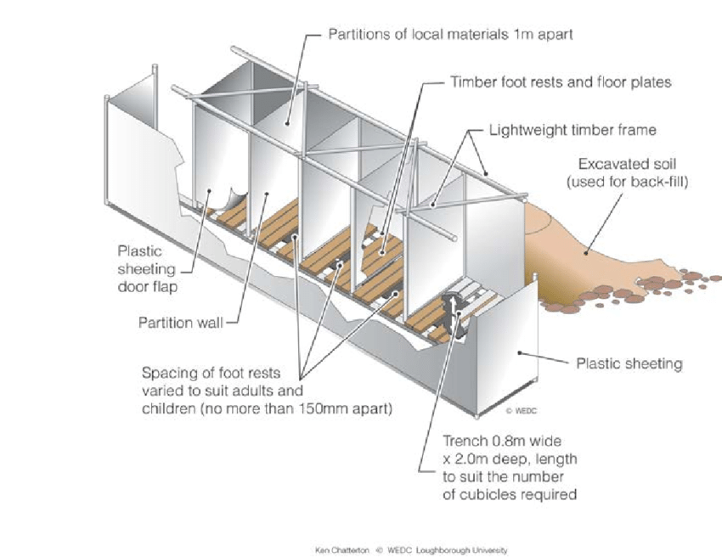
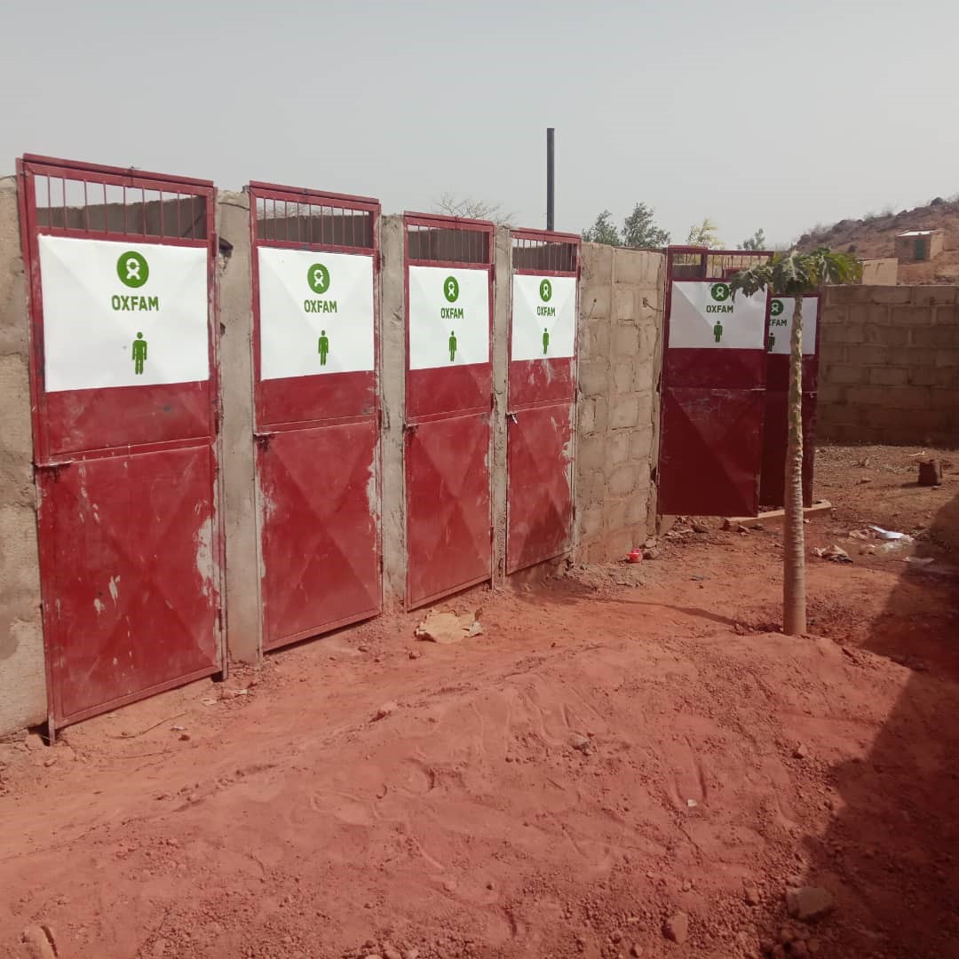
Main page
Public Toilet
Whenever there is more than 20 people per latrine door
(e.g. Sphere standard for 1st phase emergency 50 people per door)
Excreta disposal system
Assessment
Deep Trench latrine
Consultation
Multiple door Pit latrine
Monitoring
In the preparation phase there should be as much co-ordination as possible with the affected population concerning the siting and type of latrines. Site maps should be drawn up to aid the equal distribution of communal latrines and to plan where latrine corridors can be put. A map can be drawn up with community members to involve them in this process of siting the latrines. If a community map is used it is very important to conduct this exercise with men and women and also with a technical advisor present to ensure that a consensus is reached on this important point
Modalities of implementation
Construction mode
Public toilet
Family shared toilet
Household toilet
Adaptation for easier access
Latrine superstructure
Slab
Storage / pre-treatment pit
Desludging
Due to management and maintenance problems associated with communal facilities, communal latrines are normally seen as only a short-term measure, before family latrines can be built or only for public places such as near markets, food and health centres. It may be necessary to pay workers (per latrine completed) in the initial phase for construction of communal latrines. However, it is preferable, in order to promote ownership, care and maintenance, if community members can be motivated to build them. If community members are to build their own toilets, then it may be necessary to provide help to those who may have no one available to do this such as female headed households, disabled families and the elderly.
Treatment
Final disposal
Continuity of service
Operation & maintenance
It may not always be necessary to construct communal latrines as the population may be rapidly mobilised to dig their own family latrines, which are always preferable if conditions allow.
Annexes
In planning budgets, consider if the initial communal latrines can be reused during the transition to family shared / household toilet and include the necessary budget for their adaptation based on consultation with users.

Slide 53
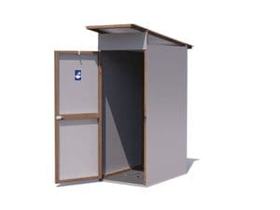
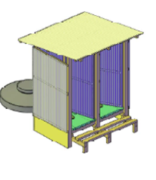

Main page
Family shared Toilet
Maximum 20 users per latrine door, dedicated to few families (~4) and the means to lock the door
Excreta disposal system
Assessment
Consultation
All different modalities of construction can apply, although user participation in the construction improves user ownership of toilets
Monitoring
Modalities of implementation
Construction mode
Public toilet
Family shared toilet
Household toilet
Adaptation for easier access
Latrine superstructure
Single door structures if space allows, or double door structures
Slab
Storage / pre-treatment pit
Desludging
Treatment
Final disposal
Continuity of service
Operation & maintenance
Annexes

Slide 54





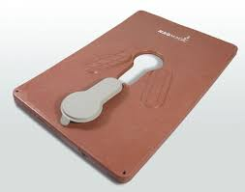




Main page
Household Toilet
Supporting families to build their own toilet through subsidies
Page 1/4
Excreta disposal system
Assessment
Consultation
Monitoring
Modalities of implementation
Construction mode
Targeting for:
Fully subsidised toilet
Partially subsidised
No subsidy
Must be discussed and agreed on with communities
Public toilet
Family shared toilet
Household toilet
Adaptation for easier access
Latrine superstructure
Slab
Storage / pre-treatment pit
Desludging
Treatment
Technical manpower
Final disposal
Continuity of service
Materials
Operation & maintenance
Annexes
Tools

Slide 55












Main page
Motivating families to construct their own toilets through participatory approaches, e.g. CLTS
Page 2/4
Excreta disposal system
Assessment
CLTS concentrates on the whole community rather than on individual behaviours
Consultation
Monitoring
The facilitation phase involves a community engagement process where WASH engineers listen to users and understand enablers and barriers
Pre-Triggering: ensuring conditions are favourable for the CLTS approach
Modalities of implementation
Construction mode
Public toilet
Family shared toilet
Technical support for appropriate latrine design in difficult ground condition
Household toilet
Adaptation for easier access
Latrine superstructure
Triggering
Slab
Storage / pre-treatment pit
Desludging
Treatment
Final disposal
Continuity of service
Post-Triggering: Celebrating achieving ODF (Open Defecation Free) status
Operation & maintenance
Annexes
Reference: Plan - Handbook of Community-led Total Sanitation

Slide 56
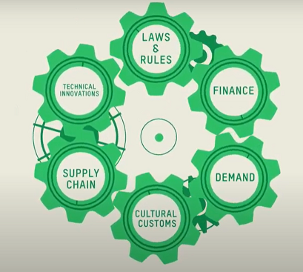
Main page
Supporting families to build their own toilet through Market-based programming
Page 3/4
Excreta disposal system
Assessment
Based on Oxfam Philippines’ program to make toilet affordable
Getting government buy in to use existing social support mechanisms to increase toilet ownership and use
Consultation
Monitoring
Modalities of implementation
Construction mode
Making it easy to save for a toilet or take out an affordable loan
Public toilet
Designing new, more affordable and more desirable products to suit a range of customers
Family shared toilet
Household toilet
Adaptation for easier access
Latrine superstructure
Slab
Storage / pre-treatment pit
Showing people that owning a toilet could become a reality through affordable loan and savings
Desludging
Reducing cost through bulk buying materials, developing local supply routes and using sales agent
Treatment
Final disposal
Continuity of service
Understanding the type of toilets people want to use and maintain
Operation & maintenance
Annexes

Slide 57
Main page
In which situation should you consider market-based or cash-based programming?
Page 4/4
Excreta disposal system
Assessment
Supporting communities and artisans / enterprise in designing appropriate sanitation infrastructure
Find out more in: GWC, J. Allen & J. Brown – Market Based Programming in WASH, Technical Guidance for Humanitarian Practitioners, 2nd edition, Sept 2021
In affected communities and communities hosting IDPs / Refugees
Consultation
Monitoring
Modalities of implementation
Construction mode
There are artisans and small business which can easily deliver any part of the excreta disposal system (e.g., material production, construction of facilities, desludging) through capacity building or financial support
Hiring the service of local enterprise for the upgrade or construction of latrine for IDPs / refugees families and their host
Public toilet
Family shared toilet
Household toilet
Adaptation for easier access
In refugee camps, people rarely have access to income
Latrine superstructure
People have an income and access to market
Conditional cash grant for toilet (through vouchers) to households building their own toilet or for vulnerable families (either in host communities or camps)
Slab
Storage / pre-treatment pit
The market need to be monitored to avoid prices inflation or any other negative impact resulting from the intervention and / or from other reasons that can be beyond the control of the program
Desludging
People have access to credit or savings groups
Treatment
Final disposal
Continuity of service
In designing think in capital investment and operational cost. The latter should be as low as possible for long term sustainability
To support loan request, think in term of return in investment (income) but also prevention in future cost / expense (reduction on health expense, less water treatment cost, reduced disaster impact, reduced water stress, etc.)
Operation & maintenance
Identifying micro-finance institutions and supporting access to credit
Annexes

Slide 58
Main page
Excreta disposal system
Assessment
There is no one-size-fits-all solution that can be picked up and apply to make WASH work inclusive; a range of different things need to be done, adapted to the specific context.
It’s not a linear process either; some activities can be carried out at various times in the programme cycle, and some can be run in parallel. An activity may result in unexpected outcomes, requiring you to respond in ways you had not originally anticipated, adapting your approach.
Focusing on the principles of the rights to sanitation will help guide your journey towards equality, non-discrimination and inclusion in WASH.
Consultation
Monitoring
Modalities of implementation
Adaptation for easier access
Lighting
Reduced mobility
Wheelchair
Menstrual Hygiene
Latrine superstructure
‘The human right to sanitation entitles everyone without discrimination to physical and affordable access to sanitation, in all spheres of life, which is safe, hygienic, secure, socially and culturally acceptable, which provides for privacy and ensures dignity.’
United Nations General Assembly / Human Rights Council
Slab
Storage / pre-treatment pit
Desludging
Treatment
Final disposal
Continuity of service
Operation & maintenance
Reference: WaterAid (2018) - Understanding and addressing equality, non-discrimination and inclusion in water, sanitation and hygiene (WASH) work. Water Aid: London, UK
Annexes

Slide 59
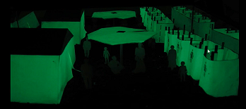
Main page
Lighting
Excreta disposal system
Assessment
Sanitation facilities are only effective if they are used, and they will only be used if the experience of using them is acceptable. This means users must feel safe and be able to see what they are doing inside the toilet. Whilst lighting may initially be viewed as a costly extra, especially in addition to the cost of a basic superstructure, its benefits justify the investment. Planning lighting in advance helps ensure that it is both efficient, effective and contributes towards greater safety, especially for women and children.
Consultation
Monitoring
Modalities of implementation
Adaptation for easier access
NATURAL LIGHT INSIDE THE TOILET
ARTIFICIAL LIGHTING INSIDE THE TOILET
LIGHTING THE WAY
Lighting
Reduced mobility
Wheelchair
Painting walls, door, floor in light color to reflect light
Window at the top of the wall or space between top of the wall and roof
Window on the roof or using material allowing light through (e.g. clear plastic sheeting)
Torches and lamp
Fixed lighting
A clear, smooth path with no obstacles marked with light-coloured stones, easier to follow
Different paths to separated men’s and women’s toilets increase privacy and safety
Lantern attached to post or building, powered through battery charged by solar panel or electricity grid
Menstrual Hygiene
Latrine superstructure
Slab
Storage / pre-treatment pit
Desludging
Treatment
If public lighting is limited, it will attract more than just insects at night. Children doing homework or men meeting to chat and drink may gather beneath it. If the only light is near a toilet, users are very visible, and this may discourage their use. Too much lighting may make going to the toilet obvious to those who would prefer the cover of darkness. Consultation with a variety of users and ongoing monitoring is the only way to fully understand what is working and what needs further adaptation
Final disposal
Continuity of service
Operation & maintenance
Annexes
Phosphorescent sheeting experimented by French Red Cross in Madagascar
Reference: Oxfam Technical brief – Lighting for Sanitation facilities

Slide 60
Main page
Reduced Mobility
Page 1/5
Excreta disposal system
Assessment
Consultation
Siting
Monitoring
Path to toilet
Modalities of implementation
No more than 15 m from household (with member with reduced mobility)
Entrance
Adaptation for easier access
Suitable for: everyone, especially users with a visual impairment and with physical impairments, including wheelchair users.
Lighting
Entrances must be: a) wide enough (wheelchair width + 20cm), and b) level enough (minimal or no difference between outside and inside)
Reduced mobility
Wheelchair
Menstrual Hygiene
Latrine superstructure
Slab
Guide string from house to latrine and bath shelter
Clear, level path, lined with rocks
Landmark posts made from local materials
Storage / pre-treatment pit
Wide and level entrance to allow wheelchair access or user with helper. Rammed earth floor.
Latrine with level concrete entrance, wide enough for a wheelchair user
Level concrete threshold with raised cement mound to reduce flooding. Mound is rounded for wheelchair access.
Desludging
Treatment
Final disposal
Continuity of service
Operation & maintenance
Annexes
Reference: WaterAid – Compendium of accessible WASH technologies

Slide 61
Main page
Page 2/5
Excreta disposal system
Door
Assessment
Door handles and closing mechanisms
Consultation
Suitable for: users with mobility devices, a helper, or carrying a small child, or people who are overweight.
Monitoring
Modalities of implementation
Suitable for: everyone, especially women and girls
Adaptation for easier access
Lighting
Latrine with a curtain for privacy made of light cloth
Outward-opening tin door on wooden frame. Raised platform edge acts as a door stop
Outward-opening wooden double doors with a latch on outside to keep closed
Horizontal handrail the full width of the door on the inside. Internal bolt.
Carved wooden handle nailed to the inside of the door
Metal hook and eye on inside of door
Reduced mobility
Wheelchair
Menstrual Hygiene
Latrine superstructure
Slab
Storage / pre-treatment pit
Desludging
Treatment
Final disposal
Continuity of service
Operation & maintenance
Annexes
Reference: WaterAid – Compendium of accessible WASH technologies

Slide 62
Main page
Page 3/5
Excreta disposal system
Internal space
Assessment
Consultation
Monitoring
Floor finish
Modalities of implementation
Think about: who will use the toilet, and how much space they will need.
Level 1: Space for users who can stand and enter using support rails, or blind users.
Level 2: Additional space for a carer, to use crutches/sticks or to park a wheelchair but not turn.
Level 3: Space for a wheelchair to enter, shut the door, and turn around inside.
Adaptation for easier access
Think about: the balance between hygiene and safety. Floors need to be smooth enough to be washed and swept, but not so smooth that they are slippery when wet.
Lighting
Reduced mobility
Wheelchair
Menstrual Hygiene
Latrine superstructure
Slab
Traditional round superstructure, cement seat, wooden handrail each side, curtain for privacy
Entrance corridor, with wall on left in front of latrine and a gap between corridor and toilet
Spacious toilet cubicle, with drop hole located in the corner to provide maximum usable space
Rammed earth floor without marram
Rammed earth floor made of marram (small stones) and sand; cow dung is smeared over to make it even and smooth
Cement slab, installed level with earth floor around it
Storage / pre-treatment pit
Desludging
Treatment
Final disposal
Continuity of service
Operation & maintenance
Annexes
Reference: WaterAid – Compendium of accessible WASH technologies

Slide 63
Main page
Page 4/5
Excreta disposal system
Handrail and support
Assessment
Consultation
Fixed seat pan
Suitable for: People who are unstable or unable to walk, squat or stand unaided
Monitoring
Modalities of implementation
Bricks protruding from wall for support to a weak or visually impaired person
Wooden/ bamboo support rails fixed to floor either in front or on either side of toilet (depending on user’s needs)
Metal bars (e.g. galvanised iron pipe) fixed to side wall/s of latrine
Suitable for: people who have difficulty squatting, including overweight people, pregnant women, older people and disabled people.
Adaptation for easier access
Lighting
Reduced mobility
Twin cement-plastered brick sitting blocks
Brick seat with a cement screed
Cement bowl made with mould
Wheelchair
Menstrual Hygiene
Latrine superstructure
Slab
Storage / pre-treatment pit
Desludging
Treatment
Final disposal
Continuity of service
Operation & maintenance
Annexes
Reference: WaterAid – Compendium of accessible WASH technologies

Slide 64
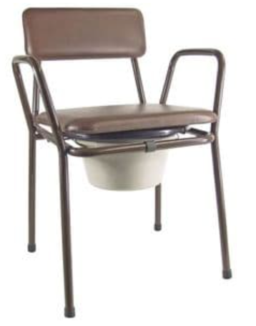
Main page
Page 5/5
Excreta disposal system
Moveable seat
Assessment
Consultation
Commode seat
Monitoring
Suitable for: users who have difficulty squatting, including overweight people, heavily pregnant women, older people, disabled people
Modalities of implementation
Adaptation for easier access
Suitable for: people who cannot reach a latrine; small children
Lighting
Low wooden or bamboo toilet stool with hole in seat, placed over toilet hole, with or without funnel as a splash guard (see lower image)
Standard varnished wooden chair with hole cut in the seat
Painted wooden chair with ‘potty’ inserted in hole in seat. Potty is removed for emptying.
Metal commode chair with plastic inset toilet pan (bought in local market). Container is placed beneath the seat and emptied into the latrine
Reduced mobility
Wheelchair
Menstrual Hygiene
Latrine superstructure
Slab
Storage / pre-treatment pit
Desludging
Treatment
Final disposal
Continuity of service
Operation & maintenance
Oxfam Supply Centre – Code HCWOW
Annexes
Reference: WaterAid – Compendium of accessible WASH technologies

Slide 65
Main page
Wheelchair access
Page 1/2
Excreta disposal system
Assessment
Consultation
Monitoring
Modalities of implementation
Adaptation for easier access
Lighting
Reduced mobility
Wheelchair
Menstrual Hygiene
Latrine superstructure
Slab
Storage / pre-treatment pit
Desludging
Treatment
Final disposal
Continuity of service
Operation & maintenance
Annexes
Reference: WaterAid – Compendium of accessible WASH technologies

Slide 66
Main page
Page 2/2
Excreta disposal system
Assessment
Consultation
Monitoring
Modalities of implementation
Adaptation for easier access
Lighting
Reduced mobility
Wheelchair
Menstrual Hygiene
Latrine superstructure
Slab
Storage / pre-treatment pit
Desludging
Treatment
Final disposal
Continuity of service
Operation & maintenance
Annexes
Reference: NDA - Building for Everyone: A Universal Design Approach

Slide 67
Main page
Menstrual Hygiene Management
Page 1/3
Excreta disposal system
Women and girls require more privacy for sanitation than men and boys, especially when dealing with menstruation. Maintaining safety and dignity while accessing sanitation facilities remains a widespread challenge in humanitarian contexts.
Assessment
Consultation
Monitoring
Modalities of implementation
Adaptation for easier access
Lighting
Reduced mobility
Wheelchair
Menstrual Hygiene
Latrine superstructure
Slab
Storage / pre-treatment pit
Desludging
Treatment
Final disposal
Continuity of service
Operation & maintenance
Annexes
Reference: Sommer, M., Schmitt, M., Clatworthy, D. (2017) – A Toolkit for integrating menstrual hygiene management (MHM) into Humanitarian Response (First Edit). New York: Columbia University, Mailman School of Public Health and International Rescue Committee

Slide 68
Main page
Page 2/3
Excreta disposal system
Assessment
Consultation
Monitoring
Modalities of implementation
Adaptation for easier access
Lighting
Reduced mobility
Wheelchair
Menstrual Hygiene
Latrine superstructure
Slab
Storage / pre-treatment pit
Desludging
Treatment
Final disposal
Continuity of service
Operation & maintenance
Annexes
Reference: Sommer, M., Schmitt, M., Clatworthy, D. (2017) – A Toolkit for integrating menstrual hygiene management (MHM) into Humanitarian Response (First Edit). New York: Columbia University, Mailman School of Public Health and International Rescue Committee

Slide 69
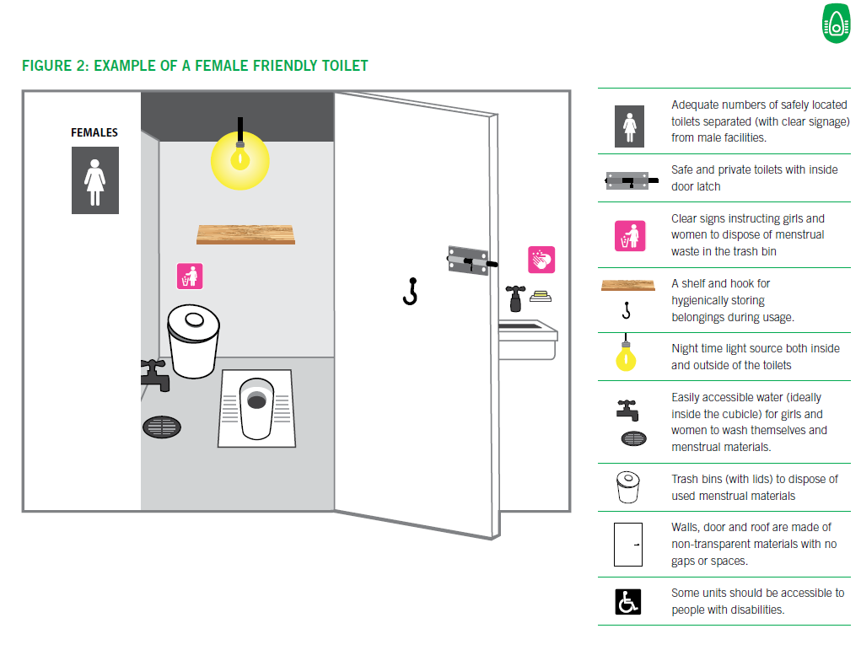
Main page
Page 3/3
Excreta disposal system
Assessment
Consultation
Monitoring
Modalities of implementation
Adaptation for easier access
Lighting
MHM-RELATED NFI CONSIDERATIONS TO SUPPORT THE WASHING AND DRYING OF MATERIALS:
Reduced mobility
Wheelchair
Menstrual Hygiene
Latrine superstructure
Slab
• Provision of MHM-designated buckets or basins with lids (as girls and women will not want to use the same buckets for cooking and other laundry activities). It can also be used for soaking and storage when not in use.
• Additional laundry soap for girls and women to wash menstrual materials
• A clothesline and clips to ensure girls and women can dry materials separately.
• In some contexts, women may want a piece of cloth to privately cover these materials while drying.
Storage / pre-treatment pit
Desludging
Treatment
Final disposal
Continuity of service
Operation & maintenance
Annexes
Reference: Sommer, M., Schmitt, M., Clatworthy, D. (2017) – A Toolkit for integrating menstrual hygiene management (MHM) into Humanitarian Response (First Edit). New York: Columbia University, Mailman School of Public Health and International Rescue Committee

Slide 70
Main page
A latrine superstructure is a shelter which provides privacy and protection for the user of the latrine. Superstructures can be built from a variety of materials ranging from bricks, blocks and stone to corrugated metal sheets, wattle and daub and, in emergencies, even plastic or sackcloth.
Excreta disposal system
Assessment
Consultation
Monitoring
Privacy, protection, health
Size
Modalities of implementation
Together with the defecation hole, it is considered by many users to be the most critical component. It is essential, therefore, that the superstructure meets their requirements. For most users, issues of security, dignity and prestige take precedence over public health consideration
Floor area: too large and people in public latrines may be tempted to defecate on the floor, particularly if the squat hole has been fouled by previous users.
For wheelchair user: doorway and floor area must be large enough to allow entry and turning.
For women and girls: superstructures with washing facilities help women and girls manage menstruation.
Height of the superstructure: should accommodate a person standing upright and be high enough to prevent the space from feeling oppressive. However, if people are used to stooping on entry to buildings, a low entrance may be acceptable or even preferred.
There is no accepted minimum size for a superstructure floor, but it would normally be greater than 0.8m wide by 1.2m long, provided the access door opens outwards. If the door opens inwards, then the length must be increased by at least 0.5m
Adaptation for easier access
Latrine superstructure
Material
Wind proofing
Environment
Privacy screen
Signage
Lock
Shape (plan view)
Handwashing
For superstructures not attached to buildings, there are two basic shapes: a simple round or rectangular space with or without a privacy wall, a barrier in front of the entrance door to give privacy to those entering or leaving the toilet and a spiral which may also be round or rectangular.
Spiral design uses more wall materials but keep the inside of the latrine dark (requirement for Ventilated Improved Latrines)
Slab
Storage / pre-treatment pit
Desludging
Treatment
Final disposal
Continuity of service
In some cultures, there may be a prohibition on facing in a particular direction when defecating. This must obviously be considered when the latrine is being positioned.
Operation & maintenance
Annexes
Reference: WEDC – Latrine superstructure

Slide 71
Main page
Material
Page 1/4
Excreta disposal system
What is the construction style in the area (superstructure and material used)? Avoid better construction standard than local dwelling as it won’t be affordable for other families to copy and build their own latrine outside of subsidised program.
Similarly, the introduction of new materials and methods should normally be avoided in a latrine programme as this diverts attention from the real purpose of the sanitation system. It is better to use local skills and materials which local tradesmen understand how to use and, most importantly, how to maintain.
Assessment
Consultation
Monitoring
Modalities of implementation
Adaptation for easier access
Latrine superstructure
A roof is not necessary.
It protect the user from rain and sun.
Check local custom as in some cultures people are used to defecating in the open and find it objectionable to have to go into a small building.
Material
Wind proofing
Environment
Privacy screen
Signage
Lock
Handwashing
Slab
Storage / pre-treatment pit
Desludging
Treatment
Final disposal
In the initial consultation, local material availability, people’s preferences & needs regarding roof, shape, size should be identified
Continuity of service
Operation & maintenance
Annexes
Reference: WHO - A guide to the development of on-site sanitation / R Franceys, J Pickford & R Reed and : WEDC – Latrine superstructure

Slide 72
Main page
Mud and wattle
Consist of upright poles, with the bark removed, interwoven with small branches, the whole being plastered with mud.
Mud and wattle may be improved by nailing bamboo strips to straight upright poles and filling the gaps with small stones before plastering with mud.
Page 2/4
Sawn timber
Increasingly, sawn timber is becoming an expensive and rare commodity in low-income areas, but if off-cuts are available from a sawmill, these can be used to clad a simple timber-framed structure.
Excreta disposal system
Assessment
Consultation
Sun-dried bricks
Known as adobe, modagadol, kacha or by other local names, made from a mixture of well-puddled and tempered clay. Moulded in simple wooden formers, and allowed to dry slowly, out of direct sunlight. Can be strengthened with the addition of natural fibres such as fine grasses or coconut fibres. The superstructure is erected slowly using mud mortar, and where necessary the walls can be strengthened with the addition of fencing wire on alternate horizontal joints.
Monitoring
Bamboo
Shelters can be made from larger-diameter bamboo poles forming the main frame with smaller bamboos nailed or strapped to them to form the walls. Alternatively palm leaves or bamboo matting can be used to fill in the walls of the bamboo frame.
Modalities of implementation
Adaptation for easier access
Latrine superstructure
Machine-pressed blocks
This technique employs a portable steel press to compact prepared soils in order to produce regular blocks. The blocks may be stabilized with up to 8% of cement or lime depending upon the character of the soils used and the degree of exposure of the finished wall. The blocks are laid in mud mortar and can be plastered externally with mud mortar which requires attention every couple of wet seasons.
Material
Wind proofing
Environment
Privacy screen
Signage
Lock
Handwashing
Fired bricks
Where also used for housing, these make an excellent material for latrine construction. To exert minimum pressure on the ground, a half-brick wall (112 mm thick) built in cement mortar is used with pillars at the corners. If mud is used as the mortar to reduce costs, then a one-brick wall (225 mm thick) should be constructed.
Slab
Storage / pre-treatment pit
Desludging
Treatment
Stone
Traditional building techniques with stones are sometimes used for latrine construction. This is normally to be avoided over direct pits as the thickness of the walls (often 450 mm or more) exerts a high load, requiring a strong pit lining for support. Stone buildings are quite acceptable, however, for offset pits.
Final disposal
Continuity of service
Operation & maintenance
Annexes
Reference: WHO - A guide to the development of on-site sanitation / R Franceys, J Pickford & R Reed and : WEDC – Latrine superstructure

Slide 73
Main page
Page 3/4
Concrete blocks
Where a more expensive standard is acceptable, or if firewood for brick firing is restricted concrete blocks can be made by hand on site or purchased from a local manufacturer. The blocks are usually 150 mm thick but to reduce materials 65-mm blocks can be made. However, greater skill is required in the laying of these blocks, and it is unlikely that a householder would be able to build without skilled assistance.
Doors
Where possible it is advisable to mount the door on self-closing hinges. Doors can be made of sawn timber, from beaten tins or corrugated iron on a wooden frame, bamboo strips or anything else that is available. Simple curtains may suffice where timber is scarce. Where spiral designs is used without door it is normal for people to knock on the outside of the structure before entering to warn anybody using the latrine of their approach. However, check users’ preference.
Hinges do not have to be manufactured in steel; strips of old car tyres or leather from old shoes can equally well be used.
Excreta disposal system
Assessment
Consultation
Monitoring
Modalities of implementation
Adaptation for easier access
Roofing
Materials such as thatch, palm leaves, clay tiles, fibre-cement tiles, wood shingles, corrugated iron, corrugated aluminium, asbestos cement, ferrocement and precast concrete can all be used for roofing the latrine superstructure. An important point to note is that the roof must be adequately tied into the wall structure and the walls must be strong enough to resist the uplift of high winds. Some materials, for example, galvanized corrugated iron, lead to greatly increased temperatures inside the latrine which may increase odour and make the building less pleasant to use.
Ferrocement
A strong cement mortar pressed into three or four layers of wire mesh forms a strong, reasonably stiff membrane known as ferrocement. This material has been used successfully for spiral superstructures but can only be used where cement costs are low, and the people are willing to accept a new technology along with their new latrines.
Latrine superstructure
Material
Wind proofing
Environment
Privacy screen
Signage
Vent pipe (for VIP, Ventilated Improved Latrine)
Minimum 150mm (smooth surface) or 200-250mm (rough surface) internal diameter pipe with a fine mesh at the top. Pipe made with unplasticized PVC, bricks, blocks, hollowed-out bamboo, ant-hill soil, cement rendered reeds or bamboo, and cement-rendered hessian. Flyscreen made with aluminium, stainless-steel or PVC-coated glass-fibre mesh, size of 1.2-1.5 mm. For the flytrap to be effective, the pipe needs to be directly under sunlight for heating and inside the cubicle should be dark, and the drop hole not covered for air circulation
Lock
Other wall materials
Plasticized materials, corrugated asbestos cement, galvanized iron and aluminium sheets are also used.
Handwashing
Slab
Storage / pre-treatment pit
Important
Care must be taken to ensure the walls of a superstructure made of brick or blocks are not too heavy if the superstructure is built directly above a pit. Heavy walls can place undue pressure on the foundations, causing the pit to collapse.
Desludging
Treatment
For a VIP to be effective all the conditions need to be respected. Any of the following happening rendered the extra cost of building a VIP latrine useless:
Not dark inside the cubicle
A cap on the drop hole
The absence of mesh on top of the pipe
Wrong pipe diameter (e.g. 4” or smaller)
Shading of the pipe (e.g. installed inside the cubicle where it can represent a source of cross-contamination by hand contact, or shaded by another building)
Final disposal
Continuity of service
Operation & maintenance
Reference: WHO - A guide to the development of on-site sanitation / R Franceys, J Pickford & R Reed and : WEDC – Latrine superstructure
Annexes

Slide 74
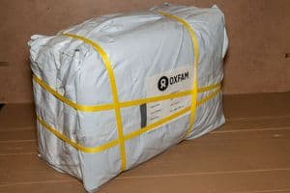
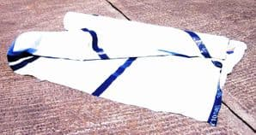
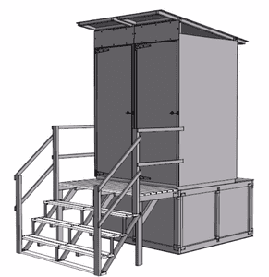
Main page
Emergency kits for latrine superstructure, suitable for first 3-4 months, camp settings
Page 4/4
Excreta disposal system
Assessment
Consultation
Monitoring
Modalities of implementation
Adaptation for easier access
Latrine superstructure
Sheeting, Reinforced Woven Plastic, Tarpaulin pieces – code SPT
Sheeting, Reinforced Woven Plastic, Roll – Code SPE
Latrine superstructure – Code LST
Material
Wind proofing
Environment
Privacy screen
Signage
Latrine kit, raised, with two cubicles – Code LRLT
Lock
Handwashing
Slab
Storage / pre-treatment pit
Desludging
Treatment
Final disposal
Continuity of service
Operation & maintenance
Reference: IFRC, Oxfam – A guide to the specification and use of plastic sheeting in humanitarian relief
Annexes

Slide 75
Main page
Wind proofing
Page 1/3
Excreta disposal system
Assessment
Foundation
Walls
During the consultation step verify if there are specific risks for building in relation to strong winds and if there is a dominant wind direction
Consultation
Monitoring
Modalities of implementation
Adaptation for easier access
Latrine superstructure
Material
Wind proofing
Environment
Privacy screen
Strong foundation to anchor the structure
Signage
Lock
Handwashing
Slab
Storage / pre-treatment pit
Desludging
Treatment
Final disposal
Continuity of service
Operation & maintenance
Annexes
Reference: Habitat for Humanity - Hurricane resistant wooden houses - safer building and retrofitting guidelines

Slide 76
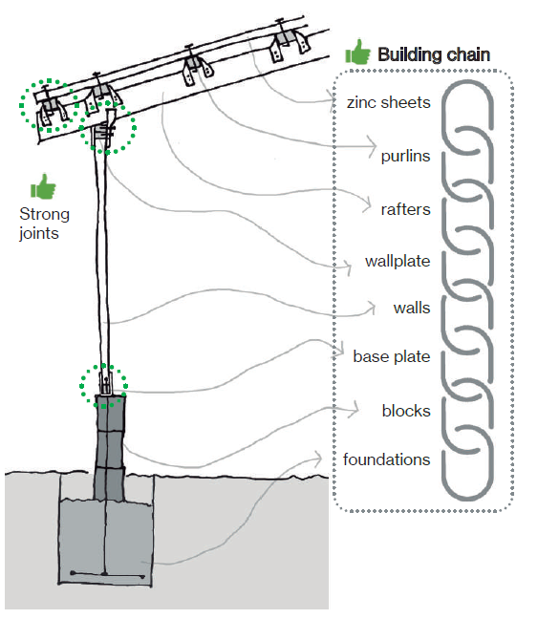
Main page
Page 2/3
Excreta disposal system
Roof
Tie bottom up
Assessment
Consultation
Monitoring
Modalities of implementation
Adaptation for easier access
Latrine superstructure
Material
Wind proofing
Environment
Privacy screen
Signage
Lock
Handwashing
Slab
Storage / pre-treatment pit
Desludging
Treatment
Final disposal
Continuity of service
Operation & maintenance
Annexes
Reference: Habitat for Humanity - Hurricane resistant wooden houses - safer building and retrofitting guidelines

Slide 77
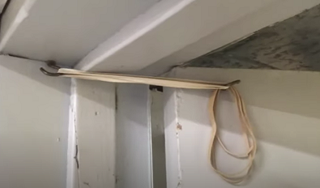
Main page
Page 3/3
Doors
Self-closing door to avoid swinging with the wind
Excreta disposal system
Assessment
Spring or elastic band installed at the top.
Consultation
Monitoring
Modalities of implementation
However, be ready to replace / repair regularly.
Adaptation for easier access
Latrine superstructure
Material
Wind proofing
Environment
Privacy screen
Signage
Lock
Handwashing
Slab
Storage / pre-treatment pit
Magnet
When the door is pushed back the magnet ensure the door stay closed
Desludging
Treatment
Final disposal
Weight hanging on a rope fixed to the door frame
Continuity of service
Operation & maintenance
Annexes

Slide 78
Main page
Environment considerations
Page 1/2
Excreta disposal system
Oxfam Ethical and Environmental purchasing policy
Assessment
Consultation
Environmental Standards
Oxfam is committed to reduce its reliance on finite/scarce resources and to minimise the environmental impact of its operations including its supply chain and will work to achieve the standards listed in this section.
Monitoring
Packaging:
  •Actively avoid undue and unnecessary packaging wherever practicable and use recycled and recyclable materials wherever appropriate.
Modalities of implementation
Adaptation for easier access
Climate change:
Monitor and actively seek to reduce the Greenhouse Gas (GHG) emissions associated with its operations and:
  •Set absolute GHG reduction targets for operations in industrialised countries or Economies in Transition, such as those identified in Annex I of the United Nations Framework Convention on Climate Change below
  •Set and report on targets for improved efficiency in countries where Oxfam runs programmes, such as those that may be regarded as non-Annex I countries under the UNFCCC
Wood and forest products:
  •Ensure that all forest products purchased are as a minimum legal in origin and provide evidence of due diligence to ensure this if requested by Oxfam
  •Suppliers of paper products sourced from Oxfam affiliate home country offices and retail products carrying the Oxfam Brand must source forest products from recycled sources or well managed forests which have been certified to a credible standard. Exceptions will be made for products which are Fairtrade marked or produced by members of the World Fair Trade Organisation as appropriate. Oxfam views the Forestry Stewardship Council (FSC) as the most credible certification for the sustainable sourcing of wood and forest products.
  •Suppliers must never knowingly become involved in, collude with or purchase timber from illegal logging operations.
Latrine superstructure
Material
Wind proofing
Environment
Privacy screen
Signage
Lock
Handwashing
Slab
Waste:
  •Reduce waste to landfill.
  •Monitor operations, including procurement, to ensure waste minimisation and high product and process efficiency.
  •Effective controls of waste in respect of ground, air, and water pollution are adopted.
Storage / pre-treatment pit
Desludging
Treatment
Conservation of biodiversity:
  •Seek to minimise the impact of operations on fauna, flora and land to ensure the conservation of biodiversity and habitats.
Final disposal
Continuity of service
Materials:
  •Reuse, recycling and the use of recycled and recyclable materials are strongly encouraged.
  •Avoid where practicable reliance on materials that are heavily dependent on finite resources.
Operation & maintenance
Water:
  •Develop a better understanding of its impact on water use and develop management processes where appropriate
Annexes

Slide 79

Main page
Page 1/2
Excreta disposal system
Oxfam International has signed the Climate and Environment Charter developed by ICRC / IFRC, committing to:
Assessment
Consultation
Monitoring
Include circular economy, environment protection and water security considerations into design
Modalities of implementation
Step up our response to growing humanitarian needs and help people adapt to the impacts of the climate and environmental crises View guidance for commitment 1
Maximize the environmental sustainability of our work and rapidly reduce our greenhouse gas emissions View guidance for commitment 2
Embrace the leadership of local actors and communities View guidance for commitment 3
Increase our capacity to understand climate and environmental risks and develop evidence-based solutions View guidance for commitment 4
Work collaboratively across the humanitarian sector and beyond to strengthen climate and environmental action View guidance for commitment 5
Use our influence to mobilise urgent and more ambitious climate action and environmental protection View guidance for commitment 6
Develop targets and measure our progress as we implement our commitments
Adaptation for easier access
Latrine superstructure
Material
Ensure Community Engagement is mainstreamed throughout the process of developing and implementing an excreta disposal system
Wind proofing
Environment
Privacy screen
Integrate Environmental Impact Assessment in the process of developing an excreta disposal system
Signage
Lock
Handwashing
Slab
Storage / pre-treatment pit
Desludging
Listen, feedback, identify and share local solutions adapted to local context and climate change impact
Treatment
Ensure construction with local materials (even if build by the users) doesn’t affect biodiversity and local ecosystems
Final disposal
Continuity of service
Operation & maintenance
Prefer solutions which minimize greenhouse gas emission (e.g., use recycled material, avoid charcoal burnt bricks, reduce methane emission by capturing and reusing as energy source, etc.)
Annexes

Slide 80
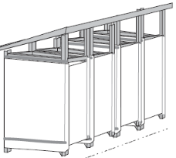
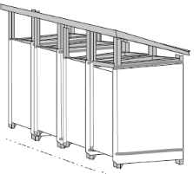
Main page
Privacy screen
Excreta disposal system
Assessment
For cultural and other reasons it can be important especially for women and girls not to be seen entering a toilet. In such situation a privacy screen can be added in front of latrine doors.
Consultation
Monitoring
Modalities of implementation
Adaptation for easier access
Latrine superstructure
Material
Wind proofing
Environment
Privacy screen
Signage
Cross bracing at corners
Lock
Bracing at least every 5 posts and should connect at 2/3 height of post
Handwashing
Slab
Storage / pre-treatment pit
Complete enclosed space, combining shower, latrines, handwashing stand, laundry station and drying clothes lines for menstrual hygiene management
Desludging
Treatment
Final disposal
For more on plastic sheeting quality and privacy issues See video Spotlight on privacy
Continuity of service
Operation & maintenance
Annexes
Reference: IFRC, Oxfam – A guide to the specification and use of plastic sheeting in humanitarian relief

Slide 81
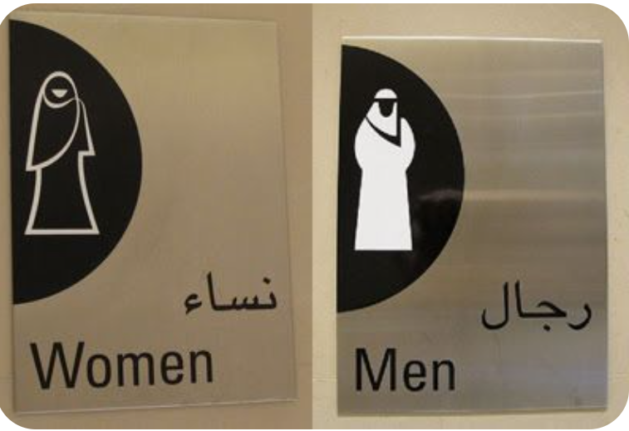






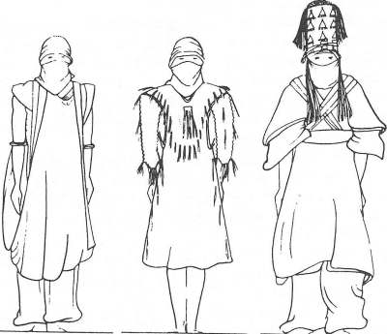



Main page
Signage
Excreta disposal system
Consult with users the best way to represent women and men latrines
Assessment
Signage need to consider literacy level and local custom representation for men and women
Consultation
Monitoring
Modalities of implementation
While in many countries men are traditionally represented with trousers and women with skirt, don’t assume it applies everywhere…
Adaptation for easier access
Latrine superstructure
Material
Wind proofing
Environment
Privacy screen
Signage
Lock
Handwashing
Slab
Storage / pre-treatment pit
Desludging
Treatment
Final disposal
e.g. Touareg men
Continuity of service
e.g. In Pakistan both women and men wear trousers under a tunic
Operation & maintenance
Various signages found on internet
Annexes
Oxfam Supply Centre – Code HMFLS

Slide 82
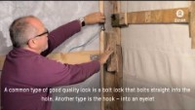
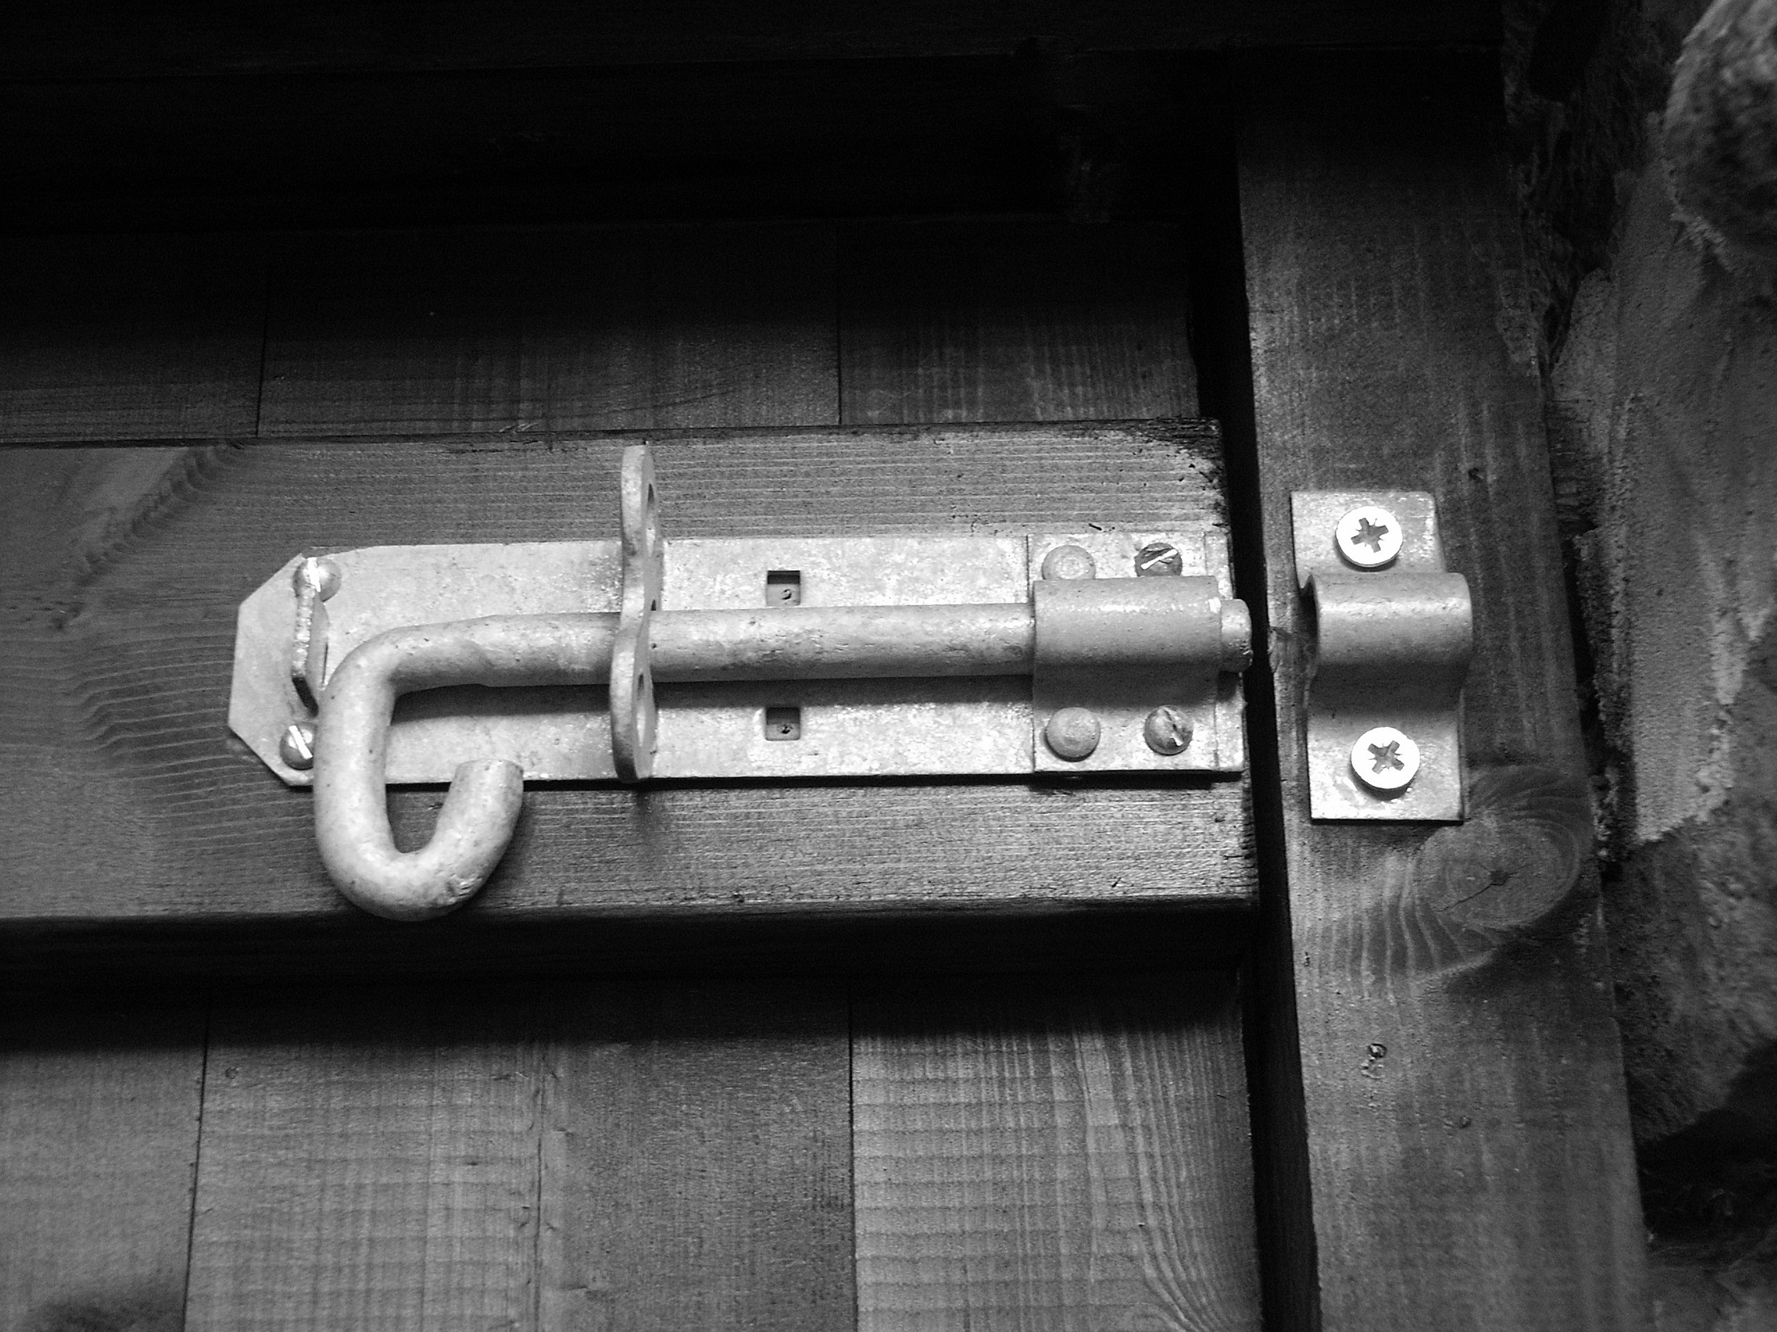
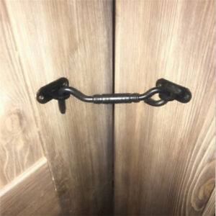

Main page
Lock
Video Spotlight on safety
Excreta disposal system
An internal lock is an important part of ensuring privacy and safety while using latrine
Assessment
Consultation
Monitoring
The most common internal locks used, both bolt and hook type of lock failed when wood door and frame change shape over time and use.
Modalities of implementation
Adaptation for easier access
Bolt lock
Latrine superstructure
Material
Wind proofing
Environment
Privacy screen
Signage
String lock
Lock
Handwashing
Slab
Storage / pre-treatment pit
Hook lock
Piece of wood to reinforce the frame on the outside of the door
Desludging
Treatment
Final disposal
Continuity of service
Operation & maintenance
String wrap around the nails several time to tight the door closed
String passed through a hole drilled through the door frame and piece of wood. Knotted on the outside
Piece of wood to reinforce inside wall of latrine with two nails sticking out
Annexes

Slide 83
Main page
Handwashing
Page 1/3
Excreta disposal system
Assessment
Handwashing is a critical practice that is promoted to protect public health, especially during outbreaks of infectious diseases such as COVID-19. Handwashing stations are used both in emergencies and in other contexts to provide locations for people to wash hands with soap. In refugee camps and internal displacement centres, units for handwashing should be installed both at households and next to latrines and in communal areas, such as in markets, schools, and health centres. The criteria for a good handwashing station include:
Consultation
Monitoring
Modalities of implementation
Principle Considerations
Cost
Maintenance required
Ability to limit hand contact by users with a tap interface (preferably with no touch or one touch action)
Accessibility, including for children, elderly and people with disabilities
Design that promotes usage through aesthetics, behavioural nudges, and ease of use
Robustness of design that can withstand misuse or vandalism and prevent theft
Additional Considerations
Ability to drain effectively without creating stagnant greywater
Availability and ease of assembly
Packability and ease of transport
Ability to conserve water
Adaptation for easier access
Latrine superstructure
Material
Wind proofing
Environment
Privacy screen
Signage
Lock
Handwashing
Slab
Handwashing stations can either be procured ready-made or they may be assembled locally.
Some of the units presented are completed products that have undergone years of research and development and thorough testing with end users.
Other options present design ideas for handwashing stations that can be constructed locally.
These design concepts require further adjustment to ensure they are reliable options for handwashing, especially when installed for communal use. Such handwashing stations should be tested not only for technical performance but for user satisfaction, correct use, and degree to which they are successful in promoting handwashing behaviour.
Storage / pre-treatment pit
Desludging
Treatment
Final disposal
Continuity of service
Operation & maintenance
Annexes
Reference: Oxfam – Handwashing stations Technical Briefing Note and the following for further reading The Sanitation Learning Hub – Handwashing compendium for Low Resource Settings

Slide 84
Main page
Page 2/3
Excreta disposal system
Assessment
Consultation
Completed Products
1. Oxfam Handwashing Station
2. Oxfam Handy Wash Tap
3. Jengu (by ARUP, BRC, and LSHTM)
Monitoring
Modalities of implementation
Adaptation for easier access
Latrine superstructure
Material
Wind proofing
Environment
Privacy screen
Signage
Lock
Handwashing
Slab
Storage / pre-treatment pit
Desludging
Treatment
Final disposal
Continuity of service
Operation & maintenance
Annexes
Reference: Oxfam – Handwashing stations Technical Briefing Note

Slide 85
Main page
Page 3/3
Excreta disposal system
Ideas for Local Assembly
4. Twin Foot Pedal Design (by WaterAid Nepal)
5. Single Foot Pedal Design
6. Long Handled Taps
Assessment
Consultation
Monitoring
Modalities of implementation
Adaptation for easier access
Latrine superstructure
Material
Wind proofing
Environment
Privacy screen
Signage
Lock
Handwashing
Slab
Other Options for Households
7. Happy Tap
8. SpaTap
9. Oxfam Bucket
10. Tippy Tap
11. Soapy Water Bottle
Storage / pre-treatment pit
Desludging
Treatment
Final disposal
Continuity of service
Operation & maintenance
Annexes
Reference: Oxfam – Handwashing stations Technical Briefing Note

Slide 86
Main page
Excreta disposal system
Tension and compression forces in a slab
Assessment
A concrete slab will stay rigid and crack where tension is the highest unless rebars are used or if the slab has a dome shape.
Consultation
How much water is available for flushing? Consult with users to understand how easy or complicate is their access to water. Include an analysis of drought impact
Monitoring
User weight
Modalities of implementation
Top face in compression
Adaptation for easier access
Latrine superstructure
Slab
Requirement
A plastic slab will bounce under the weight of the user, affecting users’ trust and potentially scaring children
Material
Waterproofing
Bottom face in tension
Cleaning
No flexion of the slab
Sitting
Storage / pre-treatment pit
Desludging
Section slab - direct drop toilet.
Section slab - offset pit
Treatment
Fractures
Final disposal
Continuity of service
Without lining consolidated soil capacity to withstand the weight may erode with time and water
Operation & maintenance
Annexes

Slide 87
Main page
Requirement
Pre-test your slab when consulting users
Excreta disposal system
A latrine slab serves two main purposes, as a support and as a seal. It must support the weight of the person using the latrine and, possibly, the weight of the superstructure. It also seals the pit, except for the squat hole and, where required, the vent pipe hole. This facilitates control of flies and smells and reduces the likelihood of rodents and surface water entering the pit. Where the slab has been made in sections (for ease of placing and emptying) or has a removable cover, the joints should be sealed with a weak mortar such as a lime or mud mortar.
Assessment
Consultation
Monitoring
Cleanliness. The slab needs to be suitable for cleaning. Rough wood or rough concrete quickly becomes dirty and difficult to clean.
Surface texture. A smooth slab may be easy to clean, but if it is too smooth, then it may be slippery when wet. The inner surface of a pour-flush pan needs to be very smooth, so the faeces can be easily washed away.
Durability. If the slab is going to last and not collapse suddenly, it needs to be resistant to rot and termite attack. It should also withstand repeated washing.
Modalities of implementation
Adaptation for easier access
Latrine superstructure
Slab
Slab slope. water should be directed toward the hole and away from the sides (in case of UDDT the slope should channel water toward a soakaway pit)
Water resistance. Urine, water for anal and menstrual cleansing and water for washing the slab will make the slab wet, so it needs to be able to withstand this and allow excess water to drain away, normally into the vault.
Requirement
Material
Waterproofing
Cleaning
Sitting
Storage / pre-treatment pit
Seal. Gaps between slab and lining / pit walls sealed with soil
Desludging
Treatment
Final disposal
Colour. To see if the slab is clean and to check for spiders, snakes or other creatures, users may prefer particular colours. Cultural and religious affiliations may influence such preferences too.
Strength. The slab needs to be strong enough to support the weight of the user, and perhaps someone to assist them. It needs to look strong to give people the confidence to use it.
Continuity of service
Operation & maintenance
Reuse. Once the pit is full, the slab may have to be moved, either to gain access to the vault so it can be emptied or moved to a new site.
Annexes
Reference: WHO - A guide to the development of on-site sanitation / R Franceys, J Pickford & R Reed and WEDC – Latrine slabs: construction material

Slide 88
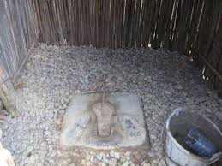
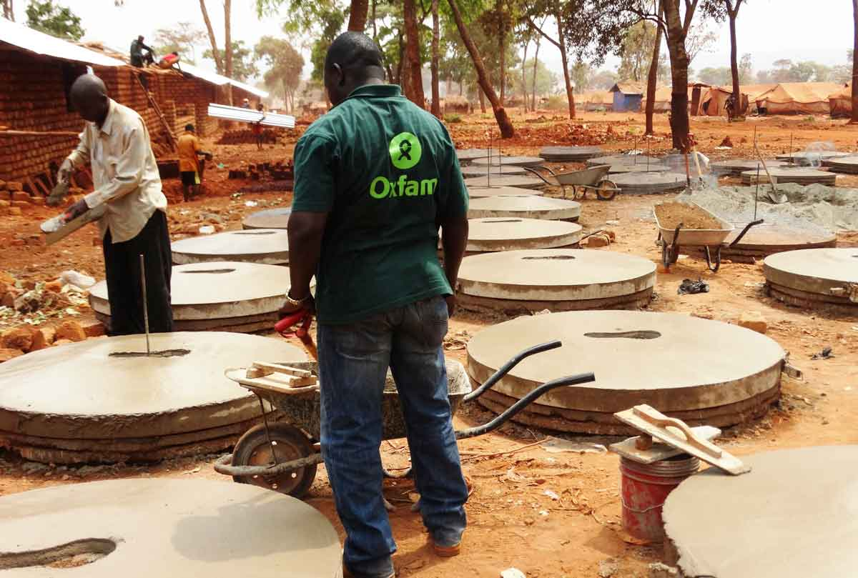
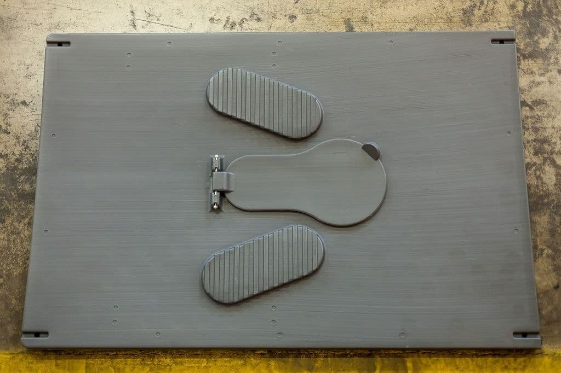
Main page
Material
Page 1/3
Excreta disposal system
Non-supporting slab
Self- supporting slab
Assessment
Consultation
Monitoring
Unreinforced concrete
Dome
Modalities of implementation
SanPlat
Adaptation for easier access
Latrine superstructure
Slab
Slab thickness (mm) | Steel bar diameter (mm) | Spacing of steel bars (mm) for minimum slab span of
 |  | 1 m | 1.25 m | 1.5 m | 1.75 m | 2 m
65 | 6 | 150 | 150 | 125 | 75 | 50
 | 8 | 250 | 250 | 200 | 150 | 125
80 | 6 | 150 | 150 | 150 | 125 | 75
 | 8 | 250 | 250 | 250 | 200 | 150
Requirement
Reinforced concrete
Material
Waterproofing
Cleaning
Sitting
Storage / pre-treatment pit
Desludging
Treatment
Squatting plate,plastic,80x60cm
Latrine Slab, Plastic Self Supporting – Code LOPN
1.2m long x 0.8m wide x 35mm thick
Final disposal
Continuity of service
Plastic
Operation & maintenance
Annexes

Slide 89
Main page
Durable timbers such as the heartwood of some tropical hardwoods are normally too expensive for use in latrines but, where available, may be expected to last satisfactorily for several years.
Page 2/3
Wood
Self- supporting slab
Excreta disposal system
Assessment
Consultation
The life of a rough timber slab can be extended by using a mixture of soil and cement to plaster and protect the wood. Alternatively, a thin cement mortar screed can be laid over the surface of the earth to protect against hookworm and to improve hygiene. However, it is usually more cost-effective to use the cement to provide a permanent concrete slab which can be transferred to a new pit when the first is filled. Where more than half a bag of cement is needed to stabilize the earth, a concrete slab is likely to be a cheaper alternative.
Monitoring
Modalities of implementation
Adaptation for easier access
Latrine superstructure
In an area where timber is abundant, hewn or sawn logs supporting a platform of wooden planks make a floor that is preferable to the mud and pole version (Fig. 7.23). The surface can be kept clean, and signs of imminent collapse are normally apparent to the adult user. The durability of timbers may be improved by some form of treatment.
Slab
Requirement
Material
The cost and environment impact of the wood treatment options need to be examined
Waterproofing
Cleaning
Sitting
Storage / pre-treatment pit
Desludging
A thick layer of earth or mud is often spread over the poles or branches to bind them together and create a smooth surface (Fig. 7.22). In many places, people are skilled at making mud floors which are almost as hard as cement and quite smooth. They need not be rough or unsanitary. There are various methods of improving the mud with local materials, such as mixing the soil with a liquor obtained by soaking animal dung overnight. In some areas the mud is mixed with charcoal or other small aggregate, or with cow dung and then smeared with ashes. Alternatively, the mud from ant-hills has been found to make a hard, practically waterproof surface (Denyer, 1978).
Treatment
Final disposal
Continuity of service
Operation & maintenance
Annexes
Reference: WHO - A guide to the development of on-site sanitation / R Franceys, J Pickford & R Reed

Slide 90
Main page
Footrests and squat holes
Page 3/3
Excreta disposal system
Assessment
Consultation
Avoid large and wide hole sizes if small children will use the latrine
Monitoring
Modalities of implementation
Adaptation for easier access
Latrine superstructure
Slab
Requirement
Water seals and pans
Material
Waterproofing
Cleaning
Sitting
Can be made in ceramic, concrete, plastic, etc.
Its weight need to be considered into the design of the slab
Storage / pre-treatment pit
Desludging
Treatment
Final disposal
Verify how easy it is to flush the pan (how many litres are required) considering users’ access to water
Continuity of service
Operation & maintenance
Annexes
Reference: WHO - A guide to the development of on-site sanitation / R Franceys, J Pickford & R Reed

Slide 91
Main page
Water proofing
Excreta disposal system
Assessment
Consultation
When locating sanitation infrastructures pay attention to topography to ensure water runoff path does not cross where latrines are located.
You can get information from local population on drainage pattern during the consultation process.
Monitoring
Modalities of implementation
Adaptation for easier access
Latrine superstructure
Slab
Requirement
Material
Waterproofing
Cleaning
Sitting
Shape a drainage channel under the overhanging roof edge to collect and evacuate rain dripping from the roof
Storage / pre-treatment pit
Desludging
Seal with soil the spaces between slab and pit walls
Treatment
Final disposal
Continuity of service
Soil shaped into a bank to divert rain and water runoff from the latrine pit
Seal the side of the latrine walls by covering the extra length of plastic sheeting with soil
Operation & maintenance
Annexes

Slide 92
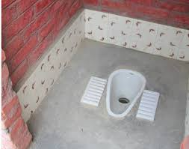




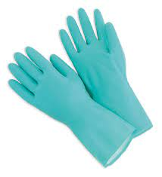
Main page
Cleaning
Excreta disposal system
Assessment
A washable slab (plastic, ceramic, concrete, wood covered with plastic sheeting)
Designated people for daily cleaning duty
Consultation
Monitoring
Modalities of implementation
Adaptation for easier access
Public toilet
Family and family shared toilet
Latrine superstructure
WASH committee
Users
Slab
Requirement
Material
Waterproofing
Latrine cleaning kit adapted to context
Cleaning
Sitting
Storage / pre-treatment pit
Desludging
Treatment
If payment of latrine attendants is considered it should be restricted to public toilets, with a fee contribution scheme from users for sustainability or with a clear transition plan and communication toward users taking over (e.g. when transitioning to family shared or family latrines)
Final disposal
Continuity of service
Operation & maintenance
Annexes

Slide 93
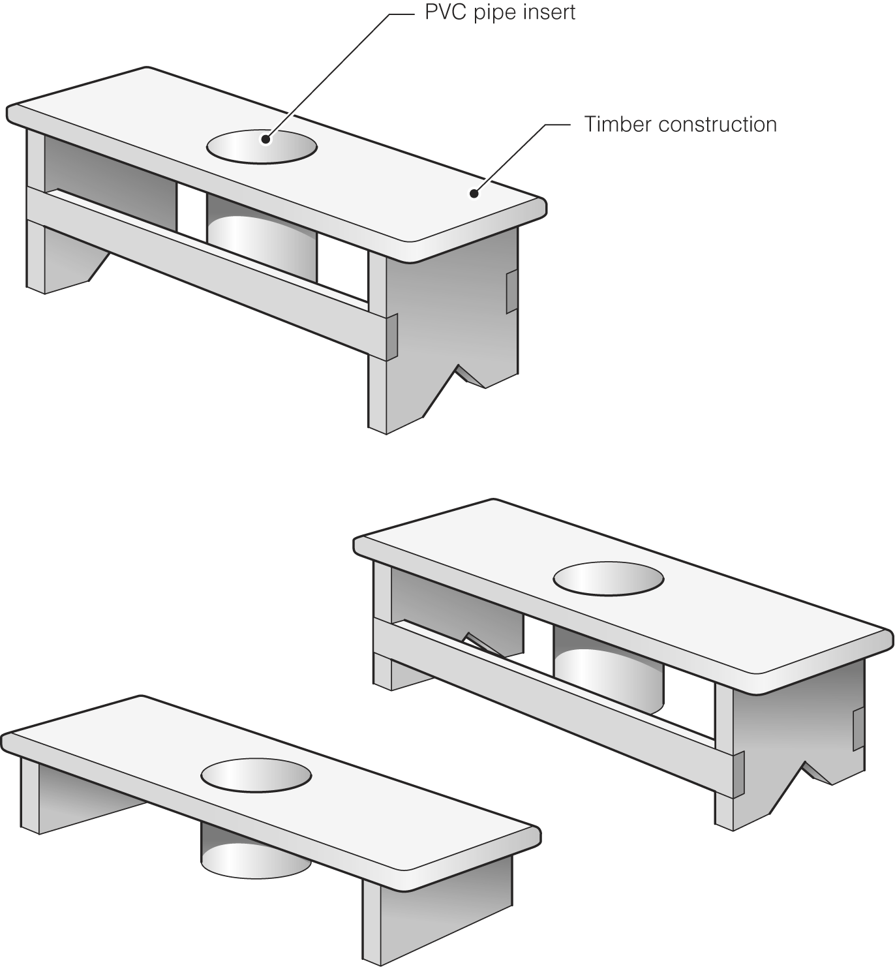
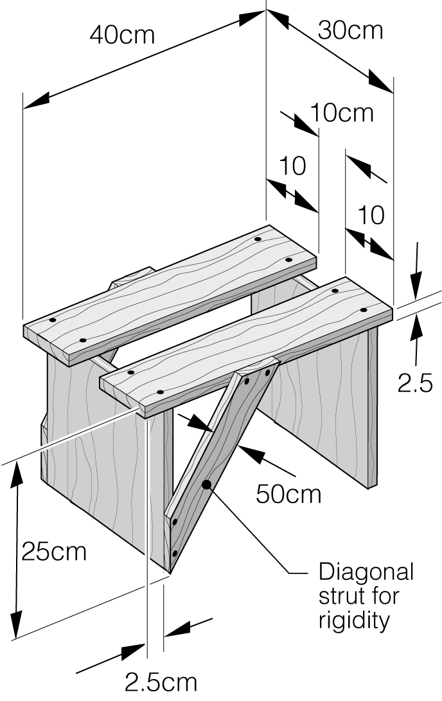
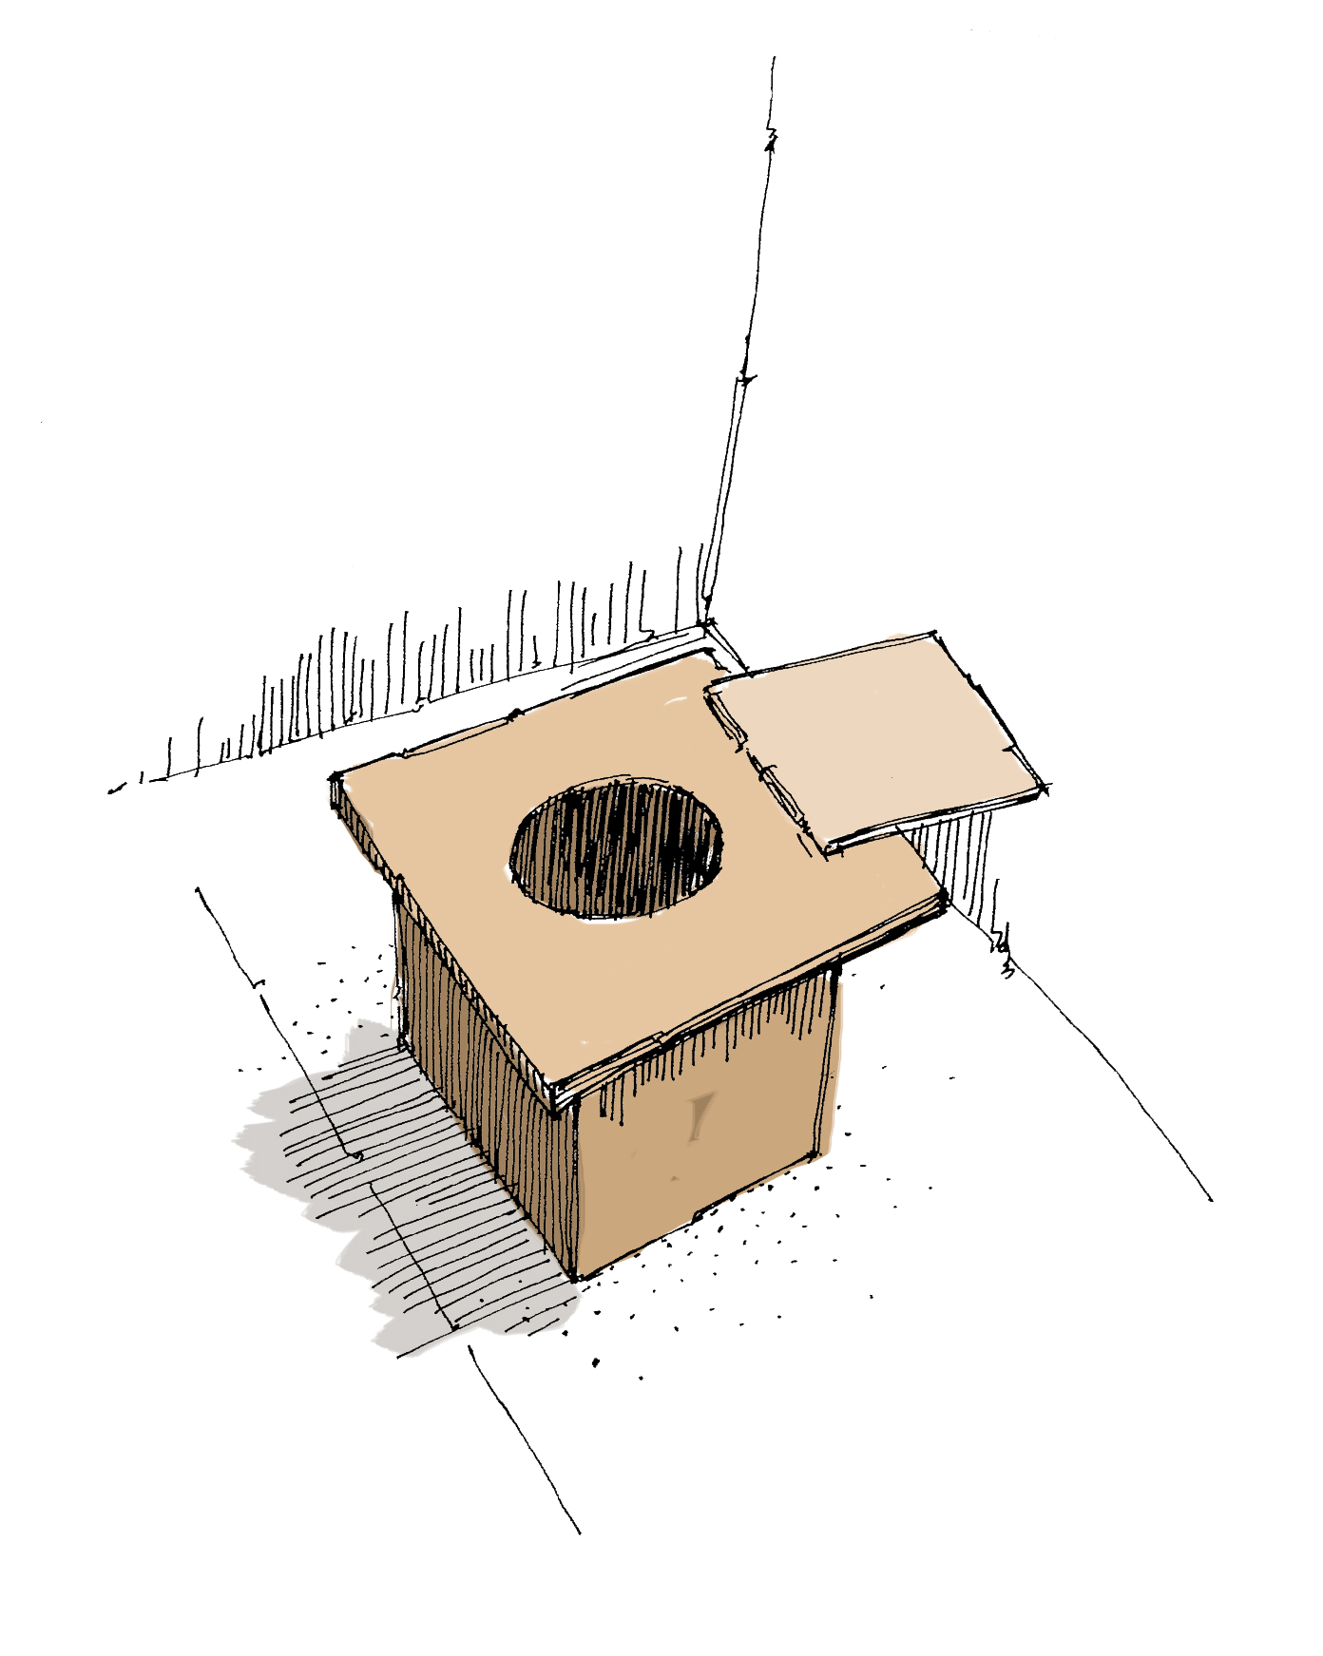
Main page
Sitting
Excreta disposal system
In many parts of the world, people prefer to sit to defecate. To make a latrine seat, a support or pedestal is built or mounted on top of the slab. The seat level should be at a position that is comfortable for the majority of the users (Fig. 7.26); this is normally about 350 mm above the top of the slab.
The seat support can be made on site from brick, concrete, mud block or timber and should be designed to minimize the load on the slab. A heavy type of construction adds weight to the slab which then requires more expensive reinforcement to carry the load. Commercially available or project-manufactured pedestals made of ceramic, glass reinforced plastic (GRP), PVC or ferrocement can also be used where people can afford them.
Assessment
Consultation
Monitoring
Modalities of implementation
Adaptation for easier access
Reference: WHO - A guide to the development of on-site sanitation / R Franceys, J Pickford & R Reed
Latrine superstructure
Slab
Wood seats
Requirement
Material
Waterproofing
Cleaning
Sitting
Storage / pre-treatment pit
Desludging
Special seats
Reference: WEDC repository
Treatment
Reference: GTZ – Technology Review of UDDTs
Final disposal
For sitting, wood can be warmer and smoother than concrete but perhaps more difficult to keep clean. Wooden seats are simpler to make locally. Plastic can be easy to clean but, if flexible, can be disconcerting to use. Concrete blocks are strong but not very comfortable.
Reference WEDC – Latrine slabs: construction material
Continuity of service
Operation & maintenance
Annexes

Slide 94
Main page
Excreta disposal system
The need for a pit lining depends upon the type of latrine under construction and the condition of the soil, as well as desludging service
Assessment
Consultation
Monitoring
Modalities of implementation
Adaptation for easier access
Latrine superstructure
Slab
Storage / pre-treatment pit
Soil considerations
Pre-treatment
Lining options
Grey water
Desludging
Treatment
Final disposal
Continuity of service
Operation & maintenance
Circular shapes are stronger than rectangular !
Annexes
Reference: WEDC – Latrine pit design booklet

Slide 95
Main page
Page 1/2
Soil considerations
Excreta disposal system
Assessment
Ground conditions
Ground conditions affect the selection and design of sanitation systems, and the following five factors should be taken into consideration:
Consultation
Bearing capacity of the soil
All structures require foundations, and some soils are suitable only for lightweight materials because of their poor load-carrying capacity - marshy and peaty soils are obvious examples.
Monitoring
Modalities of implementation
Adaptation for easier access
Self-supporting properties of the pits
Many soils may appear to be self-supporting when first excavated, particularly cohesive soils, such as clays and silts, and naturally bonded soils, such as laterites and soft rock. These self-supporting properties may well be lost over time owing to changes in the moisture content or decomposition of the bonding agent through contact with air and/or moisture. It is almost impossible to predict when these changes are likely to occur or even if they will occur at all. It is therefore safer to line the pit. The lining should permit liquid to percolate into the surrounding soil.
Latrine superstructure
Slab
Storage / pre-treatment pit
Depth of excavation
Loose ground, hard rock or groundwater near to the surface limit the depth of excavation possible using simple hand tools. Large rocks may be broken if a fire is lit around them and then cold water poured on the hot rock. Excavation below the water table and in loose ground is possible by "caissoning", but it is expensive and not usually suitable for use by householders building their own latrines.
Soil considerations
Pre-treatment
Lining options
Grey water
Desludging
Caisson waterproofing must be ensured when the water table is less than 1.5m. In addition Archimedes law may apply if the caisson is reached by water with a thrust force moving the caisson up and damaging it. All in all not a good idea…
Treatment
Pore clogging
Soil pores eventually become clogged by effluent from pits or drainage trenches. This may reduce or even stop infiltration through the soil. Clogging may be caused by:
- blockage of pores by solids filtered from the liquid;
- growth of microorganisms and their wastes;
- swelling of clay minerals; and
- precipitation of insoluble salts.
Final disposal
Continuity of service
Operation & maintenance
Annexes
Local knowledge can help determine such risks
Reference: WHO - A guide to the development of on-site sanitation / R Franceys, J Pickford & R Reed

Slide 96
Main page
Page 2/2
Excreta disposal system
Assessment
Infiltration rate
The soil type affects the rate at which liquid infiltrates from pits and drainage trenches. Clays that expand when wet may become impermeable. Other soils such as silts and fine sands may be permeable to clean water but become blocked when transmitting effluent containing suspended and dissolved solids.
The rate of infiltration also depends on the level of the groundwater table relative to the liquid in the pit or trench. In the unsaturated zone, the flow of liquid is induced by gravity and cohesive and adhesive forces set up in the soil. Seasonal variation may produce a change in the amount of air and water in the soil pores and this will affect the flow rate. Conditions at the end of the wet season should normally be used for design purposes as this is usually the time when the groundwater level is at its highest. In the saturated zone all pores are filled with water and drainage depends on the size of the pores and the difference in level between the liquid in the pit or trench and the surrounding groundwater.
Soil porosity also affects infiltration. Soils with large pores, such as sand and gravel, and rocks such as some sandstones and those containing fissures, drain easily. Silt and clay soils, however, have very small pores and tend to retain water. Soils containing organic materials also tend to retain water, but the roots of plants and trees break up the soil, producing holes through which liquids can drain quickly.
The rate of groundwater flow in unsaturated soils is a complex function of the size, shape and distribution of the pores and fissures, the soil chemistry and the presence of air. The speed of flow is normally less than 0.3 m per day except in fissured rocks and coarse gravels, where the speed may be more than 5.0 m per day, with increased likelihood of groundwater pollution.
Consultation
Monitoring
Modalities of implementation
Adaptation for easier access
Latrine superstructure
Slab
Storage / pre-treatment pit
Soil considerations
Pre-treatment
Determining infiltration rates
Lining options
Grey water
Desludging
Treatment
Final disposal
In fissured rocks conditions, it’s advised to add sand at the bottom to create a biological filtration layer and reduce pollution (minimum thickness 0.5m)
Continuity of service
Operation & maintenance
Annexes
Reference: WHO - A guide to the development of on-site sanitation / R Franceys, J Pickford & R Reed

Slide 97
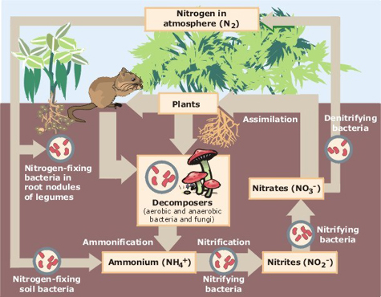


Main page
Pre-treatment
Page 1/3
Excreta disposal system
As soon as excreta are deposited, they start to decompose, eventually becoming a stable material with no unpleasant smell and containing valuable plant nutrients. During decomposition the following processes take place.
• Complex organic compounds, such as proteins and urea, are broken down into simpler and more stable forms.
• Gases such as ammonia, methane, carbon dioxide and nitrogen are produced and released into the atmosphere.
• Soluble material is produced which may leach into the underlying or surrounding soil or be washed away by flushing water or groundwater.
• Pathogens are destroyed because they are unable to survive in the environment of the decomposing material.
Assessment
Consultation
Monitoring
Modalities of implementation
Adaptation for easier access
Latrine superstructure
O2
The decomposition is mainly carried out by bacteria although fungi and other organisms may assist. The bacterial activity may be either aerobic, i.e., taking place in the presence of air or free oxygen (for example, following defecation and urination on to the ground), or anaerobic, i.e., in an environment containing no air or free oxygen (for example, in a septic tank or at the bottom of a pit). In some situations, both aerobic and anaerobic conditions may apply in turn. When all available oxygen has been used by aerobic bacteria, facultative bacteria capable of either aerobic or anaerobic activity take over, and finally anaerobic organisms commence activity.
Reference: Wikipedia
Slab
Storage / pre-treatment pit
Soil considerations
Pre-treatment
Lining options
Grey water
Desludging
Treatment
O2
Final disposal
Continuity of service
Operation & maintenance
Pathogens may be destroyed because the temperature and moisture content of the decomposing material create hostile conditions. For example, during composting of a mixture of faeces and vegetable waste under fully aerobic conditions, the temperature may rise to 70°C, which is too hot for the survival of intestinal organisms. Pathogens may also be attacked by predatory bacteria and protozoa, or may lose a contest for limited nutrients.
Annexes
Reference: WHO - A guide to the development of on-site sanitation / R Franceys, J Pickford & R Reed

Slide 98
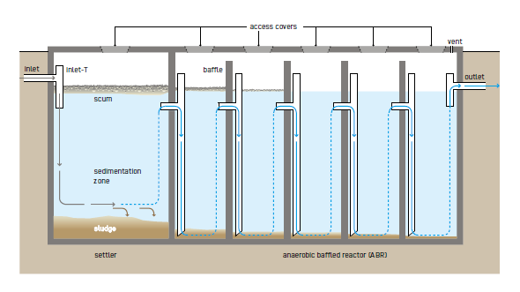
Main page
Page 2/3
Safe Treatment
Excreta disposal system
Assessment
Where possible and if the numbers are below 20,000 on site treatment, septic tanks, biogas or Anaerobic Baffled Reactor (ABR) with leachfields, Urine Diversion Dehydration Toilet (UDDT), or Tiger Worm toilets should be used to decrease desludging, transportation and disposal costs. However, all of these technologies need desludging at some point and that needs to be factored into the design and service provision. Compared the estimated desludging times for Communal pit latrine (trench 3x4x1m) which is 3 months with on-site treatment in emergency contexts
Consultation
Monitoring
Modalities of implementation
Anaerobic Treatment
Adaptation for easier access
Latrine superstructure
Slab
Storage / pre-treatment pit
Soil considerations
Pre-treatment
Septic Tanks – desludged every 2 years
ABR – desludged every 6 years
Biogas – Desludged every 6 years
Lining options
Grey water
Desludging
Dehydration
Vermi-composting
This is a design parameter. Any duration increase before desludging and the risk to clog the percolation filter with sludge increase as well as cost for repair and maintenance
Treatment
Final disposal
Continuity of service
Operation & maintenance
Annexes
Reference “Compendium of sanitation technologies in Emergencies”
Double vault UDDT – desludged every 1 year
Tiger Worm Toilets – desludged every 5 years

Slide 99
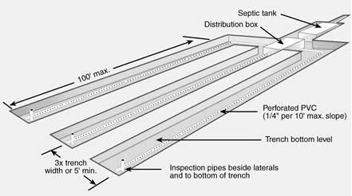
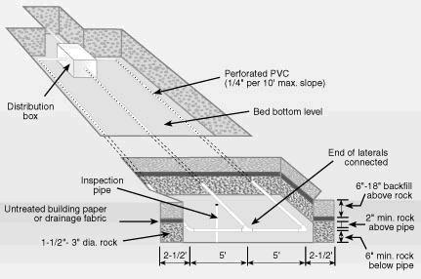
Main page
Septic tank, Biogas digester, ABRs and UDDT must be connected to infiltration system to dispose of effluent
Page 3/3
Excreta disposal system
Assessment
Vertical percolation
Horizontal percolation
Consultation
Monitoring
Modalities of implementation
Adaptation for easier access
Latrine superstructure
Slab
Storage / pre-treatment pit
Soakaway pit (e.g. in association with UDDT for managing cleaning water) for small effluent volume
Soil considerations
Leach field (e.g. in association septic tank) for larger effluent volume.
Pre-treatment
Lining options
During the consultation process, be attentive to potential co-benefit, such as urban forestry development, aquifer recharge
Grey water
Sewerage pipes
Desludging
Treatment
Simplified sewerage to connect several latrines to one pre-treatment unit such as septic tank, ABR or biogas digestor:
Pipe diameter 100 to 200 mm
Minimum slope 1% for self-cleansing and water consumption at least 50l/p/d (or minimum 0.5% slope with a minimum water consumption of 60 l/p/d)
Inspection box at each household with grease trap if kitchen grey water is collected
Simple inspection chamber diameter 400 to 600 mm (at junction, direction change, slope change, every 50 m for inspection and cleaning / unblocking pipe)
Depth minimum 30 cm (no pressure from vehicle traffic) or 60 cm under vehicle access road
Outline as straight and short as possible
Attention need to be paid to pipe and inspection chambers’ foundation to avoid movement and future counter slopes. A trained O&M team should be in place to deal with blockage and maintenance.
Final disposal
Continuity of service
Operation & maintenance
Annexes
Successful operation requires clearly defined responsibilities between service provider and users
Reference: GRET – Memento de l’assainissement and “Compendium of sanitation technologies in Emergencies”

Slide 100
Main page
Lining options
Page 1/3
Excreta disposal system
Assessment
Lining is needed when the soil is unstable or if it will become unstable due to water seeping up / in during rainy season or when desludging is required as the mechanical vacuum process will cause the wall to collapse
Consultation
Monitoring
Modalities of implementation
Foundations
Nearly all linings need a foundation to prevent the lining sinking into the
ground below. In firm soils a simple pad foundation about three times the width of the linings is sufficient (see Figure 7a). The foundation is usually made of the same material as the lining.
In soft ground a thicker foundation may be needed. Cover the base with a 10 to 15cm layer of compacted mixed stone and construct the foundation on that (see Figure 7b).
When only partially lining the pit, leave a step in the pit wall on which to build the foundation (see Figure 7c).
Adaptation for easier access
Latrine superstructure
Slab
Storage / pre-treatment pit
Soil considerations
Pre-treatment
Lining options
Grey water
Desludging
Treatment
Final disposal
Continuity of service
Operation & maintenance
Annexes
Reference: WEDC – Latrine pit excavation and linings

Slide 101


Main page
Page 2/3
Excreta disposal system
Assessment
Consultation
Monitoring
Modalities of implementation
Adaptation for easier access
Latrine superstructure
Slab
Storage / pre-treatment pit
Soil considerations
Fig-1- Simple Pit Lining with Sandbags
Pre-treatment
Lining options
Grey water
Sand bags are cut and stitched in oblong shape.
Be careful, over time the top sand bags will tear from the weight and pressure exercised by the slab
Desludging
Treatment
Final disposal
Continuity of service
Operation & maintenance
Annexes
Fig-2- Communal Trench Pit Lining with Bricks

Slide 102


Main page
Page 3/3
Excreta disposal system
Assessment
Consultation
Plastic lining
Monitoring
Modalities of implementation
Adaptation for easier access
Latrine superstructure
Slab
Storage / pre-treatment pit
Soil considerations
Pre-treatment
Bamboo cage lining.
Overtime the bamboo will deteriorate but should last 1 to 2 years (check local knowledge)
Lining options
Grey water
Desludging
Treatment
Final disposal
Continuity of service
Operation & maintenance
Annexes

Slide 103
Main page
Grey water
Grey water (because of its colour and also called sullage) consists of the liquid wastes from domestic activities such as bathing, laundry, food preparation etc. but EXCLUDING excreta related liquids, sometimes known as black water.
Excreta disposal system
Assessment
Consultation
The most common sources in emergency settings are:
Water taps;
Kitchens/feeding centres;
Laundries;
Bathing areas; and
Health care centres.
Monitoring
Typical grey water contamination from various sources
Source | Contamination
Kitchens | Cooked and uncooked animal and vegetable food waste, oils and fats, soap, silt and grit
Laundry | Laundry soap, silt and grit, oil, faeces, blood, urine
Bathing | Bathing soap, faeces, silt and grit, blood, urine
Health care centres | All of the above depending on the type of facility
Note: The faeces, blood and urine in laundry and bathing sullage is usually very low but can be significant from health care centres.
Modalities of implementation
Adaptation for easier access
Latrine superstructure
Typical grey water volumes from public institutions (Based on [2])
Institution | Sullage volume
Field hospital | 40 - 60 litres/patient/day
Hospital with operating theatres | 100 litres/intervention
Out-patient clinics | 5 litre/patient/day
Cholera treatment centre | 50 litres/patient/day 10 litres/carer per day
Viral haemorrhagic fever centre | 300–400 litres/patient/day
Feeding Centre | 25 litres/person/day 10 litres/carer/day
Public bathing area – piped water provided | 100 litres/user*
– no piped water provided | 20 litres/user
Public laundry area – piped water provide | 100 litres/user*
– no piped water provided | 20 litres
Public water points | 5 – 20 litres/user*
Note: * These numbers vary widely dependent on the quality of the control mechanism on the pipe outlet and the management of the facility.
Slab
Storage / pre-treatment pit
Risks for latrine created by grey water
Filling of latrine pits
Pit wall erosion and potential collapse
Obstruction of access paths and walkways;
Other risks created by grey water
Breeding sites for water related insect vectors
Soil erosion around temporary shelters
Filling of solid waste pits
Pollution of surface and groundwater
Reduced moral from living in a contaminated environment
Soil considerations
Pre-treatment
Lining options
Grey water
Desludging
Treatment
Final disposal
Grey water treatment options:
Gross solids removal
Grease traps
Settlement tanks
Reed beds
Continuity of service
Operation & maintenance
Grey water disposal technology options:
Infiltration
Evapotranspiration (ponds or beds)
Irrigation
Surface water diffusion
Reuse
Can be treated with black water and excreta, depending on the type of pre-treatment (septic tank) and treatment options (reed bed)
Annexes
Reference: R. Reed – Engineering in Emergencies – Sullage disposal

Slide 104
Main page
Excreta disposal system
Assessment
Consultation
What are the investment cost and operation & maintenance cost of the desludging system? Is it affordable in the short / medium / long term?
Monitoring
Modalities of implementation
Adaptation for easier access
When choosing a desludging system, pay attention to accessibility and manoeuvrability.
Latrine superstructure
How bulky is the pumping system, and how near / far from the pit can it be located?
Is there a desludging hole or should the defecation hole be used?
Slab
Can the system be locally manufactured or need to be imported?
Storage / pre-treatment pit
Lining options
Desludging
How easy is it to use?
Manual
Mechanical
Safe handling
Is the desludging system combined with a tank for safe transport or should you purchase separately a safe transportable container?
Treatment
Final disposal
Continuity of service
How thick is the sludge. Will water be needed to dilute before pumping out?
Operation & maintenance
Annexes

Slide 105


Main page
Manual desludging
Page 1/2
Excreta disposal system
Diaphragm handpump
Sludge Gulper IV
Oxfam Supply Centre – Code LDP
Assessment
Low cost, can be build locally
The Gulper 4 is a manual desludging pump for emptying toilet pits and septic tanks. It is an upgraded version of the previous Gulper pump, offering an increased pumping head of approximately 3 m and a delivery head of approximately 3 m. The pump uses flexible piping that allows for a closed system to pump directly to the back of a truck and reduces spillage. The pump has been fabricated with UK-based company BuildWorks and is currently being replicated in with local fabricators in Uganda, Malawi, Rwanda and Honduras. The engineering drawings for this pump are open-source and available from Water For People.
Consist of a rigid, disc shaped body clamped to a flexible rubber membrane called a diaphragm. An airtight seal between the diaphragm and the disc forms a cavity. To operate the pump, the diaphragm is alternately pushed and pulled causing it to deform into concave and convex shapes in the same way a rubber plunger is used to unblock a toilet.
Consultation
Monitoring
Modalities of implementation
Adaptation for easier access
Latrine superstructure
Slab
Storage / pre-treatment pit
Desludging
Nibbler
Manual
Mechanical
Collect medium viscosity sludge using a continuous roller chain loop enclosed in a PVC pipe.
Safe handling
Treatment
Others
Final disposal
Continuity of service
Human-powered vacuum system for the collection and short-distance transport of sludge called the Manual Pit Emptying Technology (MAPET). Due to issues with spare parts and high capital cost this technology was discontinued.
Operation & maintenance
Due to limited success during trials, development of the nibbler was suspended.
Annexes
Beaumont manual pump: a basic piston pump designed to intervene in small space, easy to repair, the SP10 - Human Powered Sludge Pump is still under development with the 4th iteration.
Continuous chain device [Sugden, 2008]
Reference: Feacal sludge management – Systems approach for Implementation and Operation

Slide 106
Main page
Page 2/2
Excreta disposal system
Assessment
The gulper IV version has a 3m pumping head, capital cost from 200 USD (local production) - 1,400 USD (UK manufacturer)
The PVC riser pipe has been replaced by a flexible pipe not prone to cracking
Consultation
Monitoring
Modalities of implementation
Adaptation for easier access
Latrine superstructure
Slab
Storage / pre-treatment pit
Desludging
Manual
Mechanical
Safe handling
Treatment
Final disposal
Continuity of service
Operation & maintenance
Annexes
Reference: Feacal sludge management – Systems approach for Implementation and Operation

Slide 107



Main page
Diaphragm Sludge pump
Mechanical desludging
Page 1/2
Excreta disposal system
Motorised pit screw auger
Oxfam Supply Centre – Code LDD3
Assessment
Trash pump
Some of the challenges faced by the motorised PSAs include (Still and O’Riordan, 2012; Still and Foxon, 2012):
• complicated emptying process due to the fixed length and rigidity of the auger and riser pipe;
• unsuitability for use with dry sludge and large amounts of non-biodegradable waste;
• difficulties with cleaning after use; and
• difficulties manoeuvring due to weight and size.
Consultation
Oxfam Supply Centre – Code WSDP
Monitoring
Modalities of implementation
Adaptation for easier access
The performance of a desludging pump will always be limited by two factors that are common in latrines:
1) The fluid being too thick or heavy to flow
2) Debris in the sludge blocking the inlet
Latrine superstructure
Slab
Storage / pre-treatment pit
Suitable for pumping sludge with high liquid content with solids up to 30mm in diameter
Desludging
Gobbler
Conventional vacuum truck
Manual
Using the same operating principles as the Nibbler, the Gobbler is powered using an electric motor. The motor turns a double chain drive that rotates a heavier gauge chain that of the Nibbler. However due to significant challenge it was not further developed
Mechanical
Safe handling
Vacutug
Treatment
Final disposal
Continuity of service
Operation & maintenance
Annexes
Reference: Feacal sludge management – Systems approach for Implementation and Operation
Photo: UN-Habitat

Slide 108
Main page
Page 2/2
Excreta disposal system
Assessment
Consultation
Monitoring
During the consultation process ensure you understand users’ capacity of payment compared to the cost of desludging one pit with the technical choices available.
What volume of sludge can households or group of households afford to desludge? Match latrine pit size to what households can afford.
Modalities of implementation
Adaptation for easier access
Latrine superstructure
Slab
Storage / pre-treatment pit
Desludging
Manual
Mechanical
Safe handling
Treatment
Final disposal
Continuity of service
Operation & maintenance
Annexes
Reference: Feacal sludge management – Systems approach for Implementation and Operation

Slide 109
Main page
Ensuring the service
Safe handling of sludge
Page 1/3
Excreta disposal system
Assessment
A desludging service will include the following tasks:
Interact with customers prior to removing Faecal Sludge (FS) to arrange logistics and inform them of procedures;
Locate onsite sanitation systems that are to have sludge removed;
Determine the accessibility of the system once it is located;
Open the system to facilitate the process;
Collect the FS;
Evaluate the condition of the system post-collection;
Close and secure the system once the FS removal has been completed;
Clean up after the process is completed; and
Perform the final inspection and report any issues with the system to the customers after the service is completed.
In a sustainable process where the service is paid by customers to cover costs the following task should be included:
Share the standardised fee or negotiate one, depending on the business model;
Consultation
In a camp setting it is recommended to label each latrine with a unique code with a clue to the location (e.g., section, block, street, latrine number)
In an urban setting locating a septic tank may not be obvious and looking for clues such as manhole cover, sewer cleanout, depression in a yard, or using a probe may be required
Monitoring
Modalities of implementation
Adaptation for easier access
Latrine superstructure
Slab
Storage / pre-treatment pit
The following questions can be used as a checklist to assist the service provider in determining if the system is accessible for emptying:
Can the system be opened to accommodate the sludge removal equipment (e.g., hose)?
Are there existing manholes over each compartment that can be opened?
Will the installation of new access ports be required? If so, is that a service that the residents have agreed to?
Will slabs, floors, or septic tank covers have to be rebuilt following emptying?
Will the pit collapse if emptied?
Desludging
Manual
Mechanical
Safe handling
Treatment
Final disposal
Continuity of service
Operation & maintenance
Access will be dependent on the desludging system used (e.g., vacuum truck and the maximum pipe length) and the access road dimension or neighbour agreement if private land need to be crossed or used for setting up equipment.
Annexes
Reference: Feacal sludge management – Systems approach for Implementation and Operation

Slide 110
Main page
Tools of the trade
Page 2/3
Excreta disposal system
Shovels, pry bars and probes to locate tanks and manholes;
Screwdrivers and other hand tools to open manholes and access port lids;
Long handle shovels and buckets which may be necessary to remove solids that cannot otherwise be removed;
Hooks to remove non-biodegradable solids;
Hoses for FS pumping as well as for adding water to tanks if available; and
Safety equipment including:
  Wheel chocks to prevent the vehicle from moving when parked;
  Personal protective equipment such as hardhat, face protection, eye protection, boots and gloves;
  Disinfectants, barriers, sorbents and bags for cleaning up and collecting spilled material.
Assessment
Consultation
Monitoring
Modalities of implementation
Adaptation for easier access
Latrine superstructure
Slab
Storage / pre-treatment pit
Pipe and fittings, if not maintained frequently, won’t function properly and leak
Desludging
Manual
Mechanical
Transport considerations
Safe handling
Treatment
The aspects that need to be considered for the transportation of FS include:
The type of vehicle to be used including its road worthiness, maintenance, licenses and permits, and where it is kept when it is not in service;
The type of sludge removal equipment, including hoses, pumps, augers, and other tools of the trade;
The spill management equipment to be used including shovels, disinfectants, sorbents, and collection bags;
The skills of the operator including the training and certifications that might be required to perform the work;
Procedures that need to be followed including rules of the road and activities at the treatment plant; and
Other aspects such as the use of transfer stations, worker health and safety, and emerging technologies.
Final disposal
Continuity of service
Operation & maintenance
Annexes
Reference: Feacal sludge management – Systems approach for Implementation and Operation

Slide 111




Main page
Page 3/3
Transport equipment
Excreta disposal system
Assessment
Human or animal powered
Motorised
Consultation
Up to 200 litres
Up to 1000 litres
10 to 55 m3
Monitoring
Modalities of implementation
Stability (to avoid spilling) and capacity to carry the weight should considered
Adaptation for easier access
Latrine superstructure
Slab
Storage / pre-treatment pit
Desludging
Manual
Transfer station
Mechanical
Safe handling
Treatment
Final disposal
Intermediary storage between small size collection system and final treatment plant
It can be made of portable container or a fixed station offering some pre-treatment capacity such as Settling tank, drying beds, Biogas digestor, Septic tank, ABRs
Continuity of service
Operation & maintenance
Annexes
Reference: Feacal sludge management – Systems approach for Implementation and Operation

Slide 112




Main page
The aim of wastewater and Faecal sludge treatment is the reduction of volume by separating solid and liquid, the inactivation of pathogens and the reduction of Carbonate, Nitrogen and Phosphorus returning to water bodies before disposing safely of the final products. BOD (biological oxygen demand) is a proxy indicator of organic matter pollution used to measure potential risks presented by effluents to water bodies and their fauna and flora.
Excreta disposal system
Assessment
Consultation
Monitoring
Most treatment options fall into 4 categories: physical, mechanical, chemical and biological treatment, and a full treatment chain generally involved a mix of them.
Modalities of implementation
Adaptation for easier access
Latrine superstructure
Wastewater is generally used to refer to the mixture collected in and transported through a sewer system, using flushing water to transport the faeces and urine. In addition to flushing water, wastewater generally also contains greywater, e.g. the water from showers and sinks
Slab
Wastewater chain
Storage / pre-treatment pit
Desludging
Treatment
Treatment options
Faecal sludge is the mixture of human urine and faeces, water and solid wastes (such as toilet paper and menstrual hygiene materials) that gets collected in onsite sanitation systems and is not transported through a sewer
Faecal sludge chain
Pathogen Inactivation
Final disposal
Continuity of service
Operation & maintenance
ONSITE PRETREAMENT
Liquids
Annexes
Reference: GWC – FSM TWIG – Terminology Factsheet

Slide 113


Main page
Treatment options in emergency setting
Page 1/8
Excreta disposal system
While there are a wide variety of solutions for potable water transport, storage and treatment, most existing emergency kits in sanitation focus on latrines and sludge pumps. Developing faecal sludge treatment kit for emergency purpose is in its infancy.
Assessment
Consultation
Oxfam is currently testing a flatpack septic tank kit separating liquid and solid and storing up to 6-12 months faecal sludge from about 500 people.
It is composed of a two chambers bladder tank,
Other types of treatment such as anaerobic filter, trickling filter will require a rigid tank. Metal sheet and liners have successfully replaced civil works in water emergency kits and a similar approach can be done for faecal sludge treatment.
It is certainly possible to redirect some of the existing potable water tank kit however be attentive on the liner type and its interaction with wastewater whose characteristics are different from potable water.
Monitoring
Modalities of implementation
Adaptation for easier access
Latrine superstructure
Previous version of Oxfam T tank liners were made with EPDM which tend to swell in contact with hydrocarbon (organic matter) and change its characteristics. The suitability for wastewater need to be checked with the supplier. The current version has a PVC liner which require specific blend to be used for wastewater. Again, check with the supplier on the suitability of using the kit for wastewater. The degradation of the liner characteristics may take time, sufficiently for an emergency response use but it’s important to understand and integrate the expiration date into planning.
Slab
Storage / pre-treatment pit
Desludging
Treatment
Treatment options
Selecting geotextile (for the role of support and eventually protection layer) and geomembrane (role of barrier) to design a liner system depend on the choice available locally, site characteristics, the function and geometry of the facility, the characteristic of the water to be stored, the condition of use and maintenance (including possible risks such as flood and environmental risks).
Welding, to seal geomembrane sheets, is sensitive to weather (humidity and temperature variation) and need to be carefully planned. Water and gas may accumulate underneath the geomembrane and exert backpressure on it. In this case water and gas drainage networks should be designed and installed under the geomembrane.
Pathogen inactivation
Final disposal
Continuity of service
Operation & maintenance
and a set of foldable prefabricated infiltration units
Annexes

Slide 114
Main page
Page 2/8
Other considerations for building a treatment system
Excreta disposal system
Assessment
Material-wise:
Consultation
Adapted pipe for sludge transfer: HDPE, minimum size 110mm
Slotted or perforated rigid pipe for percolation field and effluent drainage
Use appropriate valves to minimise clogging
The environment impact of a treatment system can have two objectives. The primary one is to reduce the pollution risks of water bodies (pathogen contamination and eutrophication). The second one can be to mitigate some human impact on environment such as deforestation, overextraction of aquifer… if the treatment type is carefully selected in consultation with concerned communities
Monitoring
Modalities of implementation
Adaptation for easier access
Any filtering process risk clogging and system to backwash with water or a combination water and air to unblock pores and pipes need to be included into the design
Latrine superstructure
Slab
Design-wise:
Storage / pre-treatment pit
Where drying beds are considered, rain and runoff pathway should be mapped to minimise their impact on the treatment process. A roof on the drying beds may be required.
Desludging
Look beyond faecal sludge and wastewater treatment and consider how end products (treated effluent, biogas / biomass / compost / dry sludge / fuel briquette) can support climate change adaptation and water security
E.g., by supporting urban forests, agroforestry, crop irrigation, biodiversity & land management, water resource management, etc.
Treatment
Flood risks and their impact on the treatment plant should be considered when locating site and designing infrastructure. Overflow management should be planned to minimise groundwater contamination.
Treatment options
Pathogen inactivation
Final disposal
Continuity of service
Site topography is a key factor for gravity flow design into the treatment process and minimise pumping needs.
Operation & maintenance
Annexes
On the selection of the treatment option:
Can users’ needs for energy, agriculture, cooking fuel be served by the treatment process?

Slide 115



Main page
Page 3/8
The refugees’ camps of Cox’s Bazar in Bangladesh with their lack of space and the long-term Rohingya crisis was the occasion to implement and test various treatment options in an emergency setting
Excreta disposal system
Assessment
Consultation
Monitoring
Modalities of implementation
Out of 8 technologies reviewed 2 rated best on several indicators:
1- Upflow filters (decentralised)
2- Anaerobic Baffled reactors – ABR (centralised)
Key indicators used to compare technologies were
Capital and operational costs (CAPEX and OPEX);
Area requirement and layout;
Speed of construction and commissioning;
Expertise required for set up and operate;
Operation and maintenance issues;
Process pinch points;
Quality of liquid and solid effluent (pathogen inactivation);
Disposal of final products (liquid and solid); and
Resilience to flooding/natural disaster.
Adaptation for easier access
Latrine superstructure
Slab
Storage / pre-treatment pit
Desludging
Treatment
Lime came out a good and robust treatment option but only during the immediate emergency phase due to its high OPEX.
Treatment options
Pathogen inactivation
Final disposal
Continuity of service
Centralised (treating more than 20m3/ day of sludge and serving a large area) and decentralised (serving a smaller area and treating 2-5m3/day) system were studied
Operation & maintenance
Depending on your design parameters, check which technology fit best
Annexes
Reference: ARUP / Oxfam / UNHCR - Faecal Sludge Management for disaster Relief: Technology comparison study

Slide 116

Main page
Page 4/8
Excreta disposal system
Assessment
Consultation
Monitoring
Modalities of implementation
Adaptation for easier access
Latrine superstructure
Slab
Storage / pre-treatment pit
Desludging
Treatment
Treatment options
Pathogen inactivation
Final disposal
Continuity of service
Operation & maintenance
Annexes
Reference: Faecal Sludge Management for disaster Relief: Technology comparison study

Slide 117
Main page
Page 5/8
Excreta disposal system
Assessment
Reference: Faecal Sludge Management for disaster Relief: Technology comparison study
Consultation
Monitoring
Modalities of implementation
Adaptation for easier access
Latrine superstructure
Slab
Storage / pre-treatment pit
Desludging
Treatment
Treatment options
Pathogen inactivation
Final disposal
Continuity of service
Operation & maintenance
Annexes

Slide 118
Main page
Page 6/8
Upflow filters
Excreta disposal system
Variation in layout, by replacing 2 filters with settlement tanks
Assessment
Consultation
Monitoring
Modalities of implementation
Adaptation for easier access
Latrine superstructure
Slab
Storage / pre-treatment pit
Desludging
Treatment
Treatment options
Pathogen inactivation
CAPEX
$10,710 per m3 treated
Final disposal
Continuity of service
Operation & maintenance
OPEX
$0.87 per m3 treated
Annexes
Whole life cost (10 years)
$47,000
Capacity
2 m3 per day
Reference: Faecal Sludge Management for disaster Relief: Technology comparison study

Slide 119
Main page
Page 7/8
ABR
Excreta disposal system
Assessment
Consultation
Monitoring
Modalities of implementation
Adaptation for easier access
Latrine superstructure
Slab
Storage / pre-treatment pit
Desludging
Treatment
CAPEX
$342 per m3 treated
Treatment options
Pathogen inactivation
OPEX
$0.06 per m3 treated
Final disposal
Continuity of service
Operation & maintenance
Whole life cost (10 years)
$21,160
Annexes
Capacity
35 m3 per day
Reference: Faecal Sludge Management for disaster Relief: Technology comparison study

Slide 120
Main page
Page 8/8
Lime
Excreta disposal system
Assessment
Consultation
Monitoring
Modalities of implementation
Adaptation for easier access
Latrine superstructure
Slab
Storage / pre-treatment pit
Desludging
Treatment
CAPEX
$975 per m3 treated
Treatment options
Pathogen inactivation
OPEX
$9 per m3 treated
Final disposal
Continuity of service
Operation & maintenance
Whole life cost (10 years)
$396,870
Annexes
Capacity
11 m3 per day
Reference: Faecal Sludge Management for disaster Relief: Technology comparison study

Slide 121
Main page
Pathogen inactivation
Page 1/4
Excreta disposal system
Sullage = grey water
Assessment
Consultation
Monitoring
There is a variety of pathogen types found in wastewater and faecal sludge, each with different survival capacity
Modalities of implementation
Adaptation for easier access
Latrine superstructure
Ebola virus can also be found in urine, faeces and grey water
Slab
Storage / pre-treatment pit
Desludging
SARS-Cov-2 (causing the Covid-19 infection) can also be found in faeces, limited evidence in urine and potentially in grey water
Treatment
Treatment options
Pathogen inactivation
Final disposal
Continuity of service
Operation & maintenance
Annexes
Reference: WHO - A guide to the development of on-site sanitation / R Franceys, J Pickford & R Reed

Slide 122
Main page
Page 2/4
Excreta disposal system
In fresh water, Ebola virus can survive for 6 days, while still unknow, tests have demonstrated the potential infection route through wastewater
Assessment
Consultation
Monitoring
Modalities of implementation
In salty water, vibrio cholerae can survive for months
Adaptation for easier access
Latrine superstructure
It’s important to check if the treatment process effectively eliminate helminths eggs and cysts
Slab
Storage / pre-treatment pit
Without treatment this is the number of day pathogens need to be contained to avoid contaminating water sources or people
Desludging
Treatment
Treatment options
Pathogen inactivation
Final disposal
Guidance from WHO states that the “Ebola virus is likely to inactivate significantly faster in the environment than enteric viruses with known waterborne transmission (e.g., norovirus, hepatitis A virus)”
Continuity of service
Operation & maintenance
Annexes
Reference: NSW, Brown and Root Service, Septic Safe Onsite Sewage Risk Assessment System (OSRAS) handbook – Annex F

Slide 123

Main page
Page 3/4
Excreta disposal system
Assessment
Consultation
Monitoring
Inactivation of bacteria is done through competition with other microflora, desiccation and high temperature
Modalities of implementation
Adaptation for easier access
Latrine superstructure
Slab
Storage / pre-treatment pit
Desludging
Treatment
Treatment options
Pathogen inactivation
The most important factor affecting the survival of all helminth eggs is temperature, with rapid death resulting from temperatures below freezing and above 45°C (Feachem et al. 1983).
Final disposal
Continuity of service
Operation & maintenance
Treatment processes such as composting and anaerobic digestion raise temperature up to 60 °C
Annexes
Reference: NSW, Brown and Root Service – Septic Safe Onsite Sewage Risk Assessment System (OSRAS) handbook – Annex F

Slide 124
Main page
Page 4/4
Excreta disposal system
Temperature is the most predictor of virus inactivation.
Assessment
Consultation
Monitoring
Heat, high or low pH, sunlight (UV) and common disinfectants (such as chlorine) all facilitate the inactivation of human enteric virus
Modalities of implementation
Adaptation for easier access
Latrine superstructure
Slab
Storage / pre-treatment pit
Desludging
Treatment
Leaked into groundwater, the virus capacity to contaminate people will depend how long until it reaches any water point compare to the virus survival rate
Treatment options
Pathogen inactivation
Final disposal
Continuity of service
Operation & maintenance
Annexes
Reference: NSW, Brown and Root Service, Septic Safe Onsite Sewage Risk Assessment System (OSRAS) handbook – Annex F

Slide 125
Main page
The various treatment technologies generate different products whose quality and pollution risks will condition which disposal method is the safest for people’s health and the environment
Excreta disposal system
Assessment
Consultation
Biomass (plant, bacteria, fish)
Monitoring
Modalities of implementation
Still contain pathogen above WHO recommended level for reuse
Anaerobic digestate
Adaptation for easier access
High Carbon, Nitrogen and Phosphorus content
Latrine superstructure
Dry sludge
Slab
Storage / pre-treatment pit
Compost
The compost produced by the worms is sterile, but there is no guarantee it is free from pathogen as fresh faecal sludge can be mixed with the compost
Desludging
Vermicompost
Treatment
Biogas
Final disposal
Burying
Reuse
Pollution risks
Still contain organic matter with biological oxygen demand high enough to disturb environment and water bodies
Filtered effluent
Continuity of service
Participate in the reduction of greenhouse gas emissions
Operation & maintenance
Annexes
For more information on standards for sludge and effluent reuse : WHO – WHO Guidelines for the safe use of wastewater, excreta and greywater in agriculture and aquaculture
Reference: A. Nigussie et al. – Vermicomposting as a technology for reducing nitrogen loss and greenhouse gas emission from small-scale composting

Slide 126


Main page
Burying
Excreta disposal system
Assessment
Consultation
Disposed in a landfill mixed with solid waste
Time and cost saving: use existing infrastructure and reduce capital cost
Proper equipped landfills are waterproofed to protect groundwater
Subject to landfill operator approval
Can potentially cause instability in landfill cell slope
Fees to use the landfill need to be included into the OPEX
Monitoring
Modalities of implementation
Adaptation for easier access
Latrine superstructure
Slab
Storage / pre-treatment pit
Can be built near the treatment facility (reduce transport cost)
Designed to sludge specification
Construction licence can be included with the treatment plant’s
In clay soil simple trenches, easy to dig without heavy machinery are sufficient for burying the sludge
Construction and operation cost need to integrated into budget
Need space
Preparation period can take time as it includes soil and hydrogeological analysis prior to design
If clay is not available to waterproof the cells, geotextile not available in country may be required (longer procurement time)
Disposed in a dedicated landfill (monofil)
Desludging
Treatment
Final disposal
Burying
Reuse
Pollution risks
Continuity of service
Operation & maintenance
Annexes

Slide 127

Main page
Reuse
Page 1/3
Excreta disposal system
The most widely reuse for faecal sludge & wastewater treatment products are soil conditioner and organic fertilizer
Assessment
Consultation
Soil conditioner
Mixed with soil to improve its physical, biological and / or chemical structure in preparation for planting.
Monitoring
The addition of organic matter causes bacteria proliferation and stimulate roots development as well as increase the clay humus complex
Modalities of implementation
Clay + humus + Calcium
Adaptation for easier access
Composts are the best form of soil conditioner – even better if the composting process combines sludge with plant debris
Silt
macropore
Latrine superstructure
Sand
Slab
Aggregate
micropore
Storage / pre-treatment pit
Organic fertilizer
Spread over plants to provide them with nutrients
Desludging
Treatment
Assume that not all pathogens have been inactivated and avoid contact with any edible part of the plant
→ Reuse is not appropriate for vegetable gardening such as lettuce!!!
Final disposal
Burying
Reuse
Pollution risks
Continuity of service
Operation & maintenance
Annexes
Different plants have different nutrient needs. How useful is the treated sludge as fertilizer will depend on its nutrient ratio for the main element Nitrogen, Phosphorus, Potassium, and other secondary element such as Calcium, Sulphur, etc.,
Reference: Feacal sludge management – Systems approach for Implementation and Operation

Slide 128



Main page
Page 2/3
Excreta disposal system
Fuel briquettes
Buy-in and community engagement is required at the initial stages of developing the briquette manufacturing and marketing
Assessment
Consultation
Sensitisation of communities on latrine proper use to improve faecal sludge quality
Monitoring
Modalities of implementation
Potential for income generation
Adaptation for easier access
Latrine superstructure
Adapted stoved improve fuel efficiency of the briquette
Alternative to firewood collection, reducing both environment impact and risk to women
Slab
Storage / pre-treatment pit
A kg of briquettes burns at the equivalent of 3 kg of charcoal
Desludging
Treatment
Final disposal
Burying
Reuse
Pollution risks
After a process of carbonization, dry sludge mixed with carbonized biomass, such as saw dust and rice husks, can be moulded in briquettes
Gardening waste can be used as biomass and fuel for carbonization process
Continuity of service
Operation & maintenance
Annexes

Slide 129
Main page
Page 3/3
Other reuses
Excreta disposal system
Assessment
Consultation
Using deep trench row in tree plantation and only if the risk to groundwater pollution is very low
Monitoring
Modalities of implementation
Adaptation for easier access
Latrine superstructure
Slab
Irrigation (ensuring there is no contact with edible part of plants)
Storage / pre-treatment pit
Desludging
Treatment
Aquifer recharge (provide the soil has time and capacity to remove the residual pollution)
Final disposal
Burying
Reuse
Pollution risks
Continuity of service
Operation & maintenance
Annexes
Reference: Feacal sludge management – Systems approach for Implementation and Operation

Slide 130
Main page
Pollution risks
Page 1/3
Excreta disposal system
The principal concern for contamination from faecal sludge deposit, treatment product and effluent are pathogen and nitrate, with the later accumulating overtime with delayed pollution risks for water sources.
Assessment
Consultation
Soil profiles, permeabilities of soil layers and groundwater levels must be analysed to evaluate the potential for pollution attenuation and groundwater pollution risks.
Monitoring
Modalities of implementation
Adaptation for easier access
Significant risk - less than 25 days travel time
Low risk - between 25 and 50 days travel time
Very low risk - greater than 50 days travel time
Latrine superstructure
Slab
Storage / pre-treatment pit
Desludging
Treatment
Final disposal
Burying
Reuse
Pollution risks
Continuity of service
The smaller the pores and voids the slower leaching fluid travel through soil layers, increasing the potential for pollution attenuation
Operation & maintenance
Annexes
Reference: ARGOSS 2001. Guideline for assessing the risk to groundwater from on-site sanitation – British Geological Survey Commissioned Report

Slide 131
Main page
Page 2/3
Excreta disposal system
Sources of faecal pollution within urban and rural setting from a) sanitation and b) other sources
Assessment
Consultation
Unsaturated zone
Monitoring
Modalities of implementation
First line of natural defence against groundwater pollution
Where the most effective pollution attenuation occurs
Biological activity in the upper soil layers can remove, transform, retard microbiological and to a lesser extent chemical contamination
Adaptation for easier access
Latrine superstructure
Slab
Storage / pre-treatment pit
Desludging
Treatment
Final disposal
Saturated zone
Burying
Pollution attenuation more limited,
Distance to water point from contamination entry zone and the speed of groundwater travel will condition the risk to human beings
Reuse
Pollution risks
Continuity of service
Operation & maintenance
Annexes
Reference: ARGOSS 2001. Guideline for assessing the risk to groundwater from on-site sanitation – British Geological Survey Commissioned Report

Slide 132
Main page
Pollution attenuation processes within the saturated and unsaturated zones
Page 3/3
Excreta disposal system
Assessment
Consultation
Monitoring
Mechanical filtration is more effective for larger organisms such as protozoan cysts and helminths but will also help to attenuate bacteria and is dependent on the pore size of the rock
Modalities of implementation
Adaptation for easier access
Latrine superstructure
Pathogens’ diameter compared with aquifer matrix apertures
Slab
Storage / pre-treatment pit
Desludging
Treatment
Final disposal
Burying
Reuse
Pollution risks
Continuity of service
Die-off of pathogen will depend on their survival time in various environment (from a few days for the cholera vibrion up to several months for helminths eggs in fresh water)
Operation & maintenance
Annexes
Reference: ARGOSS 2001. Guideline for assessing the risk to groundwater from on-site sanitation – British Geological Survey Commissioned Report

Slide 133
Main page
Excreta disposal system
Where there are human beings there is the need to ensure proper excreta disposal service for as long as the settlement lasts
Assessment
Consultation
Monitoring
Modalities of implementation
While camps are temporary structures to provide immediate protection and assistance to refugees and internally displaced people, people length of stay vary widely from a few months to several decades in protracted crisis.
Adaptation for easier access
Latrine superstructure
Slab
Storage / pre-treatment pit
However, most people affected by a crisis are more likely to be hosted by local population or to move in urban or peri-urban locations often in abandoned buildings and / or flood prone areas
Desludging
Treatment
Final disposal
Continuity of service
Each situation faces its own challenges to ensure any excreta disposal system continue to deliver quality service to all affected and hosting population.
Emergency phases
Budgeting
Operation & maintenance
Annexes

Slide 134
Main page
Emergency phases
Page 1/5
Excreta disposal system
What are the activities to implement and the parameters you need to check and verify in order to ensure an excreta disposal service is in place and operational in all phases of an emergency, whatever the settings?
Assessment
Consultation
Monitoring
Preparedness
Modalities of implementation
e.g., flood can destroy latrines, treatment systems, damage transport trucks, overflow and fill latrines, damage water network and stop latrine flushing system, etc.
What are the hazards that can / will affect excreta disposal services?
Adaptation for easier access
Latrine superstructure
What are the hazards that can / will displace people to areas where there is no functional excreta disposal service?
e.g., severe drought reduces access to water impacting the flushing of latrines and sewerage as well as handwashing, it can also dry out clays and undermine foundation of infrastructure
Slab
Storage / pre-treatment pit
What are the population groups whose access to excreta disposal services will be the most affected?
Contingency planning exercises usually provide information on hazards, geographical areas and potential affected population size. But it often does not inform on how various population groups are affected differently by disaster.
Desludging
Treatment
Final disposal
Continuity of service
What are the existing excreta disposal systems and their functional status? Has the markets for material and services been assessed?
Local disaster response plan may inform on location for evacuation centres (often schools) but not the status of its excreta disposal system neither if there is enough infrastructure to serve the number of affected population it can shelter.
Emergency phases
Budgeting
Operation & maintenance
It important to examine both what function and what doesn’t and why.
e.g., technical issues may reflect local entrepreneurs’ skills and limitations
Operation and maintenance issues may highlight service affordability limitation
Misuse and limit use should alert on design problem as well as security concern to access services and in general a lack of users’ consultation and preference inclusion for designing systems and infrastructures
Annexes
What emergency latrine model is appropriate and what material should be pre-stocked or can standby agreement with suppliers / enterprises be made as preparedness planning?

Slide 135



Main page
Page 2/5
1st phase / onset emergency
Excreta disposal system
Assessment
Camp
Urban
Rural
Consultation
Monitoring
Speed is important but not at the sake of quality and consultation with people
Container based latrine / PeePoo bag
Tools and material supporting communities to manage open defecation
Deep trench latrine (ratio 1:50)
Modalities of implementation
Adaptation for easier access
Set monitoring system
Assess and strengthen existing Faecal Sludge collection and transport system
Latrine superstructure
Build a good enough excreta disposal system for the first few weeks while you defined and build the final system based on a proper technical assessment and consultation, design with local actors
Train and support cleaning and repair teams
Slab
Train and implement SaniTweak for adaptation of latrine models
Storage / pre-treatment pit
Desludging
Sanitation stakeholders, construction and services delivery mapping
Treatment
Gender sensitive excreta disposal services’ risk mapping and analysis
Final disposal
Where and who are the “invisible” people? What difficulties do they have to access excreta disposal services?
Continuity of service
Set up / reactivate and train sanitation committee(s)
Emergency phases
Budgeting
Where malnutrition has high prevalence, target families with malnourished children with sanitation package (latrine subsidy & hygiene promotion)
Operation & maintenance
Annexes
What are the enablers and blockers for sanitation uptake?
Anthropological / socio-economical study

Slide 136
Main page
2nd phase / stabilisation period
Page 3/5
Excreta disposal system
Assessment
Camp
Urban
Rural
Consultation
Monitoring
Building a sound and affordable operation and maintenance system is essential especially if the excreta disposal system will be needed for more than a year
With local authorities, design and build faecal sludge treatment system when not existing
Distribution tool kits and material (slab) for household latrine construction
Build family shared latrine, lined and desludgeable (ratio 1:20)
Modalities of implementation
Adaptation for easier access
Voucher (material, technical human resource or artisan for full service) to vulnerable households for upgrade or construction of latrine
Set up or hire local desludging service when existing (with a voucher system)
Support local artisans to produce slab (tools and equipment, voucher for most vulnerable households)
Latrine superstructure
Support upgrade up the sanitation ladder building from existing systems and practices
Slab
Support families with consumable and tools for cleaning and small maintenance
Storage / pre-treatment pit
Construction of public institution latrines (school and health centres)
Desludging
Operators and monitors’ training need to be planned and implemented
Treatment
Analyse capacity building needs of excreta disposal service actors
Support community health workers and local authorities (or sanitation committee) develop and implement a sanitation and handwashing promotion plan
Maintain and equip repair team
Final disposal
With local authorities, design and build faecal sludge treatment system when not existing and if the type of latrine built requires it (N/A in case of tiger worm toilet or UDDT)
Continuity of service
Ensure local authorities, utilities and technical department are involved in all steps of design and construction of excreta disposal services
Upgrade manual desludging service (manual pump, protection equipment, training)
Emergency phases
Budgeting
Operation & maintenance
Voucher for desludging service (vulnerable households, public institution)
Annexes
Identify and support sanitation “champions” who will model and promote appropriate infrastructures and practices
“Cash for latrine” conditional grant

Slide 137
Main page
Page 4/5
Recovery / exit phase
Excreta disposal system
Assessment
Camp
Urban
Rural
Consultation
Monitoring
Accompany people going back to their place with household level infrastructure, through participatory approaches and subsidies for the most vulnerable
Support local entrepreneur for the construction of public toilet (combined with biogas as transitional storage / decentralised faecal sludge treatment station)
Participative and community approach to manage ODF status
Review excreta disposal service operational cost, identify options for minimising OPEX, collaborate with local utilities… and evaluate feasibility of transferring operation and maintenance management
Modalities of implementation
Adaptation for easier access
With communities explore and design low-cost ecological sanitation options (Arborloo, Fossa Alterna, adapted UDDT)
Latrine superstructure
With local authorities and local entrepreneur explore waste to value project (compost, biogas, irrigation) associated with treatment plant
Communication and discussion with communities on the transfer plan (purpose, responsibilities, consequence, cost, etc.). Adapt plan with feedbacks.
Slab
Support local authorities, utilities and / or technical department take over the supervision or O&M of public infrastructures and services
Storage / pre-treatment pit
Desludging
Treatment
Identification of micro-finance institutions and support for project definition to access loan
Implement required structural change to reduce OPEX, build capacity of local utility for transfer of management responsibilities
Final disposal
Continuity of service
Support local enterprises for appropriate materials and services market
Market evaluation for latrine construction material, faecal sludge treatment product
Emergency phases
Budgeting
Transfer of service delivery responsibility is easier if the design and planning of the system was done with local authorities and within an overall sanitation plan
Operation & maintenance
Market evaluation faecal sludge treatment product prospect
Annexes
Be careful of labour law and refugees’ status as not all staff can be transferred into utilities’ workforce

Slide 138
Main page
Page 5/5
Excreta disposal system
Prevention & mitigation
Assessment
Camp
Urban
Rural
Consultation
Monitoring
Identify lessons learned from how disasters have impacted excreta disposal systems
Construction of privately managed public toilet in market, bus station located in cholera hotspots (associated with biogas / Faecal sludge deconcentrated treatment station)
Assess existing camp sanitation system capacity
Modalities of implementation
Adaptation for easier access
Review past camp setting and management lessons learned
Advocacy to improve designing, financing for resilient excreta disposal systems
Community capacity building to identify sanitation service needs and authorities influencing / advocacy
Latrine superstructure
Slab
Support sanitation strategic and planning workshop at local and regional levels
Storage / pre-treatment pit
If there isn’t a local sanitation strategic plan involving all stakeholders, how can the development process be initiated / supported?
Partnership with CSO for quality and access equity to sanitation service monitoring
Desludging
Treatment
Final disposal
Strengthen sanitation services in evacuation centres
Continuity of service
Who are the sanitation champions?
Emergency phases
Whenever there is a contingency planning exercise planned, it’s important to read the various scenario with an excreta disposal service lenses:
What level of service will be needed, potentially for how long and where?
What did we do right before, what could we improve in the future?
How might we integrate lessons learned from previous emergencies in future responses?
How might we better involve communities and local authorities at all stages of setting up an excreta disposal service in an emergency?
How can the markets for sanitation material and services be supported during an emergency response?
Budgeting
Operation & maintenance
Annexes

Slide 139

Main page
Budgeting
Page 1/4
Excreta disposal system
Funding availability is often higher at a beginning of an emergency and therefore it’s important to plan carefully the various aspect of the excreta disposal system that need / can be funded in the first 6 months and later.
Assessment
Consultation
Community engagement
Preparedness
0-6 month
6-12 months
> 1 year
Monitoring
Modalities of implementation
Monthly incentives for volunteers (1 woman, 1 man per 1,000 targeted people)
Adaptation for easier access
or
Community group grant (1 group per 5,000 targeted people)
Latrine superstructure
Safe meeting area / Community centre
Slab
Storage / pre-treatment pit
Communication / phone credit
Desludging
Community mobilisation kits
Treatment
Capacity building / training
Final disposal
Equipment and material for community events
Continuity of service
Translation service
Emergency phases
Budgeting
Formative research (anthropological, socio-economical studies)
Operation & maintenance
Annexes
Assessment
Kit (Tablet, software, stationaries)
People cost (Incentive, perdiem, accommodation, etc.)

Slide 140
Main page
Page 2/4
Excreta disposal system
Latrines
Preparedness
0-6 month
6-12 months
> 1 year
Assessment
Consultation
Emergency latrines
Monitoring
Rehabilitation / construction Institutional latrines (school / health centre)
Modalities of implementation
Tool kit for communities
Adaptation for easier access
Voucher / subsidies for slab and other latrine material
Latrine superstructure
Support to local entrepreneur producing slab / latrine walls
Slab
Storage / pre-treatment pit
Sanitation market evaluation
Latrine cleaning kit
Desludging
Treatment
CLTS triggering and monitoring cost
Final disposal
Fully subsidised, adapted household latrine (e.g. UDDT)
Continuity of service
Emergency phases
Desludging
Budgeting
Operation & maintenance
Desludging kit
Annexes
Desludging service cost (people, consumable or rental desludging truck)
Transitional storage and transport (material and service operation cost)
If renting the service of a desludging truck, both lines are included in the same service

Slide 141
Main page
Page 3/4
Excreta disposal system
Preparedness
0-6 month
6-12 months
> 1 year
Treatment / disposal
Assessment
Consultation
Rehabilitation wastewater / Faecal Sludge (FS) treatment plant
Monitoring
Construction wastewater / FS treatment plant
Modalities of implementation
Market survey for recycling / use of treatment products
Adaptation for easier access
Piloting innovative treatment technique
Latrine superstructure
Piloting project creating synergy between FS treatment & farming
Slab
Support micro-business with biodigester / composting treatment products
Storage / pre-treatment pit
Desludging
Treatment
Operation and maintenance
Final disposal
Continuity of service
Rehabilitation / replacement of latrines
Emergency phases
Repair team / material cost
Budgeting
Operation & maintenance
Cleaning team people cost (salaries, incentives, etc.)
Annexes
Treatment site cost (salaries / incentives, consumable and tools, etc.)

Slide 142
Main page
Page 4/4
Excreta disposal system
Monitoring
Preparedness
0-6 month
6-12 months
> 1 year
Assessment
Consultation
Complain and feedback mechanism
Monitoring
Tools & equipment (Camera, GPS, protective gear, sticks, etc.)
Modalities of implementation
Kit (Tablet, software, stationaries)
Adaptation for easier access
People cost (Incentive, perdiem, accommodation, etc.)
Latrine superstructure
Slab
Other budgeting post
Storage / pre-treatment pit
Support to local authorities’ sanitation strategic plan development
Desludging
Treatment
Trainings, conference, other meeting cost
Final disposal
Perdiem, accommodation and transport cost for government / university sanitation specialist collaboration
Continuity of service
Emergency phases
Logistic cost (transport and storage of material + vehicle for staff movement)
Budgeting
Operation & maintenance
Staff salaries (1 assistant officer per 5,000 targeted people if direct implementation, or 10,000 people if construction is done through enterprise + 1 officer for 2-4 assistant + PHE manager)
Annexes
Decommissioning sanitation infrastructures (cleaning, disinfecting, dismantling, closing safely)

Slide 143
Main page
Anaerobic lagoon
Excreta disposal system
200,000
Some sanitation infrastructure with low capital expenditure (CAPEX) have high operational expenditure (OPEX). For situation where excreta disposal infrastructures are needed long term (>1-2 year) it is important to aim for low OPEX even if the CAPEX is high, especially since higher funding are usually available at the beginning of an emergency and shrink afterward
Assessment
Consultation
Monitoring
CAPEX
Modalities of implementation
Adaptation for easier access
20,000 USD
Upflow filter
Latrine superstructure
Centralised treatment
Slab
Storage / pre-treatment pit
ABR
Decentralised treatment
10,000
Desludging
Treatment
Latrine
Final disposal
Continuity of service
Operation & maintenance
5,000
Geotubes
Biogas
Lime
Cost comparison
WASH committee
WASH utility
Ecosan / UDDT
Annexes
lined permanent Latrine 20p
Tiger worm
Raised Latrine 20p
lined permanent Latrine 50p
Cost covered by Users, Community engagement, staff, logistic and overhead not included
Unlined emergency Latrine
OPEX 1 year
1,000
2,000
3,000
4,000 USD

Slide 144
Main page
Cost comparison
Full excreta disposal cycle considered for the cost comparison of systems
Page 1/3
Excreta disposal system
Emergency unlined pit latrine (public)
CAPEX $ 44
Clean and repair
Yearly OPEX $ 2,800
Decommissioning and closing pit after 2-3 month
Yearly OPEX $ 96
Build a new latrine to continue the service
Yearly OPEX $ 234
Amounts are indicative and do not include any costs related to community engagement, hygiene promotion, and organisation staff.
Assessment
Consultation
Monitoring
Modalities of implementation
UDDT $ 1,070
TWT $ 570
Household level
Clean and repair
Managed by users (labour and consumable)
Manual emptying once a year manageable by users
Transport and bury manageable by users
Adaptation for easier access
Latrine superstructure
Tiger worm toilet
$ 310
(family shared in camp setting)
Manual emptying once every 5 years
Yearly OPEX $ 3
Transport and reuse manageable by users
Slab
Storage / pre-treatment pit
Clean and repair
Managed by users with provision consumable
Yearly OPEX $ 315
Decentralised Treatment
Yearly OPEX $ 0.1 (Biogas) to $ 20 (Lime)
Shared CAPEX $ 4 to 112 (nber year operate, type)
Desludging
Manual desludging
Yearly OPEX $ 60
Transitional storage and transport
Yearly OPEX $ 12
Transport & bury
Yearly OPEX $ 4
Treatment
Masonry lined pit latrine $ 446
(family shared)
Final disposal
Transport & reuse
Cost recovery with sale product OPEX $ 0
Continuity of service
Masonry and CGI Raised pit latrine
$ 220
(family shared)
Mechanical desludging with transport
Yearly OPEX $ 10 for lined pit
$ 36 for raised pit
Operation & maintenance
Centralised Treatment
Yearly OPEX $ 0.1 to 1.8
Shared CAPEX $ 1.9 to 65
Cost comparison
Assuming people are willing to pay enough to cover the transport cost
WASH committee
WASH utility
Annexes
Calculation parameters: cost equivalent to 20 people, faecal sludge accumulation rate 100 litres per person and per year, 1 cubicle shared by 50 people for public latrine, 20 people for family shared latrine and 5 people for household level. Mechanical desludging is optimised (1 trip empties several latrines until full).
Procurement cost are based on Asia prices and will varies for other regions. E.g., for Ethiopia, CAPEX is increased by 80 to 100% with similar labour cost, while in South Sudan construction cost are multiply by 4.5 and labour cost are divided by 5.

Slide 145
Main page
Cost for 20 people over 10-year period according to phasing scenario
Page 2/3
Excreta disposal system
Assessment
Scenario # | Description | Total cost | Comment
1 - camp setting | Emergency unlined pit latrine and replacement | $ 31,344 | Supposed sufficient space to build new latrines. Most likely a lack of buy-in and collaboration from users
2 - camp setting | Emergency unlined pit latrine for 6 months then permanent lined pit latrine family shared, sludge transported and disposed in a landfill | $ 4,568 | For planning purpose consider 2m3 of sludge per year for 20 people instead of 0.8 m3 after treatment. If the water table is high and the pit must be raised, then the volume to evacuate per year is above 7m3. Supposed the existing landfill (if any) is accepting the sludge*
3 – camp setting | Emergency unlined pit latrine for 6 months then permanent lined pit latrine family shared, sludge transported and disposed in a landfill for 6 month while a treatment system is built Starting year 2 all sludge is treated before transported in landfill | $ 4,992 | 0.8 m3 per 20 people per year more susceptible to be accepted by landfill (dryer and less instability risks). *
4 – camp setting | Emergency unlined pit latrine for 6 month then Tiger worm toilet family shared | $ 4,852
5- host community | Support for the construction of UDDT or Tiger Worm Toilet at household level | $ 570 (TWT) or $ 1070 (UDDT) | If in a camp setting, then a 6 months phase with emergency latrine may be needed (with an additional cost of about $ 1,600)
Consultation
Monitoring
10% of the cost in the first year
Modalities of implementation
Adaptation for easier access
Latrine superstructure
About 50% of the cost in the first year
Slab
Storage / pre-treatment pit
Desludging
Treatment
Final disposal
Continuity of service
Operation & maintenance
Cost comparison
WASH committee
WASH utility
Annexes
100% of the cost in the first year
*A landfill fee per m3 may apply and is not included in the total cost (landfill operation cost average is $ 35 per tonne)

Slide 146
Main page
Estimated cost for 1 household (5 people) for building and maintaining a toilet
Cleaning cost not included
Page 3/3
Excreta disposal system
Assessment
Options / Types of latrine | Suitability of option | Costs (Asian reference) |  |  |  | Comments on calculation OPEX | Treatment associated costs (10 years)
 |  | CAPEX | OPEX | Total 10 year | Total 20 year
Simple Pit Latrine – Pour flush – unlined – movable superstructure (wood and bamboo mat) | Area with stable soil and enough space to dig new pit. Best when good infiltration rate | $ 150 | $ 55 + $ 46 | $ 306 | $ 462 | Dig a new pit (~1-1.5m3) and move superstructure every 5 years. Change bamboo mats every 10 years | N/A
Simple Pit Latrine – Pour flush – lined - superstructure (wood and bamboo mat) | Suitable when desludging service is available and affordable | $ 185 | $ 30 + $ 46 | $ 291 | $ 397 | Desludged every 5 years. Change bamboo mats every 10 years | $ 0.5 (ABR), $ 1.1 (Biogas), $ 13 (upflow filter)
Raised Latrine – Brick / CHB masonry | Area with high water table. Need more frequent desludging (at least 5-6 time more). Shower should be separated. Suitable when desludging service is available and affordable | $ 225 | $ 30 | $ 525 | $ 825 | Desludged once a year | $ 1.2 (ABR), $ 2.7 (Biogas), $ 32 (upflow filter)
UDDT – double chamber CHB masonry, superstructure CGI sheet | Area difficult to dig, high water table or with high risk of groundwater contamination. Suitable for long term | $ 268 | $ 15 + $ 110 | $ 418 | $ 678 | Empty one chamber once a year. Change CGI sheet after 20 years | N/A
Tiger Worm Toilet – stone and brick masonry, CGI sheet | Above or below ground, detergent should not be used, and shower should be separated | $ 285 | $ 10 + $ 110 | $ 385 | $ 595 | Empty vermicompost every 5 years. Change CGI sheet after 20 years | N/A
Septic Tank | Require space for effluent percolation or connection to sewer | $ 850 | $ 50 | $ 1,000 | $ 1,150 | Desludged every 3 years (depending on the designed sludge accumulation volume) | $ 0.4 (ABR), $ 0.8 (Biogas), $ 9.5 (upflow filter)
Consultation
Monitoring
Modalities of implementation
Adaptation for easier access
Latrine superstructure
Slab
Storage / pre-treatment pit
Desludging
Treatment
Final disposal
Continuity of service
Operation & maintenance
Cost comparison
WASH committee
WASH utility
Annexes

Slide 147
Main page
WASH committee
Incentives or no incentives?
Be consistent to what is casual work, volunteer works without incentive and works with incentives (within the organisation and other organisations). What the labour law says?
Committee members’ need also to earn their living and deal with domestic duties
Explore feasibility of community-based solution to compensate committee members’ time
Excreta disposal system
Assessment
Built from existing structures whenever possible
Consultation
Monitoring
Modalities of implementation
Transparency
The more community members understand the project in terms of finances, committee functioning and selection of committee members, the more chance of success
Inclusion
Active involvement of women and other vulnerable groups, and fair representation of different ethnic groups
Adaptation for easier access
Latrine superstructure
Slab
Storage / pre-treatment pit
Participation
Meaningful community input at the program design stage clarify which activities are the responsibility of communities’ members
Desludging
Ownership
It’s a community committee. Terms of reference, members selection, committee structure, constitution, etc., should be devised and agreed with the wider community
Treatment
Final disposal
Continuity of service
Operation & maintenance
Cost comparison
Capacity building
Training needs should be developed in collaboration with the community to ensure materials are appropriate and to encourage participation
WASH committee
WASH utility
Accountability
2-way communication and timely response to community concerns and delivery of commitments within an agreed timescale and accountable to local authorities or village leader
Annexes

Slide 148

Main page
WASH utility / private contractor with a service agreement
Page 1/2
Excreta disposal system
The legal definition can vary between countries according to the type of organisation legally accepted for operating, controlling, managing and / or owning a WASH public service and its infrastructures.
There is sometime a minimum population target for an organisation to be defined as “utility”. Below this target, community structures such as Users’ association or WASH committee are in charged of the WASH service
Assessment
Consultation
Monitoring
Modalities of implementation
Adaptation for easier access
How much it cost to operate and maintain for the WASH utility?
Latrine superstructure
What is the cost recovery scheme?
Slab
How much do communities trust their WASH utility?
Storage / pre-treatment pit
Desludging
What is the population willingness to pay for the service?
Treatment
Final disposal
Continuity of service
Operation & maintenance
In which conditions is it preferable to works through WASH utility to set up and manage an excreta disposal system in an emergency setting?*
Cost comparison
WASH committee
What is the WASH utility capacity to operate and maintain the service?
WASH utility
Annexes
* There is no clear-cut answer to this question and more testing and research are required to understand success and failure conditions

Slide 149



Main page
Page 2/2
Excreta disposal system
Fragmented sector and multiplicity of actors
Need for a transition plan to accompany users from a fully subsidised to paid service
Assessment
Consultation
Lack of comprehensive sanitation plan connecting sewer, onsite sanitation, faecal sludge transport and treatment systems
Monitoring
Tentation to focus on paying customer and concentrate OPEX on zones with highest cost recovery potential
Modalities of implementation
In refugee camp settings, the legal status of refugee may impact the transfer of staff to a water/sanitation utility
Legal structure and registered
Adaptation for easier access
More attractive for staff long term job opportunity
Latrine superstructure
Slab
Education focus on construction and less on operation and maintenance skills
Governance and lack of transparency are recurrent issues with utilities
Storage / pre-treatment pit
Better connection to local authorities and local market
Desludging
Treatment
Staff experience with operation and maintenance issues
Final disposal
Preventative maintenance and capital maintenance rarely integrated in budget and operation plans
Continuity of service
Operation & maintenance
Exit plans involving WASH utilities need to be done from the design stage with the participation of local authorities and the utility
Cost comparison
WASH committee
Handover to an existing utility requires buy-in both from the utility team (acceptable incurred cost, technicity and technical expertise, infrastructure in good enough condition) and from the users / community (trust that the level of service will be maintained, understanding new roles and responsibility, willingness and ability to pay for the service cost)
WASH utility
Annexes

Slide 150

Main page
Double door pit latrine
Drawing
BoQ
Double door pit latrine
Excreta disposal system
Deep Trench latrine
Assessment
Emergency desludgeable lined pit latrine
Consultation
Raised “trench” latrine
Monitoring
Emergency sandbag raised latrine
Modalities of implementation
Adaptation for easier access
Single pit latrine
Latrine superstructure
This design is from the Philippines 2007/2014 in Evacuation Centers with limited space
Raised Single pit latrine
Off-set pour-flush latrine
Slab
Storage / pre-treatment pit
SaTo Pan Pour Flush Toilet
Containment pour flush latrine
Desludging
Treatment
UDDT double vault
Final disposal
Tiger worm toilet
Continuity of service
Operation & maintenance
Annexes

Slide 151
Main page
Drawing
BoQ
Double door pit latrine
Excreta disposal system
Deep Trench latrine
IN | Item descriptions | Unit | Qnty | Cost/Unit | Total cost
1 | Pit Digging | m3 | 2.4
2 | Coco Lumber 1"x2"x8' | pcs | 22
3 | Coco Lumber 2"x2"x10' | pcs | 16
4 | Coco Lumber 2"x3"x8' | pcs | 6
5 | CWN 2" | kg | 2
6 | CWN 3" | kg | 2
7 | CWN 4" | kg | 2
8 | Barrel Bolt (Ordinary) | pcs | 2
9 | Hinges 3"x3" | pair | 4
10 | Door Handle 5" | pcs | 2
11 | PVC Pipe 2" dia.(Sanitary Pipe) | pcs | 1
12 | Latrine Slab w/ P-Trap | set | 2
13 | Tarpaulin 4x6 | shits | 2
14 | Labour cost for construction
15 | Skilled | Man-days | 2
16 | Un- skilled | Man-days | 4
 | Total Cost Per Country (Local Currency):
Assessment
Emergency desludgeable lined pit latrine
Consultation
Raised “trench” latrine
Monitoring
Emergency sandbag raised latrine
Modalities of implementation
Adaptation for easier access
BoQ for Diagram/drawing -I- Double Door Communal/Shared Simple Pit Latrines (unlined and non-ventilated)
Single pit latrine
Latrine superstructure
Raised Single pit latrine
Off-set pour-flush latrine
Slab
Storage / pre-treatment pit
SaTo Pan Pour Flush Toilet
Containment pour flush latrine
Desludging
Treatment
UDDT double vault
Final disposal
Tiger worm toilet
Continuity of service
Operation & maintenance
IN | Item descriptions | Unit | Qnty | Cost/Unit | Total cost
1 | 2"x2"x6' Wood baton | pcs | 9
2 | Zinc/iron Sheet G26X 1.8cm, 3mL | pcs | 2
3 | CWN 2", 1 1/2" | kg | 0.5
4 | un- skilled labour | Person/day | 2
 | Total cost per Country (Local Currency):
Additional cost for lining the pit
Annexes

Slide 152

Main page
Deep Trench latrine
Drawing
BoQ
Double door pit latrine
Excreta disposal system
Deep Trench latrine
Assessment
A Deep Trench Latrine is a widely used as communal latrine option for emergencies. It can be quickly implemented (within 1–2 days) and consists of several cubicles aligned up above a single trench. A trench lining can prevent the latrine from collapsing and provide support to the superstructure
Emergency desludgeable lined pit latrine
Consultation
Raised “trench” latrine
Monitoring
Emergency sandbag raised latrine
Modalities of implementation
Adaptation for easier access
Single pit latrine
Latrine superstructure
Raised Single pit latrine
Off-set pour-flush latrine
Slab
Storage / pre-treatment pit
SaTo Pan Pour Flush Toilet
Containment pour flush latrine
Desludging
Treatment
UDDT double vault
Final disposal
Tiger worm toilet
Continuity of service
Operation & maintenance
Annexes

Slide 153

Main page
Drawing
BoQ
Double door pit latrine
Excreta disposal system
Deep Trench latrine
Assessment
Emergency desludgeable lined pit latrine
Consultation
Raised “trench” latrine
Monitoring
Emergency sandbag raised latrine
Modalities of implementation
Adaptation for easier access
Single pit latrine
Latrine superstructure
Raised Single pit latrine
Off-set pour-flush latrine
Slab
Storage / pre-treatment pit
SaTo Pan Pour Flush Toilet
Containment pour flush latrine
Desludging
Treatment
UDDT double vault
Final disposal
Tiger worm toilet
Continuity of service
Operation & maintenance
Annexes
Internal lining can be done using sand bag or locally avail be material for Emergency purpose

Slide 154
Main page
Drawing
BoQ
Double door pit latrine
Excreta disposal system
IN | Item descriptions | Unit | Qnty | Cost/Unit | Total cost
 | Sub Structure
1 | Excavation/Pit Digging 3m deep | m3 | 14
2 | Sand Bags for Internal wall lining | Pcs | 156
 | Super Structure (+Floor Work)
3 | Timber Post 3"x2"x8' | pcs | 22
4 | Timber 2"x1"x10' | pcs | 24
5 | Timber 2"x2"x8' hand washing stand | pcs | 2
6 | Timber Plank 10”x1”x6’ | pcs | 1
7 | Nails 2" | kg | 1
8 | Nails 3" | kg | 1
9 | Hand washing plastic barrel/bucket with faucet – 20/30 ltrs | pcs | 1
10 | Tarpaulin 4x6m (Plastic sheeting) | M2 | 33
11 | Oxfam Plastic Slab (1.2x0.8) | Pcs | 4
12 | Door Hinges | Pcs | 8
13 | Door Locks(Internal) | pcs | 4
14 | Sand Bags to protect the wall/pit from flush/flood water from | Pcs | 45
 | Labour cost for construction
15 | Skilled | man-days | 4
16 | Un- skilled | man-days | 8
 | Decommissioning of Trench latrine
17 | Hydrated/chlorinated lime | kg | 10
18 | Unskilled labour | Man days | 4
 | Total Cost
Deep Trench latrine
Assessment
Emergency desludgeable lined pit latrine
Consultation
Raised “trench” latrine
Monitoring
Emergency sandbag raised latrine
Modalities of implementation
Adaptation for easier access
Single pit latrine
Latrine superstructure
Raised Single pit latrine
Off-set pour-flush latrine
Slab
Storage / pre-treatment pit
SaTo Pan Pour Flush Toilet
Containment pour flush latrine
Desludging
Treatment
UDDT double vault
Final disposal
Tiger worm toilet
Continuity of service
Operation & maintenance
Annexes
BOQ for Diagram/Drawing ID 2 Deep Trench Latrine;( 3 M deep below NGL)

Slide 155

Main page
Emergency desludgeable lined pit latrine
Double door pit latrine
Excreta disposal system
Deep Trench latrine
Assessment
Emergency desludgeable lined pit latrine
Consultation
Raised “trench” latrine
Monitoring
Emergency sandbag raised latrine
Modalities of implementation
Adaptation for easier access
Single pit latrine
Latrine superstructure
Raised Single pit latrine
Off-set pour-flush latrine
Slab
Storage / pre-treatment pit
SaTo Pan Pour Flush Toilet
Containment pour flush latrine
Desludging
Treatment
UDDT double vault
Final disposal
Tiger worm toilet
Continuity of service
Operation & maintenance
Annexes

Slide 156


Main page
Raised “trench” latrine
Drawing
BoQ
Double door pit latrine
Excreta disposal system
Deep Trench latrine
Assessment
Emergency desludgeable lined pit latrine
Consultation
Raised “trench” latrine
Monitoring
Emergency sandbag raised latrine
Modalities of implementation
Adaptation for easier access
Single pit latrine
Latrine superstructure
Raised Single pit latrine
Off-set pour-flush latrine
Slab
Storage / pre-treatment pit
SaTo Pan Pour Flush Toilet
Containment pour flush latrine
Desludging
Treatment
UDDT double vault
Final disposal
Tiger worm toilet
Continuity of service
Operation & maintenance
Annexes

Slide 157
Main page
Drawing
BoQ
Double door pit latrine
Excreta disposal system
Deep Trench latrine
IN | Item descriptions | Unit | Qnty | Cost/Unit | Total cost
 | Sub Structure (+Block Work)
1 | Excavation of pit hole | M3 | 2
2 | Hollow Concrete Blocks, 40x20x20 | pcs | 165
3 | Cement Portland 50kg | bags | 6
4 | Sand | m3 | 0.5
5 | Gravel | m3 | 0.5
6 | 10mm RC bar 12m length | pcs | 4
7 | Binding wire | kg | 1
8 | Wooden pole for formwork | pcs | 2
9 | Timber 200x25mm for formwork | m | 12
 | Super Structure
10 | CGI sheet 2m length | pcs | 10
11 | Timber 100x50mm | m | 16
12 | Timber 50x50mm | m | 8
13 | Timber 50x25mm | m | 36
14 | 75mm pvc vent pipe | m | 3
15 | Nails (assorted 3" and 4") | kg | 6
16 | Roofing nails | kg | 3
17 | Hinges | pcs | 4
18 | Door lock (inner) | pcs | 2
19 | Door lock (outer) | pcs | 2
 | Labour Cost
20 | Labour skilled(Mason Carpenter) | Man days | 6
21 | Labour unskilled | Man days | 18
 | Total Estimated cost
Assessment
Emergency desludgeable lined pit latrine
Consultation
Raised “trench” latrine
Monitoring
Emergency sandbag raised latrine
Modalities of implementation
Adaptation for easier access
Single pit latrine
Latrine superstructure
Raised Single pit latrine
Off-set pour-flush latrine
Slab
Storage / pre-treatment pit
SaTo Pan Pour Flush Toilet
Containment pour flush latrine
Desludging
Treatment
UDDT double vault
Final disposal
Tiger worm toilet
Continuity of service
Operation & maintenance
Annexes

Slide 158

Main page
Emergency sandbag raised latrine
Double door pit latrine
Excreta disposal system
Deep Trench latrine
Assessment
Emergency desludgeable lined pit latrine
Consultation
Raised “trench” latrine
Monitoring
Emergency sandbag raised latrine
Modalities of implementation
Adaptation for easier access
Single pit latrine
Latrine superstructure
Raised Single pit latrine
Off-set pour-flush latrine
Slab
Storage / pre-treatment pit
SaTo Pan Pour Flush Toilet
Containment pour flush latrine
Desludging
Treatment
UDDT double vault
Final disposal
Tiger worm toilet
Continuity of service
Operation & maintenance
Annexes

Slide 159


Main page
Single pit latrine
Drawing
BoQ
Double door pit latrine
Excreta disposal system
Deep Trench latrine
Assessment
Emergency desludgeable lined pit latrine
Consultation
Raised “trench” latrine
Monitoring
Emergency sandbag raised latrine
Modalities of implementation
Adaptation for easier access
cm
slab raised to stop water from
Single pit latrine
10
Latrine superstructure
cm
entering the pit
Raised Single pit latrine
–40
Support sand bag /Mason/ring
Off-set pour-flush latrine
Slab
20
Storage / pre-treatment pit
SaTo Pan Pour Flush Toilet
Containment pour flush latrine
Desludging
250-300cm
Treatment
UDDT double vault
Final disposal
Tiger worm toilet
Continuity of service
Operation & maintenance
Annexes

Slide 160

Main page
Drawing
BoQ
Double door pit latrine
Excreta disposal system
Deep Trench latrine
Assessment
Emergency desludgeable lined pit latrine
Consultation
Raised “trench” latrine
Monitoring
Emergency sandbag raised latrine
Modalities of implementation
Adaptation for easier access
Single pit latrine
Latrine superstructure
Raised Single pit latrine
Off-set pour-flush latrine
Slab
Storage / pre-treatment pit
SaTo Pan Pour Flush Toilet
Containment pour flush latrine
Desludging
Treatment
UDDT double vault
Final disposal
Tiger worm toilet
Continuity of service
Operation & maintenance
Annexes

Slide 161
Main page
Drawing
BoQ
Double door pit latrine
Excreta disposal system
Deep Trench latrine
IN | Item descriptions | Unit | Qnty | Cost/Unit | Total cost
 | Sub-Structure
1 | Excavation of 3m deep pit (Circular with R=0.6) | M3 | 3.5
2 | Sandbag for Top soil lining (40-50 cm high)
3 | Mason work for top Pit lining (40 cm high)(Optional) (for slab support) | M3 | 0.7
 | Super Structure(+ Floor Work)
4 | Plastic Slab (Oxfam type) | Pcs | 1
5 | Domslab or concrete rectangular slab (Optional )( See details of the slab design and material required @ the last page ) | Pcs-1
6 | Tarpaulin 4x6m (Plastic sheeting) for Walling and Roofing | M2 | 10
7 | Corrugated Iron Sheet (GI34) for Walling & Roofing (Optional for instead of Plastic) | pcs | 9
8 | Heavy wood columns (10cmx3m length)?? | pc | 6
9 | Wood timber (2.5cmx5cmx4m)?? | pcs | 8
10 | Nails 2’’ | kg | 1
11 | Nails 3’’ | kg | 0.5
12 | Roofing Nails | kg | 1
13 | Door Hings | pcs | 2
14 | Door Locks (Tower Bolts)(in &out side) | pcs | 2
 | Labour Cost
15 | Skilled Labour | Man/days | 2
16 | Non Skilled labour | Man/days | 6
 | Total cost
Assessment
Emergency desludgeable lined pit latrine
Consultation
Raised “trench” latrine
Monitoring
Emergency sandbag raised latrine
Modalities of implementation
Adaptation for easier access
Single pit latrine
Latrine superstructure
Raised Single pit latrine
Off-set pour-flush latrine
Slab
Storage / pre-treatment pit
SaTo Pan Pour Flush Toilet
Containment pour flush latrine
Desludging
Treatment
UDDT double vault
Final disposal
Tiger worm toilet
Continuity of service
Operation & maintenance
Annexes

Slide 162


Main page
Raised single pit latrine
Drawing
BoQ
Double door pit latrine
Excreta disposal system
Deep Trench latrine
Assessment
Emergency desludgeable lined pit latrine
Consultation
Raised “trench” latrine
Monitoring
Emergency sandbag raised latrine
Modalities of implementation
Adaptation for easier access
Single pit latrine
Latrine superstructure
Raised Single pit latrine
Off-set pour-flush latrine
Slab
Storage / pre-treatment pit
SaTo Pan Pour Flush Toilet
Containment pour flush latrine
Desludging
Treatment
UDDT double vault
Final disposal
Tiger worm toilet
Continuity of service
Operation & maintenance
Annexes

Slide 163
Main page
Drawing
BoQ
Double door pit latrine
Excreta disposal system
Deep Trench latrine
Assessment
Emergency desludgeable lined pit latrine
Consultation
IN | Description | Unit | QTY | Unit cost | Total Cost
1 | Wooden Posts (4m x 5cm x 5cm) | Pcs | 16
2 | Wooden Planks (4m x 20cm x 2.5cm) | Pc | ½
3 | Nails (10cm Galvanized) | Kg | ½
4 | Domed Head Nails (4cm Galvanized) | Kg | ½
5 | Domed Latrine Slab (150cm dia x 5cm) | Pc | 1
6 | Bricks (8cm x 12cm x 25cm) | Pcs | 54
7 | Plastic Sheeting | M2 | 16
8 | Metal Bolts and Washers (M10 x 12cm) | Pcs | 12
9 | Metallic Door Bolt (4cm Galvanized) | Pc | 1
10 | Metallic Padlock with 4 Sets of Keys | Pc | 1
11 | Metallic Door Hinge (4cm x 8cm x 2mm Galvanized) | Pcd | 3
12 | Wooden Grab Rails and Door Handles (Minimum 50cm Length) | Pcs | 4
13 | Mirror (80cm x 60cm) | Pc | 1
14 | Coarse Sand | M3 | 0.4
15 | Coarse Gravel (6mm – 10mm) | M3 | 0.8
16 | Cement (50kg sacks) | sack | 6
 | Total Cost
Raised “trench” latrine
Monitoring
Emergency sandbag raised latrine
Modalities of implementation
Adaptation for easier access
Single pit latrine
Latrine superstructure
Raised Single pit latrine
Off-set pour-flush latrine
Slab
Storage / pre-treatment pit
SaTo Pan Pour Flush Toilet
Containment pour flush latrine
Desludging
Treatment
UDDT double vault
Final disposal
Tiger worm toilet
Continuity of service
Operation & maintenance
Annexes

Slide 164


Main page
Offset pour-flush latrine
Drawing
Double door pit latrine
Excreta disposal system
Deep Trench latrine
Assessment
Emergency desludgeable lined pit latrine
Consultation
Raised “trench” latrine
Monitoring
Emergency sandbag raised latrine
Modalities of implementation
Adaptation for easier access
Single pit latrine
Latrine superstructure
Raised Single pit latrine
Off-set pour-flush latrine
Slab
Storage / pre-treatment pit
SaTo Pan Pour Flush Toilet
Containment pour flush latrine
Desludging
Treatment
UDDT double vault
Final disposal
Tiger worm toilet
Continuity of service
Operation & maintenance
Annexes

Slide 165

Main page
Drawing
Double door pit latrine
Excreta disposal system
Deep Trench latrine
Assessment
Emergency desludgeable lined pit latrine
Consultation
Raised “trench” latrine
Monitoring
Emergency sandbag raised latrine
Modalities of implementation
Adaptation for easier access
Single pit latrine
Latrine superstructure
Raised Single pit latrine
Off-set pour-flush latrine
Slab
Storage / pre-treatment pit
SaTo Pan Pour Flush Toilet
Containment pour flush latrine
Desludging
Treatment
UDDT double vault
Final disposal
Tiger worm toilet
Continuity of service
Operation & maintenance
Annexes
Reference: WEDC – Pour-Flush Latrines booklet

Slide 166


Main page
SaTo Pan pour-flush toilet
Drawing
BoQ
Double door pit latrine
Excreta disposal system
Deep Trench latrine
Assessment
Emergency desludgeable lined pit latrine
Consultation
Raised “trench” latrine
Monitoring
Emergency sandbag raised latrine
Modalities of implementation
Adaptation for easier access
Single pit latrine
Latrine superstructure
Raised Single pit latrine
Off-set pour-flush latrine
Slab
Storage / pre-treatment pit
SaTo Pan Pour Flush Toilet
Containment pour flush latrine
Desludging
Treatment
UDDT double vault
Final disposal
Tiger worm toilet
Continuity of service
Diagram/Drawing -- SaTo Pan Pour Flush Toilet (Unlined/Lined/Raised – require adjustment on the BoQ once decided which one to adopt) (Option C)
Operation & maintenance
Annexes

Slide 167
Main page
Drawing
BoQ
Double door pit latrine
Excreta disposal system
Deep Trench latrine
Assessment
IN | Description | Unit | QTY | Unit cost | Total Cost
1 | Wooden Posts (4m x 5cm x 5cm) | pcs | 16
2 | Wooden Planks (4m x 20cm x 2.5cm) | pcs | ½
3 | Nails (10cm Galvanized) | kg | ½
4 | Domed Head Nails (4cm Galvanized) | kg | ½
5 | Domed Latrine Slab (150cm dia x 5cm) | pc | 1
6 | Bricks (8cm x 12cm x 25cm) | pcs | 54
7 | Plastic Sheeting | M2 | 16
8 | Metal Bolts and Washers (M10 x 12cm) | pcs | 12
9 | Metallic Door Bolt (4cm Galvanized) | pc | 1
10 | Metallic Padlock with 4 Sets of Keys | pc | 1
11 | Metallic Door Hinge (4cm x 8cm x 2mm Galvanized) | pcs | 3
12 | Wooden Grab Rails and Door Handles (Minimum 50cm Length) | pcs | 4
13 | Mirror (80cm x 60cm) | pc | 1
14 | Coarse Sand | M3 | 0.4
15 | Coarse Gravel (6mm – 10mm) | M3 | 0.8
16 | Cement (50kg sacks) | sack | 6
 | Total Cost
Emergency desludgeable lined pit latrine
Consultation
Raised “trench” latrine
Monitoring
Emergency sandbag raised latrine
Modalities of implementation
Adaptation for easier access
Single pit latrine
Latrine superstructure
Raised Single pit latrine
Off-set pour-flush latrine
Slab
Storage / pre-treatment pit
SaTo Pan Pour Flush Toilet
Containment pour flush latrine
Desludging
Treatment
UDDT double vault
Final disposal
Tiger worm toilet
Continuity of service
Operation & maintenance
Annexes

Slide 168
Main page
Containment pour-flush latrine
Drawing
BoQ
Double door pit latrine
Excreta disposal system
Deep Trench latrine
Assessment
Emergency desludgeable lined pit latrine
Consultation
Raised “trench” latrine
Monitoring
Emergency sandbag raised latrine
Modalities of implementation
Adaptation for easier access
Single pit latrine
Latrine superstructure
Raised Single pit latrine
Off-set pour-flush latrine
Slab
Storage / pre-treatment pit
SaTo Pan Pour Flush Toilet
Containment Pour flush latrine
Desludging
Treatment
UDDT double vault
Final disposal
Tiger worm toilet
Continuity of service
Operation & maintenance
Example for a 2-door unit of contained pour flush latrines in a displacement camp, Philippines 2010.
Annexes

Slide 169
Main page
Drawing
BoQ
Double door pit latrine
Excreta disposal system
Deep Trench latrine
Assessment
Emergency desludgeable lined pit latrine
Consultation
IN | Item descriptions | Unit | Qnty | Unit Cost | Total Cost
 | Material Required
1 | Timber (100x50x3600)L | pcs | 12
2 | Timber (50x50x2400) | pcs | 11
3 | Timber (50x25x2400) | pcs | 11
4 | Timber Planks (225x20x2400) | pcs | 4
5 | CGI Sheet (partition) 34G, 6’H | no | 1
6 | CGI Sheet (door) 32G, 6’H | no | 3
7 | CGI Sheet (roof), 32G, 8’H | no | 4
8 | PVC Pipe, 100 mm - T250 | ft | 12
9 | PE Tank 1000L | no | 2
10 | Squatting slab with bend & pan (Oxfam) | set | 2
11 | Silicon Gel (gum) | set | 1
12 | Nails 3” | kg | 1
13 | Nails 2” | kg | 0.5
14 | Nails 1 ½” | kg | 0.25
15 | Umbrella Nails 1 ½” | kg | 0.5
16 | T-Hinges (150mm) | no | 4
17 | Door handle (150mm) | no | 2
18 | Tower Bolt (150mm) | no | 2
19 | Gate hook (100mm) | no | 2
 | Labour:
21 | Skilled labourer | man-day | 2
22 | Un-skilled labourer | man-day | 4
 | Total cost
Raised “trench” latrine
Monitoring
Emergency sandbag raised latrine
Modalities of implementation
Adaptation for easier access
Single pit latrine
Latrine superstructure
Raised Single pit latrine
Off-set pour-flush latrine
Slab
Storage / pre-treatment pit
SaTo Pan Pour Flush Toilet
Containment Pour flush latrine
Desludging
Treatment
UDDT double vault
Final disposal
Tiger worm toilet
Continuity of service
Operation & maintenance
Annexes

Slide 170

Main page
UDDT double vault
Drawing
BoQ
Double door pit latrine
Excreta disposal system
Deep Trench latrine
Assessment
Emergency desludgeable lined pit latrine
Consultation
Raised “trench” latrine
Monitoring
Emergency sandbag raised latrine
Modalities of implementation
Adaptation for easier access
Single pit latrine
Latrine superstructure
Raised Single pit latrine
Off-set pour-flush latrine
Slab
Storage / pre-treatment pit
SaTo Pan Pour Flush Toilet
Containment pour flush latrine
Desludging
Treatment
UDDT double vault
Final disposal
Tiger worm toilet
Continuity of service
Operation & maintenance
Annexes

Slide 171

Main page
Drawing
BoQ
Double door pit latrine
Excreta disposal system
Deep Trench latrine
Assessment
Emergency desludgeable lined pit latrine
Consultation
Raised “trench” latrine
Monitoring
Emergency sandbag raised latrine
Modalities of implementation
Adaptation for easier access
Single pit latrine
Latrine superstructure
Raised Single pit latrine
Off-set pour-flush latrine
Slab
Storage / pre-treatment pit
SaTo Pan Pour Flush Toilet
Containment pour flush latrine
Desludging
Treatment
UDDT double vault
Final disposal
Tiger worm toilet
Continuity of service
Operation & maintenance
Annexes

Slide 172
Main page
IN | Item description | Qty | Unit | Unit cost | Total cost
 | Vault Construction
1 | Cement | 4.5 | 50kg bags
2 | Sand | 0.6 | m3
3 | Gravel 0.1 | 0.25 | m3
4 | Hollow Concrete Blocks, 40x20x20 | 100 | pc
5 | PPR Pipe 50mm | 2 | metres
6 | PPR Elbow 50mm | 2 | pc
7 | Vault Doors | 2 | pc
 | Main Slab & Urine Pot
8 | Cement | 2.5 | 50kg bags
9 | Sand | 0.5 | m3
10 | Gravel 0.25 | 0.5 | m3
11 | Reinforcement bar, Ø6mm | 10 | kg
12 | Binding Wire | 0.5 | kg
13 | Bonda Iron | 2 | kg
14 | Purlin 5 x 7 x 400 cm, for slab form work. | 0.1 | pc
15 | PPR Pipe, Ø50mm | 0.1 | metres
16 | Floor Drain | 1 | pcs
 | Superstructure
17 | Eucalyptus pole Ø10cm | 6 | pc
18 | Eucalyptus pole Ø8cm | 6 | pc
19 | Purlin 5 x 7 x 400 cm | 3 | pc
20 | Timber 150 x 20 x 400cm | 1 | pc
21 | Engine Oil | 2 | litres
22 | Hollow Concrete Blocks, 40x15x20 | 40 | Pcs
23 | cement | 1 | bag
24 | sand | 0.5 | m3
25 | Bamboo with standard length of 4m | 120 | pc
26 | plastic sheet | 0.5 | pc
27 | Iron sheet, 2 x 0.9 m, G-35, for roof and Door. | 4 | pc
28 | Nails, Roofing | 1.8 | kg
29 | Nails 10, cm | 2 | kg
30 | Nails, 6cm | 2 | kg
31 | Nails, 8cm | 1 | kg
32 | Tower Bolt,15cm | 2 | pcs
33 | Door Latch | 2 | pcs
34 | Butt Hinge, 15cm | 2 | pcs
35 | Pad Lock | 1 | pcs
36 | Hand Washing stand
37 | Eucalyptus Pools Ø 8cm 5 m long (for Truss/wall work) | 1 | No
38 | Hollow Concrete Blocks, 40x40x20 | 2 | pc
 | GRAND TOTAL COST FOR updated UDDT design
Drawing
BoQ
Double door pit latrine
Excreta disposal system
Deep Trench latrine
Assessment
Emergency desludgeable lined pit latrine
Consultation
Raised “trench” latrine
Monitoring
Emergency sandbag raised latrine
Modalities of implementation
Adaptation for easier access
Single pit latrine
Latrine superstructure
Raised Single pit latrine
Off-set pour-flush latrine
Slab
Storage / pre-treatment pit
SaTo Pan Pour Flush Toilet
Containment pour flush latrine
Desludging
Treatment
UDDT double vault
Final disposal
Tiger worm toilet
Continuity of service
Operation & maintenance
Annexes

Slide 173
Main page
Design
BoQ
Double door pit latrine
Tiger worm toilet (TWT)
Excreta disposal system
Deep Trench latrine
Assessment
Emergency desludgeable lined pit latrine
Consultation
Raised “trench” latrine
Monitoring
Emergency sandbag raised latrine
Modalities of implementation
Adaptation for easier access
Single pit latrine
Latrine superstructure
Raised Single pit latrine
Off-set pour-flush latrine
Slab
Storage / pre-treatment pit
SaTo Pan Pour Flush Toilet
Containment pour flush latrine
Desludging
Treatment
UDDT double vault
Final disposal
Tiger worm toilet
Continuity of service
Operation & maintenance
Reference: Tiger worm toilet manual
Annexes

Slide 174
Main page
Design
BoQ
Double door pit latrine
Excreta disposal system
Deep Trench latrine
Assessment
Emergency desludgeable lined pit latrine
Consultation
Raised “trench” latrine
Monitoring
Emergency sandbag raised latrine
Modalities of implementation
Adaptation for easier access
Single pit latrine
Latrine superstructure
Raised Single pit latrine
Off-set pour-flush latrine
Slab
Storage / pre-treatment pit
SaTo Pan Pour Flush Toilet
Containment pour flush latrine
Desludging
Treatment
UDDT double vault
Final disposal
Tiger worm toilet
Continuity of service
Operation & maintenance
Annexes
Reference: Tiger worm toilet manual

Slide 175
Main page
Design
BoQ
Double door pit latrine
Excreta disposal system
Deep Trench latrine
Assessment
Emergency desludgeable lined pit latrine
Consultation
Raised “trench” latrine
Monitoring
Emergency sandbag raised latrine
Modalities of implementation
Adaptation for easier access
Single pit latrine
Latrine superstructure
Raised Single pit latrine
Off-set pour-flush latrine
Slab
Storage / pre-treatment pit
SaTo Pan Pour Flush Toilet
Containment pour flush latrine
Desludging
Treatment
UDDT double vault
Final disposal
Tiger worm toilet
Continuity of service
Operation & maintenance
Reference: Tiger worm toilet manual
Annexes

Slide 176
Main page
Sr.No. | Description | Quantity | Unit | Unit cost | Total
 | Material
1 | Hard wood 3" x3" post 9' length | 4 | pcs
2 | 3" x 2" hard wood 12' length | 9 | pcs
3 | 3"x1" hard wood 12' length | 2 | pcs
4 | 3" x 0.5" hard wood for beading | 9 | pcs
5 | 6" x 1" plank 12 length | 5 | pcs
6 | pan cover with 5 ply wood , 2" x1" frame | 1 | pcs
7 | 1"x 1" wire mesh | 0.04 | roll
8 | concrete footing with M.S flat ( 8" x 1' x 1.5') | 4 | pcs
9 | concrete ring ( 3' dia, 1.5' height) | 2 | pcs
10 | reinforced concrete cover with man hole (3' dia) | 1 | pcs
11 | vernish ( 1 gal ) | 1 | gal
12 | cement | 0.76 | bags
13 | boulder | 0.125 | sud
14 | Aggregate | 0.038 | sud
15 | sand | 0.019 | sud
18 | brush | 2 | pcs
19 | GI plain sheet ( 5 ft ) | 30 | ft
20 | C.G.I roofing sheet | 2 | pcs
21 | roofing nail | 0.5 | viss
22 | nail ( various size) | 1 | viss
23 | 1/2" dia Bolt and Nut 5" long with washers | 8 | pcs
24 | pan | 1 | pcs
25 | 3" dia PVC pipe 4' | 1 | nos
26 | tarpaulin sheet 4' x 4' | 0.04 | roll
28 | fly screen 4' x 5' | 5 | ft
29 | 4" Hinge | 3 | pcs
30 | 4" Handle | 2 | pcs
31 | tower bolts | 2 | pcs
32 | bedding material/coconut coir | 5 | bags
 | Labour cost
33 | carpenter | 2 | man.days
34 | mason | 1 | man.days
35 | worker | 4 | man.days
 | Total
Design
BoQ
Double door pit latrine
Excreta disposal system
Deep Trench latrine
Assessment
Emergency desludgeable lined pit latrine
Consultation
Raised “trench” latrine
Monitoring
Emergency sandbag raised latrine
Modalities of implementation
Adaptation for easier access
Single pit latrine
Latrine superstructure
Raised Single pit latrine
Off-set pour-flush latrine
Slab
Storage / pre-treatment pit
SaTo Pan Pour Flush Toilet
Containment pour flush latrine
Desludging
Treatment
UDDT double vault
Final disposal
Tiger worm toilet
Continuity of service
Operation & maintenance
Annexes
Single door household TWT

Slide 177
Main page
Design
BoQ
Double door pit latrine
Excreta disposal system
Sr.No. | Description | Quantity | Unit | Unit cost | Total
 | Material
1 | Hard wood 3" x3" post 9' length | 6 | pcs
2 | 3" x 2" hard wood 12' length | 15 | pcs
3 | 3"x1" hard wood 12' length | 3 | pcs
4 | 3" x 0.5" hard wood for beading | 13 | pcs
5 | Pan cover with 5 ply wood , 2" x1" frame | 2 | pcs
6 | 8mm rebar | 240 | Rft
7 | 6 mm rebar | 160 | Rft
8 | Binding wire | 0.5 | viss
9 | vernish ( 1 gal ) | 1 | gal
10 | cement | 22.34 | bags
11 | boulder | 3.225 | sud
12 | Aggregate | 0.25 | sud
13 | sand | 1 | sud
15 | brush | 2 | pcs
16 | GI plain sheet ( 5 ft ) | 55 | ft
17 | C.G.I roofing sheet | 4 | pcs
18 | roofing nail | 1 | viss
19 | nail ( various size) | 1.5 | viss
20 | 1/2" dia Bolt and Nut 5" long with washers | 12 | pcs
21 | pan | 2 | pcs
22 | 3" dia PVC pipe 4' | 2 | nos
24 | fly screen 4' | 15 | ft
25 | 4" Hinge | 6 | pcs
26 | 4"handle | 4 | pcs
27 | tower bolts | 2 | pcs
28 | padlock | 2 | pcs
29 | Bedding material/coconut coir | 25 | bags
 | Labour
30 | Carpenter | 2 | man.days
31 | Mason + steel fixer | 5 | man.days
32 | Worker | 8 | man.days
 | Total
Deep Trench latrine
Assessment
Emergency desludgeable lined pit latrine
Consultation
Raised “trench” latrine
Monitoring
Emergency sandbag raised latrine
Modalities of implementation
Adaptation for easier access
Single pit latrine
Latrine superstructure
Raised Single pit latrine
Off-set pour-flush latrine
Slab
Storage / pre-treatment pit
SaTo Pan Pour Flush Toilet
Containment pour flush latrine
Desludging
Treatment
UDDT double vault
Final disposal
Tiger worm toilet
Continuity of service
Operation & maintenance
Annexes
Double door shared TWT

